Slide 1
The Common Metabolic Diseases Knowledge Portal efforts to support & strengthen NIDDK’s data ecosystem & accelerate medical breakthroughs
September 20, 2023
Noël Burtt
cmdkp.org & kp4cd.org
Notes:
support NIDDK-funded investigators and provide examples of how this helps strengthen NIDDK’s data ecosystem and accelerate medical breakthroughs
Xujing- no repository can be an exoert, interoperabilitiy

Slide 2
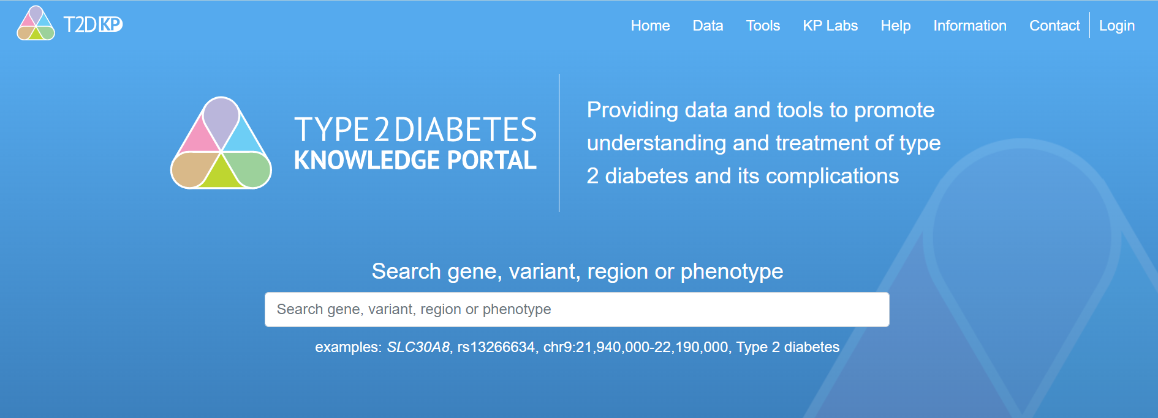
Type 2 Diabetes Knowledge Portal
Summary Statistics
Scientific Questions
Results & Knowledge
Make genetic association data available to the wider research community
Notes:
Simple mission: make genetics data accessible for non-experts
Oriented by scientific questions;
Federation with ah sister analysis pipeline which served results to the US node for the portal display – 12 datasets

Slide 3
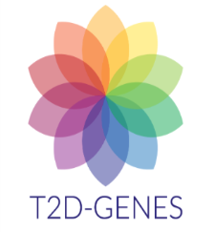
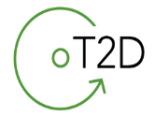
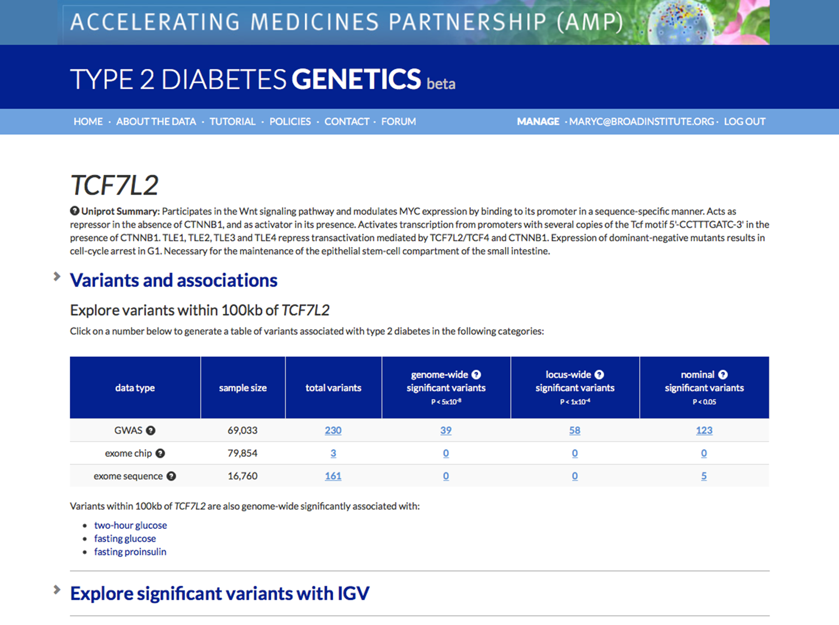
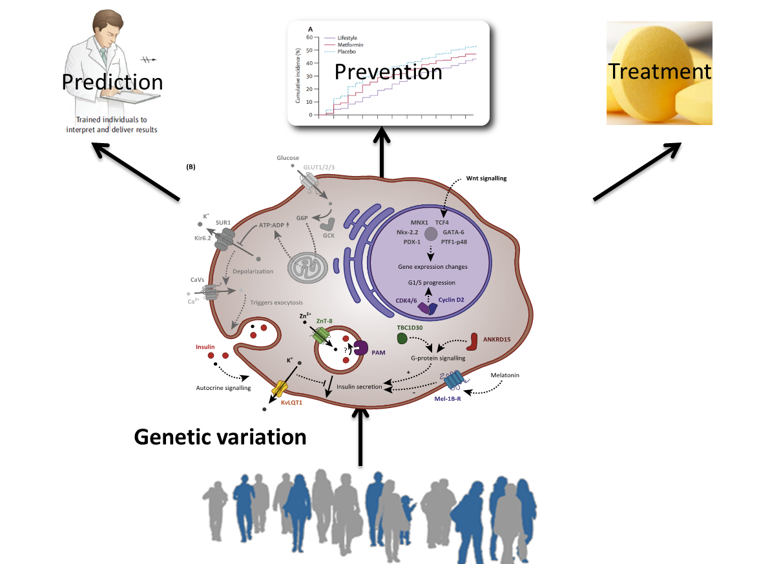
Data Coordinating Center for T2D Genetics
2015
2010
9 Datasets, 25 traits
Notes:
Al from an email outlining our proposal and our promise
Willingness was gravifying and empowering

Slide 4
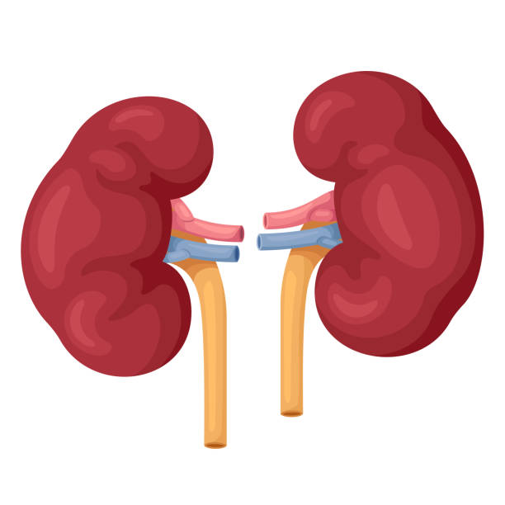
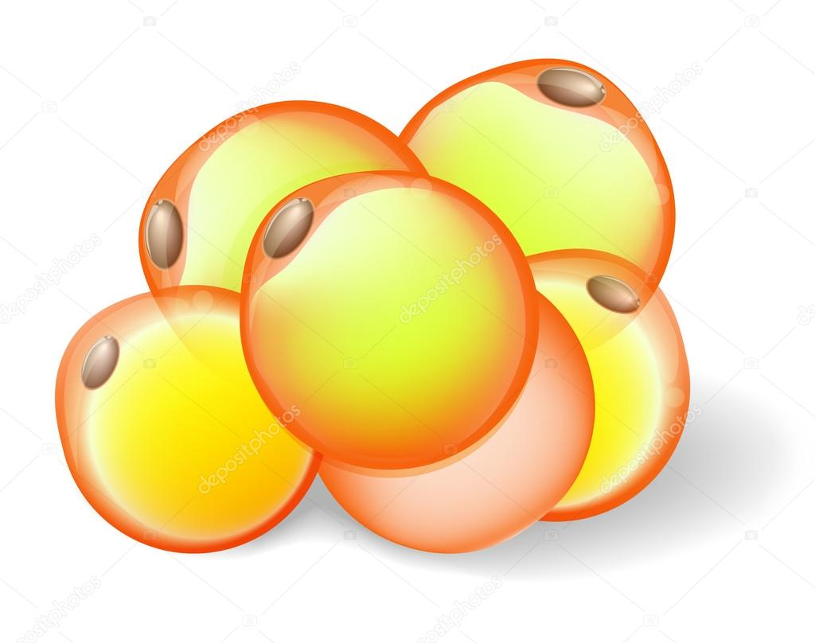
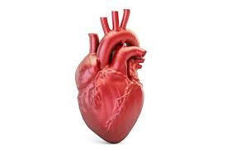
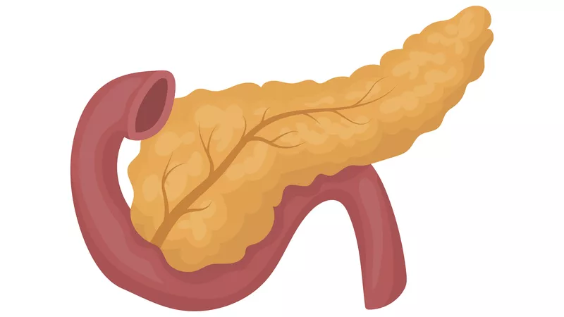
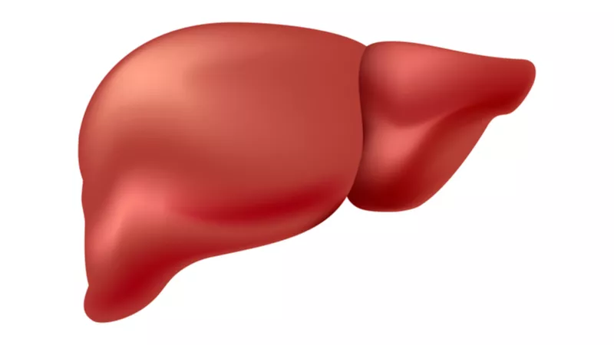
Common Metabolic Diseases Knowledge Portal
Inflammatory Drivers
Kidney
Disease
Type 1 & 2 Diabetes/
Prediabetes
Obesity
Liver
Disease
Heart
Disease

Slide 5
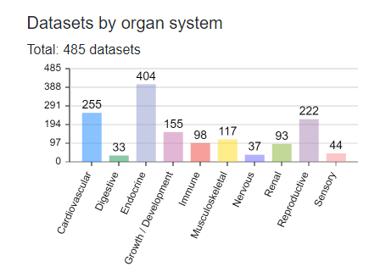
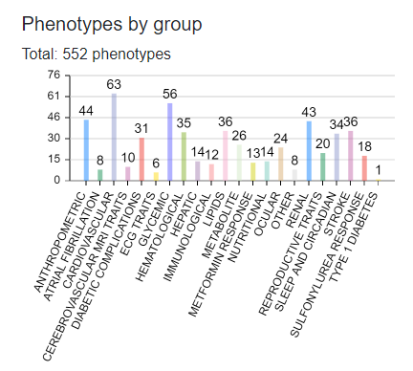
Genetic Associations
Over 50 countries represented
Notes:
Full sum stats and supported detailed phenotype information
WEX and WGS
Curated credible sets

Slide 6
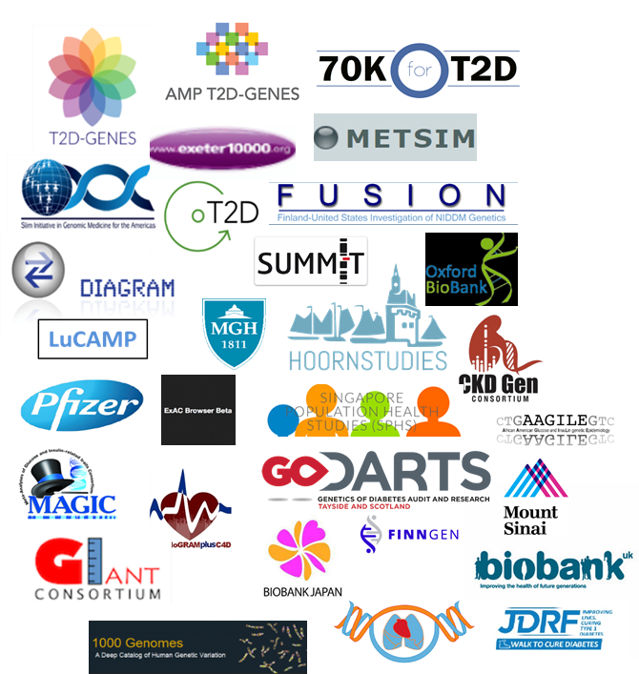
Sources
Investigator/Consortium Partnerships
Curation & Research
Resources

Slide 7
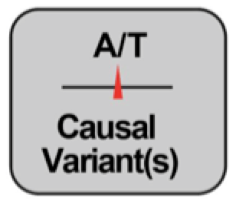
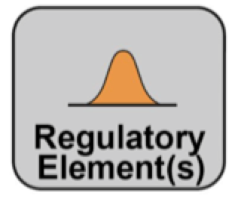
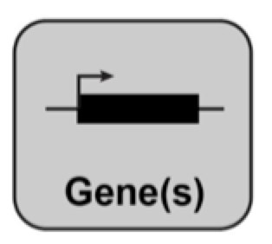
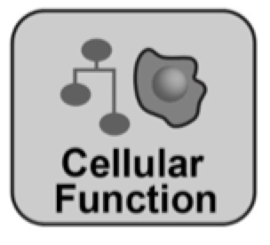
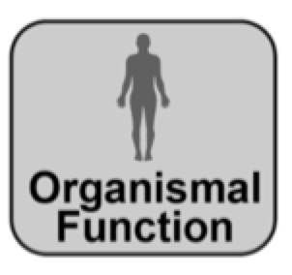
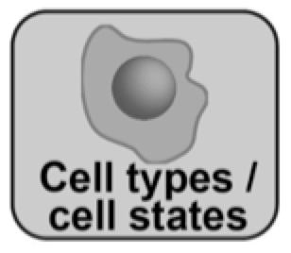
Pivoting research focus
Trait #Loci
T2D 403+
T1D 90
eGFRcrea 424
Obesity 941
CAD 279
Increased complexity
GWAS catalog October 2022
Notes:
What is the variant?
What is the regulatory effect & in what tissue?
What is the gene?
What is the pathway?
What is the mechanism?

Slide 8
Integrate data & present the knowledge
Summary Statistics
Scientific Questions
Results & Knowledge

Slide 9
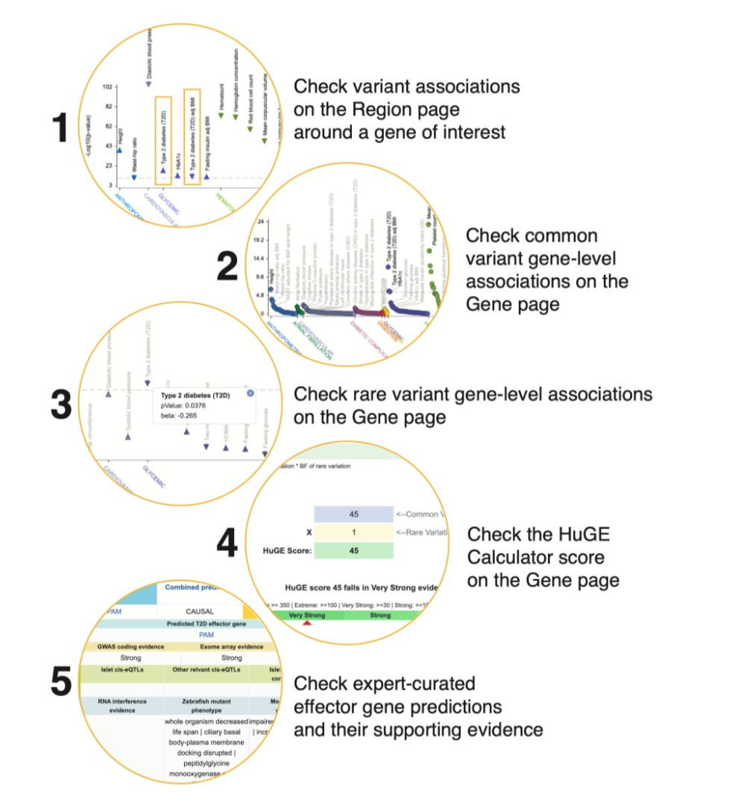
Our philosophy & approach
Collaborate directly with disease research communities to understand data, analytical results required to represent knowledge
Onboard precomputed results & generating summary representations from contributors
Encode analytical methods
Incorporate external resources
Integrated results accessible in an intuitive, browsable, open-access, web portal
Notes:
Present integrated results based on scientific questions

Slide 10
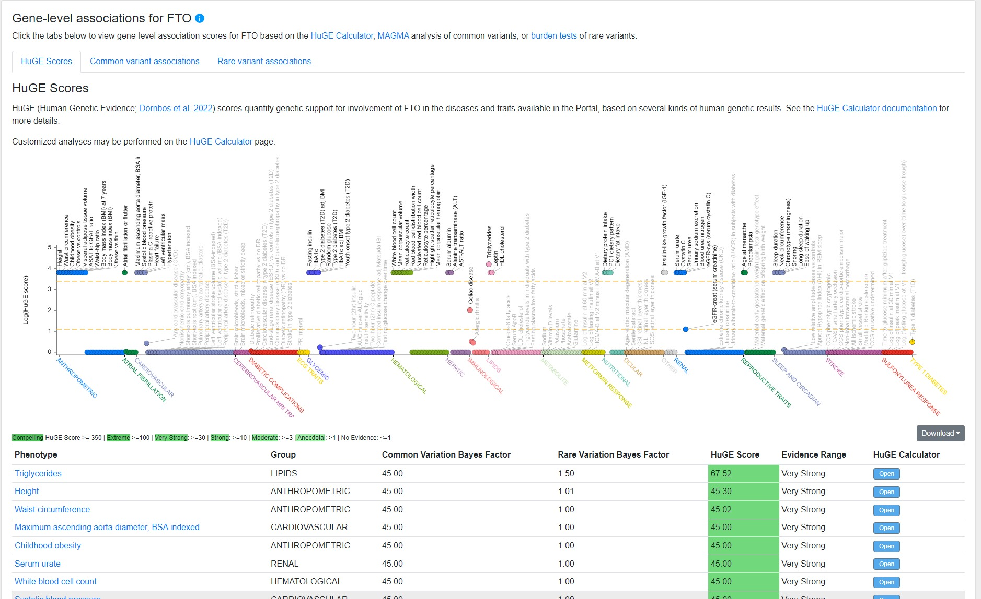

Slide 11
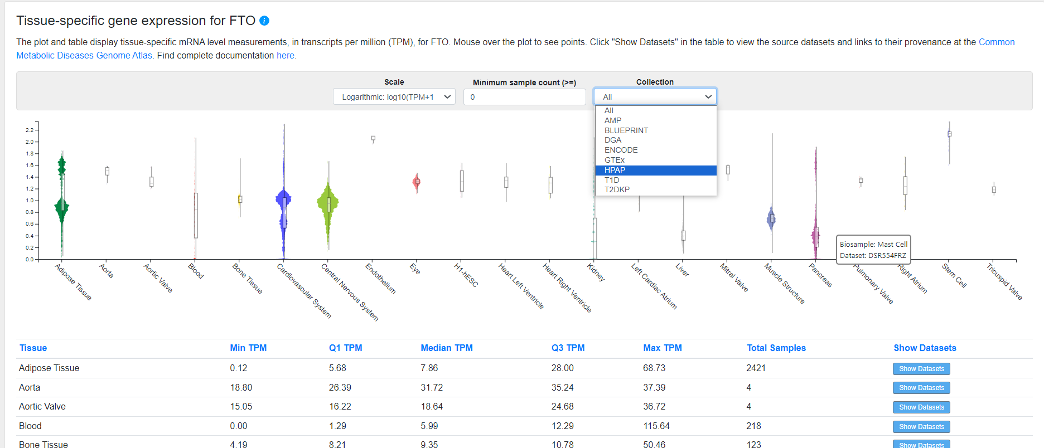

Slide 12
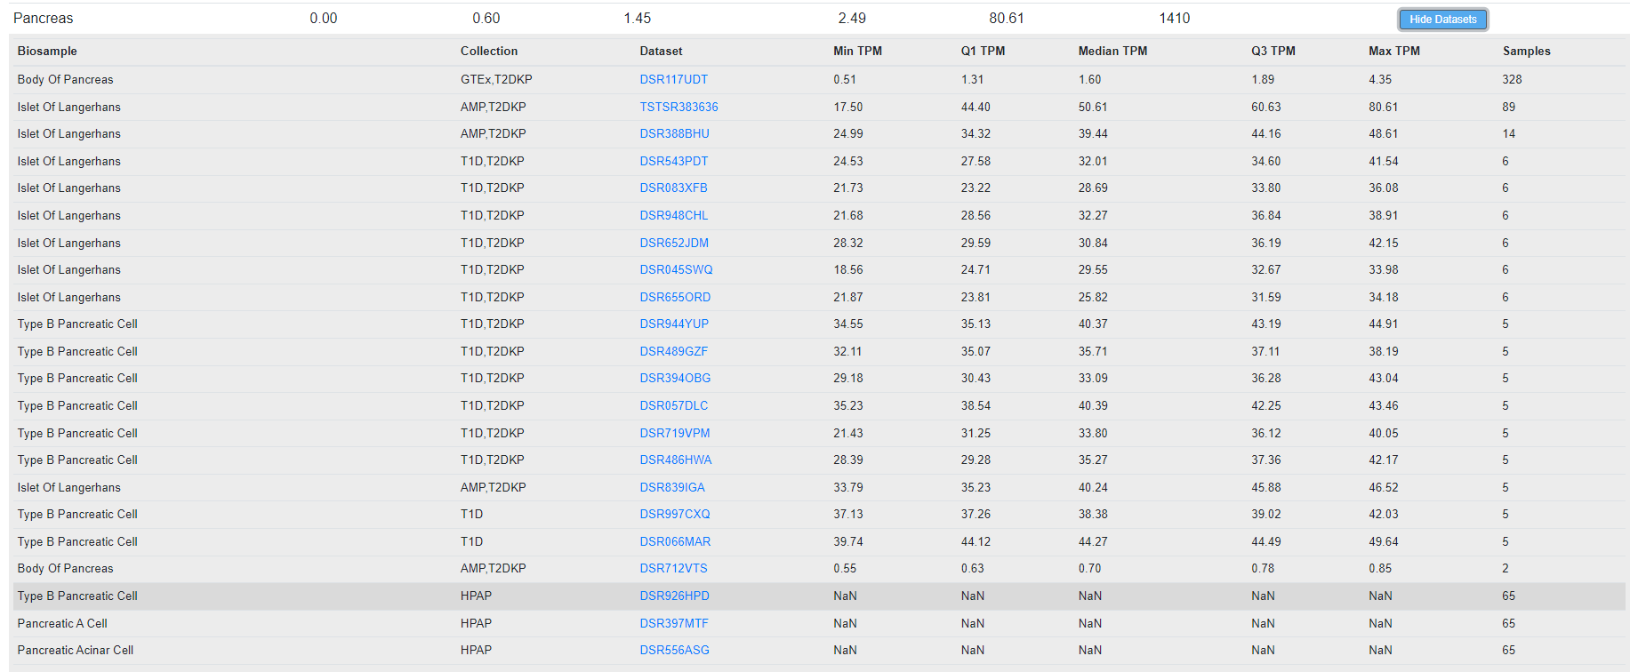
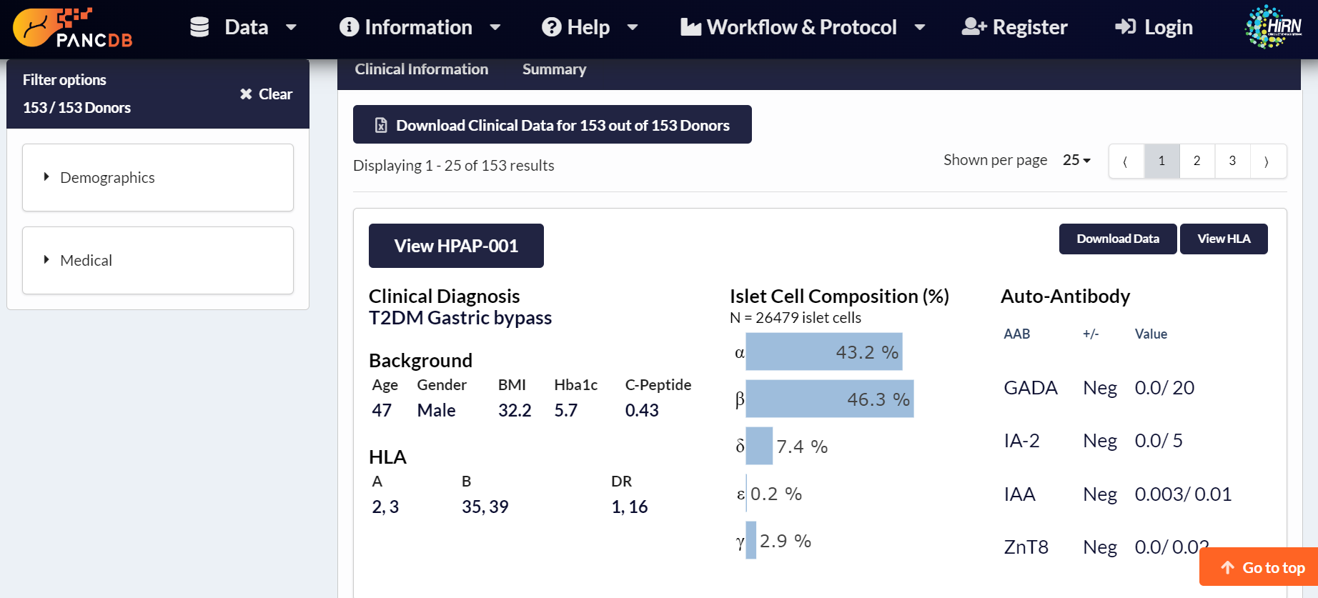
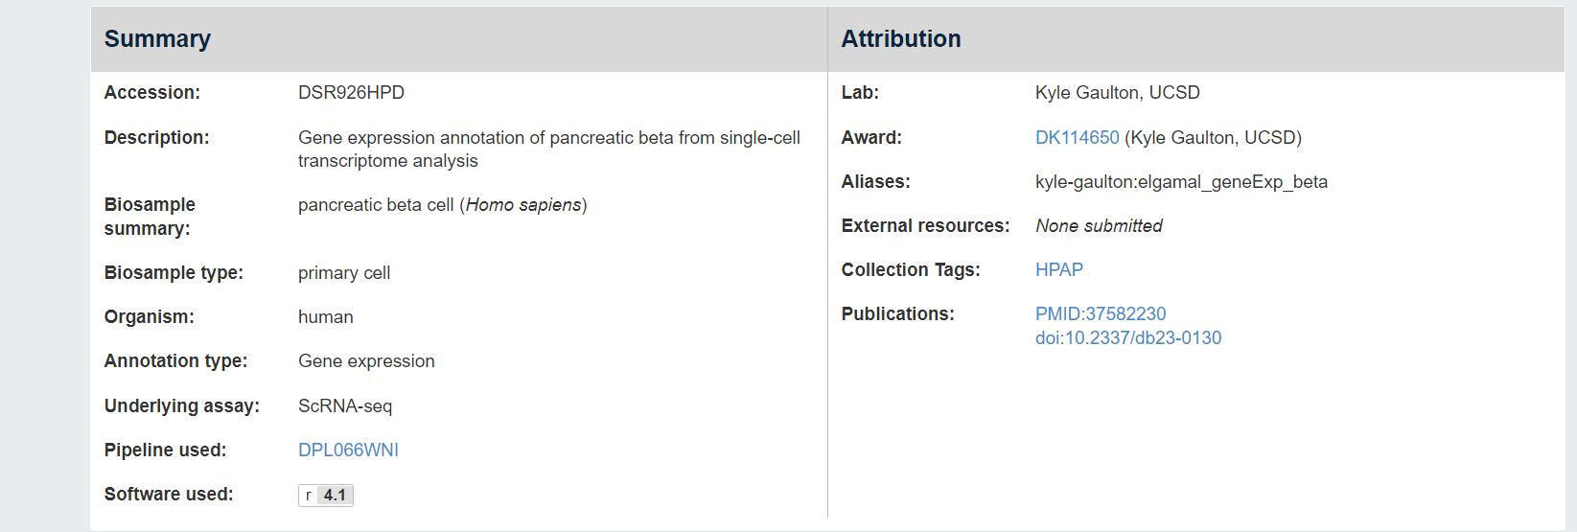

Slide 13
Way forward
Maintenance equals Sustainability- keep it relevant
Capitalize on the efforts of data repositories & disease/domain specific resource- connect to create summary representations
Create cross- talk with other resources- human & machine!
Create structure for sharing (2-way) - push-base rather than pull based
Allow resources to be computationally accessible – encourage user-define analyses
New models for contribution & incentives- build ambassadors
Orchestrate the community to develop scientific questions warranting data integration- amplifies every resource
Embrace generative AI tools - insist on human expert curation for presentation knowledge
Share & educate- engage & listen to your users

