Slide 1
Workshop II: NIDDK-CR Analytics Workspace and Challenge Preview
Anya Dabic, Booz Allen Hamilton
Courtney Shelley, Booz Allen Hamilton

Slide 2
Data Centric Challenge – Overview
Background
The NIDDK Central Repository is conducting a Data Centric Challenge aimed at augmenting and enhancing existing Repository data for future secondary research, including data-driven discovery by artificial intelligence (AI) researchers
The NIDDK-CR Data Centric Challenge will build upon future challenges to develop tools, approaches, models and/or methods to increase data interoperability and usability for artificial intelligence and machine learning applications
Towards this, NIDDK is seeking innovative approaches to enhance the utility of select NIDDK datasets focused on Type 1 Diabetes (T1D) for AI applications – next slide
Goals of the Data Centric Challenge
Generate an “AI-ready” dataset that can be used for future data challenges
Produce methods that can be used to enhance the AI-readiness of NIDDK data
Key Dates
Challenge Launch / Registration Start: 9:00AM September 20, 2023
Challenge Registration End: 5:00PM October 20, 2023
Submission Start: 9:00AM October 30, 2023
Submission End: 5:00PM January 5, 2024
To learn more and register for the Data Centric Challenge, visit the official Challenge.gov page: https://www.challenge.gov/?challenge=niddk-central-repository-data-centric-challenge

Slide 3
Data Centric Challenge – Datasets
Data will be accessible from the NIDDK-provided workbench environment (AWS Service Workbench) to approved Challenge participants – download not permitted
The Environmental Determinants of Diabetes in the Young (TEDDY) is a prospective cohort study that follows children with and without a family history of T1D
Four studies from the Type 1 Diabetes TrialNet network:
TN01 (Pathway to Prevention) is a screening and monitoring prospective cohort study established to provide a source of participants for enrollment into TrialNet prevention trials, including children and adults
TN16 (Long-Term Investigative Follow-Up) is a prospective observational study that aims to observe the long-term effects of treatments used in other TrialNet studies
TN19 (ATG-GSCF in New Onset T1D) is a clinical trial following two potential prophylaxes
TN20 (Immune Effects of Oral Insulin in Relatives at Risk for Type 1 Diabetes Mellitus) is a clinical trial to learn more about the immune effects of oral insulin
Please visit the links provided to learn more about the studies that will be offered for this Challenge.
Note: Certain variables have been redacted from the original data files available in the NIDDK-CR. The codebook/data dictionary for the Challenge-specific TEDDY and TrialNet data are available under the Resources tab on the official Challenge.gov page.

Slide 4
Data Centric Challenge – Prompt
Participation in this challenge will be tiered based on the challenge applicants’ self-described experience with data science and analytics (i.e., beginner, intermediate, or advanced)
All participants will be instructed to 1) prepare a single merged dataset by aggregating all data files associated with TEDDY, TrialNet, or both, and 2) augment and enhance the single merged dataset to prepare a single AI-ready dataset.
Beginner (TEDDY) – For the beginner-level challenge, the goal for challenge participants will be to aggregate datasets from the TEDDY study into a single unified and machine-readable dataset, then enhance the aggregated dataset for AI-readiness.
Intermediate (TrialNet) – For the intermediate-level challenge, the goal for challenge participants will be to aggregate and harmonize four studies within the TrialNet set of studies (TN01, TN16, TN19, and TN20) into a single unified and machine-readable dataset, then enhance the harmonized dataset for AI-readiness.
Advanced (TEDDY and TrialNet) – For the advanced level challenge, the goal for challenge participants will be to 1) aggregate all files in TEDDY, 2) harmonize the four studies in TrialNet, and 3) fuse the aggregated TEDDY dataset with the harmonized TrialNet dataset, then enhance the fused dataset for AI-readiness.
More information about the Data Centric Challenge prompt, submission requirements, and guidance on AI-readiness and documentation preparation can be found on the Overview tab on the official Challenge.gov page

Slide 5
Data Centric Challenge – Submission Requirements
A single “raw” dataset resulting from data aggregation, harmonization, and/or fusion of all study data files (from TEDDY, TrialNet, or both – as per level of participation) that has not otherwise been altered. This dataset must be represented as a single rectangular file (i.e., tabular, spreadsheet, or matrix) in .csv file format
An “AI-ready” version of the aggregated, harmonized, and/or fused dataset that has been enhanced for AI-readiness. This dataset must be represented as a single rectangular file (i.e., tabular, spreadsheet, or matrix) in .csv file format
The code script, in Python or R, used to generate the raw and AI-ready files submitted to your private GitHub repository
A human-readable data dictionary/codebook documenting the AI-ready dataset (Excel format preferred, with the following information included at a minimum: variable name, variable label/description, variable type, measurement unit as applicable (e.g., pounds, kilograms), and corresponding code lists as needed (e.g., 0 = No, 1 = Yes).
Challenge Solution Submission Form, describing the 1) AI-ready dataset, 2) methods for preparing the AI-ready dataset, and 3) potential use cases for the prepared dataset as it relates to T1D, or other disease areas of interest to NIDDK.

Slide 6
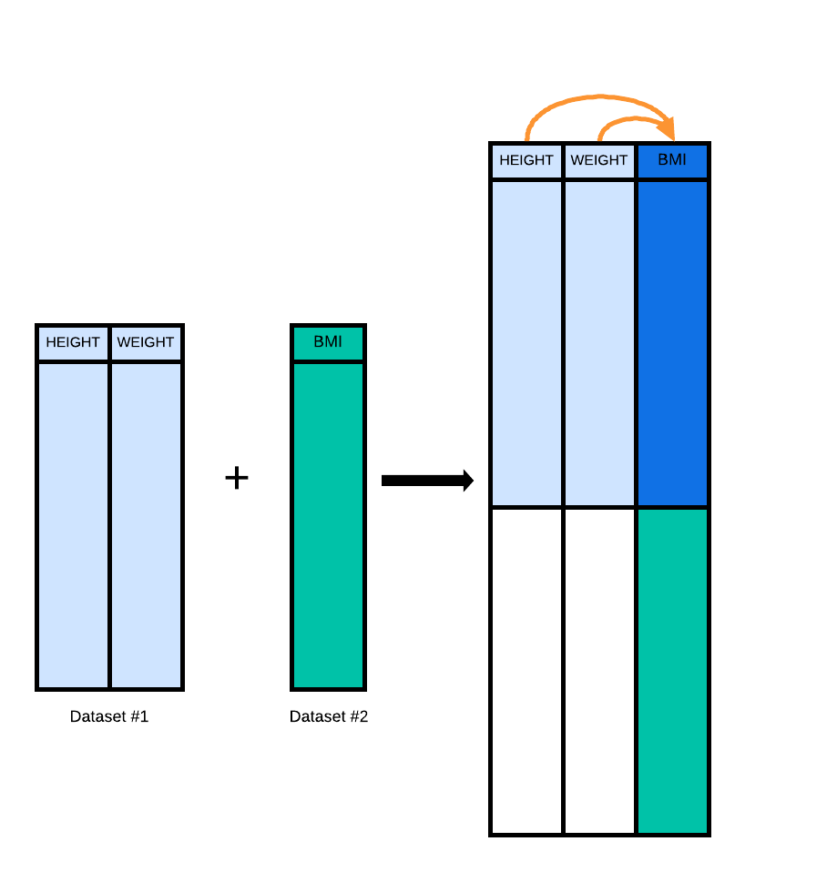
Data Centric Challenge – Guidance on AI-Readiness
AI-readiness refers to data that are machine-readable, reliable, accurate,
explainable, predictive, and accessible for future AI applications
AI-readiness will include:
pre-processing steps such as addressing errant values,
handling of missing values,
relabeling and recoding of data elements (aka columns, variables, features, or attributes) and values during harmonization to ensure consistency and standardized formatting
documentation of all data handling steps, all variables, and the dataset itself
When possible,
attempt to retain as much information as possible by creating new data elements that are transforms of existing elements without deleting or overwriting existing elements.

Slide 7
Data-Centric Challenge – Guidance on Data Dictionary and Solution Submission Form
Reviewers will assess descriptiveness and informativeness of:
Challenge Solution Submission Form, which should include:
the study from which the data was generated so that secondary researchers can understand the study population, sampling schema, location, and type of study (longitudinal, retrospective, case-control, etc.)
data enhancements and methods for preparing the AI-ready dataset
potential use cases for the prepared data, and any other important information to convey about the methods or procedures used
Code Script, and
Data Dictionary/Codebook, which should include documentation of:
all data elements, including name, description, data type such as numeric or free text, and expected values
handling of missingness
Special attention should be given to created/derived variables so future users can understand
the original data from which the new element(s) were generated and methodology used to create, and
the intended purpose of newly generated elements (e.g., right-censor indicator useful for time-to-event analysis derived from missing values in T1D diagnosis, which indicate that a participant was not diagnosed with T1D during the study period.

Slide 8
Data Centric Challenge Overview – Judging Criteria
Judging Criteria | How to Measure
Proposal Quality (20 points) | Is the Challenge submission complete (i.e., have the "raw" and "AI-ready" datasets been generated in the AWS Service Workbench, code submitted to the challenge participant’s private GitHub repository, Challenge Solution Submission Form submitted to Challenge.gov)? Are the methods for preparing the AI-ready dataset and its applications clearly described?
Data Enhancement* (40 points) | Have the participants generated 1) a single rectangular file (i.e., tabular, spreadsheet, or matrix) in .csv format that has been aggregated, harmonized, or fused, as per level of participation, and 2) an AI-ready version of the aggregated, harmonized, and/or fused file. Algorithmically-Reviewed Evaluation (25 points): Data quality will be measured across each data element by applying numeric metrics across each of four dimensions of accuracy, completeness, consistency, and validity. Human-Reviewed Evaluation (15 points): Reviewers will assess descriptiveness and informativeness of the Challenge Solution Submission Form, code script, and data dictionary/codebook.
Utility & AI Readiness* (40 points) TOTAL POINTS: 100 | Can the data be applied to multiple ML models? Can the AI-ready dataset be applied to a wide range of use cases (both within and beyond T1D)? Algorithmically-Reviewed Evaluation (25 points): Participants’ unenhanced data file will be split into training and testing data subsets. The provided code script used to generate the submitted AI-ready file will then be applied separately to each subset. A prepared supervised machine learning model will be fitted using the training data subset and then tested using the testing data subset. Evaluation in this section will be based on ability to run all scripts to reproduce the AI-ready dataset without errors, the ability to train a machine learning model with minimal additional pre-processing, and model performance within acceptable levels of accuracy, precision, and recall. Human-Reviewed Evaluation (15 points): Potential use cases for the AI-ready dataset as described in the Challenge Solution Submission form.
*NOTE: A minimum score of 10 points in each of the Data Enhancement and Utility and AI Readiness sections must be obtained on the algorithmic evaluation criteria to move forward with the manual criteria.
More information about the judging criteria can be found under the Judging tab for Phase 2 on the official Challenge.gov page

Slide 9
Data Centric Challenge – Prizes
One winner will be selected from each experience level (Beginner, Intermediate, and Advanced)
Winners will select from one of the three prize options:
Co-author a challenge results article with NIDDK Repository and NIDDK Data Science staff to be submitted to a journal or professional meeting;
Present challenge results at an appropriate NIH-level meeting, such as the Office of Data Science Strategy (ODSS) Data Sharing and Reuse Seminar Series;
Virtual meeting with NIDDK leadership to present participant’s challenge results
All winners may be recognized as a “challenge champion” for subsequent data challenges

Slide 10
Data Centric Challenge – Rules
By participating, each Participant certifies that they have read, understand, and will comply with the complete set of rules promulgated by the NIH/NIDDK and published in the official challenge announcement on Challenge.gov
Each Participant must agree to and abide by the NIDDK-CR Data and Resources Use Agreement (DUA) and the NIDDK-CR Data Challenge Addendum when registering to participate in this Challenge, and to access the NIDDK-CR datasets within the AWS Service Workbench.
Each Participant shall have a legal signatory authority to enter into valid binding agreements to legally bind themselves, or if employed by an institution, have an institution-authorized signatory representative (AOR) to execute the agreement.
If an applicant is not affiliated with an institution, but wishes to participate in this Challenge, they should contact NIDDK-CRsupport@niddk.nih.gov for further guidance.
All analyses need to be conducted within the NIDDK-provided workbench environment. Data Challenge Participants are not permitted to download, copy, or extract data from the NIDDK-provided workbench environment. Data must remain in the NIDDK-provided workbench environment, and any review, analysis, manipulation, or modification of the data will occur within this environment.
More information about the Challenge rules and eligibility requirements can be found under the Rules tab on the official Challenge.gov page

Slide 11
Data Centric Challenge – How to Enter
Phase 1: Registration – Open until 5:00PM EDT October 20, 2023
Interested applicants will register to participate via Challenge.gov
The following documents must be completed and submitted to Challenge.gov to register:
Data Challenge Registration Form
NIDDK-CR Data and Resources Use Agreement (DUA)
NIDDK-CR Data Challenge Addendum
Required documents and detailed instructions can be found under the How to Enter tab for Phase 1 on Challenge.gov
Applicants will have until 5:00 PM EDT on October 20, 2023, to submit their applications to Challenge.gov. Applications submitted after this date and time will not be accepted.
Challenge participants approved to proceed to Phase 2 will be notified via the NIDDK-CR Support email (niddk-crsupport@niddk.nih.gov) with their AWS Service Workbench login credentials and detailed instructions on using the AWS Service Workbench.
Data Challenge Participants will perform data aggregation, augmentation, and enhancement tasks using Python or R programming language in SageMaker Jupyter Notebook to generate their code for making the data AI-ready – next slide
Phase 2: Data Enhancement – Opens on October 30, 2023 and closes on January 5, 2024
Detailed instructions on how to register for the Data Centric Challenge can be found under the How to Enter tab for Phase 1 on the official Challenge.gov page

Slide 12
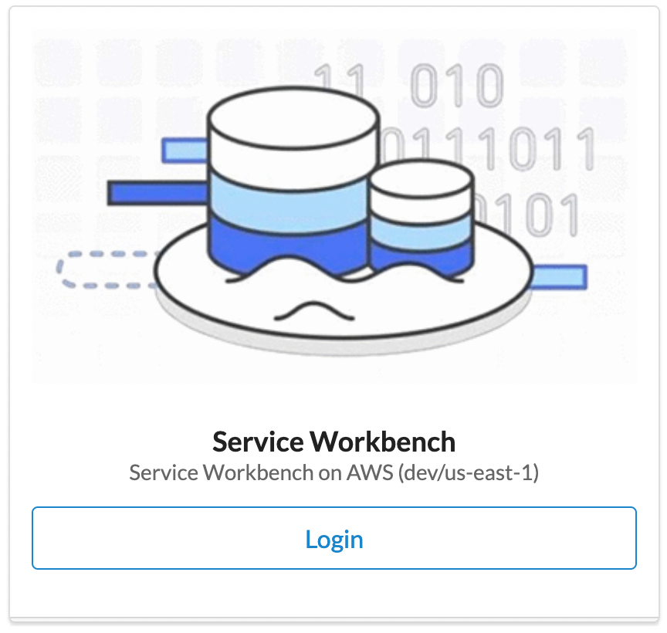
AWS Service Workbench (SWB) Demonstration
AWS Service Workbench – Learning Objectives:
Accessing SWB
Creating a Workspace in SWB
Launching Jupyter Notebook instance in SWB
Note: A detailed Tutorial on using AWS Service Workbench will be provided to participants approved to move forward to Phase 2 of the Data Centric Challenge

Slide 13
Questions and Answers

