Slide 1
Welcome & Opening Remarks
Gregory Germino
Deputy Director, NIDDK

Slide 2
Aligning Strategic Plan Objectives

Slide 3
NIH Strategic Plan for Data Science Goals and Objectives
Data Infrastructure
Optimize data storage and security
Connect NIH data systems
Modernized Data Ecosystem
Modernize data repository ecosystem
Support storage and sharing of individual datasets
Data Management, Analytics, and Tools
Support useful, generalizable, and accessible tools and workflows
Broaden utility of and access to specialized tools
Better integrate clinical and observational data into biomedical data science
Workforce development
Improve discovery and cataloging resources
Stewardship and Sustainability
Develop policies for FAIR data ecosystem
Enhance the NIH data-science workforce
Expand the national research
Engage a broader community
Enhance stewardship

Slide 4
NLM Strategic Plan Goals
Accelerate discovery and advance health through data-driven research
Connect the resources of a digital research enterprise
Advance research and development in biomedical informatics and data science
Reach more people in more ways through enhanced dissemination and engagement
Know NLM users and engage with persistence
Foster distinctiveness of NLM as a reliable, trustable source of health information and biomedical data
Build a workforce for data-driven research and health
Expand and enhance research training for biomedical informatics and data science
Assure data science and open science proficiency
Foster open science policies and practices
Create a sustainable institutional, physical, and computational infrastructure
Support research in biomedical and health information access methods and information dissemination strategies
Enhance information delivery
Increase workforce diversity
Engage the next generation and promote data literacy

Slide 5
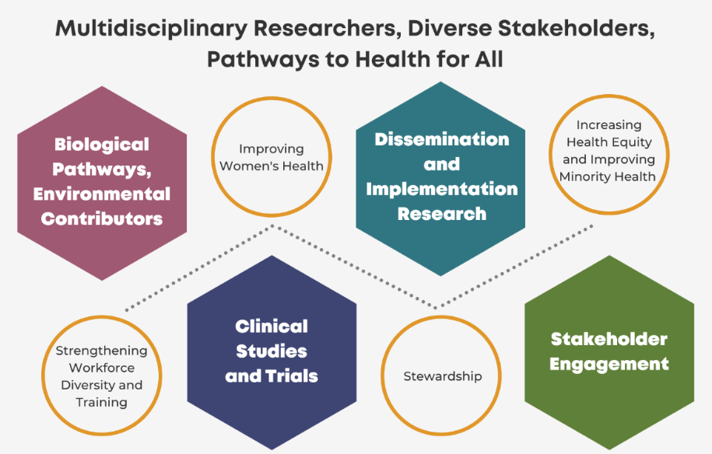
NIDDK Strategic Plan for Research
https://www.niddk.nih.gov/about-niddk/strategic-plans-reports/niddk-strategic-plan-for-research

Slide 6
Research Opportunities
Goal 2: Advance pivotal clinical studies and trials for prevention, treatment, and cures in diverse populations
2.4 - Advance pivotal clinical studies and trials for prevention, treatment, and cures in diverse populations
Developing and incorporating common data elements into clinical studies
2.5 - Optimize clinical infrastructure and resources for clinical studies
Leveraging the research value of repositories
1.3 - Develop innovative technologies and resources and expand data science to advance scientific progress and enhance health
Goal 1: Advance understanding of biological pathways and environmental contributors to health and disease
Advancing data repository/biorepository science and management to enhance utility and user adoption

Slide 7
Scientific Stewardship Opportunities
Strengthen Biorepositories
Promote Data Science
Enhance Partnerships
Promote Innovation

Slide 9
Thank you!

