Slide 1
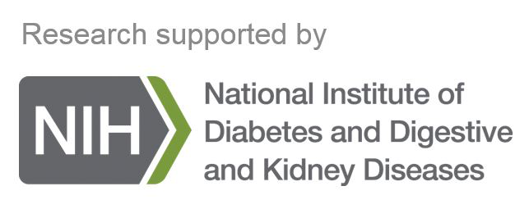
New Diagnostics for MASLD in Children
Miriam B. Vos, MD, MSPH, FAASLD
Professor of Pediatrics, GI, Hepatology and Nutrition
Director, Pediatric Program GA-CTSA
Emory University & Children’s Healthcare of Atlanta

Slide 2
Disclosures
Research Funding
  NIH – NINR, NIDDK
  Target Real World Solutions
  Quest
  Sonic Incytes
Consulting
  Boehringer Ingelheim
  Bristol Myers Squibb
  Novo Nordisk
  Prosciento
  Intercept
  Thiogenesis

Slide 3
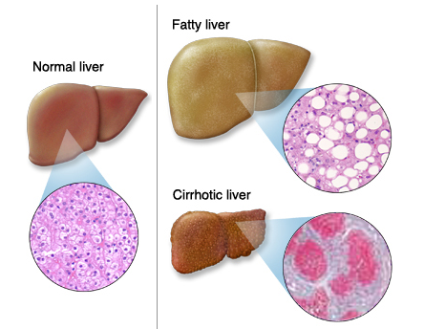
What is MASLD (Formerly Known as NAFLD)?
Metabolic Dysfunction-Associated Steatotic Liver Disease
Steatotic liver
Mayo Foundation for Education and Research
Notes:
What is Fatty Liver?

Slide 4
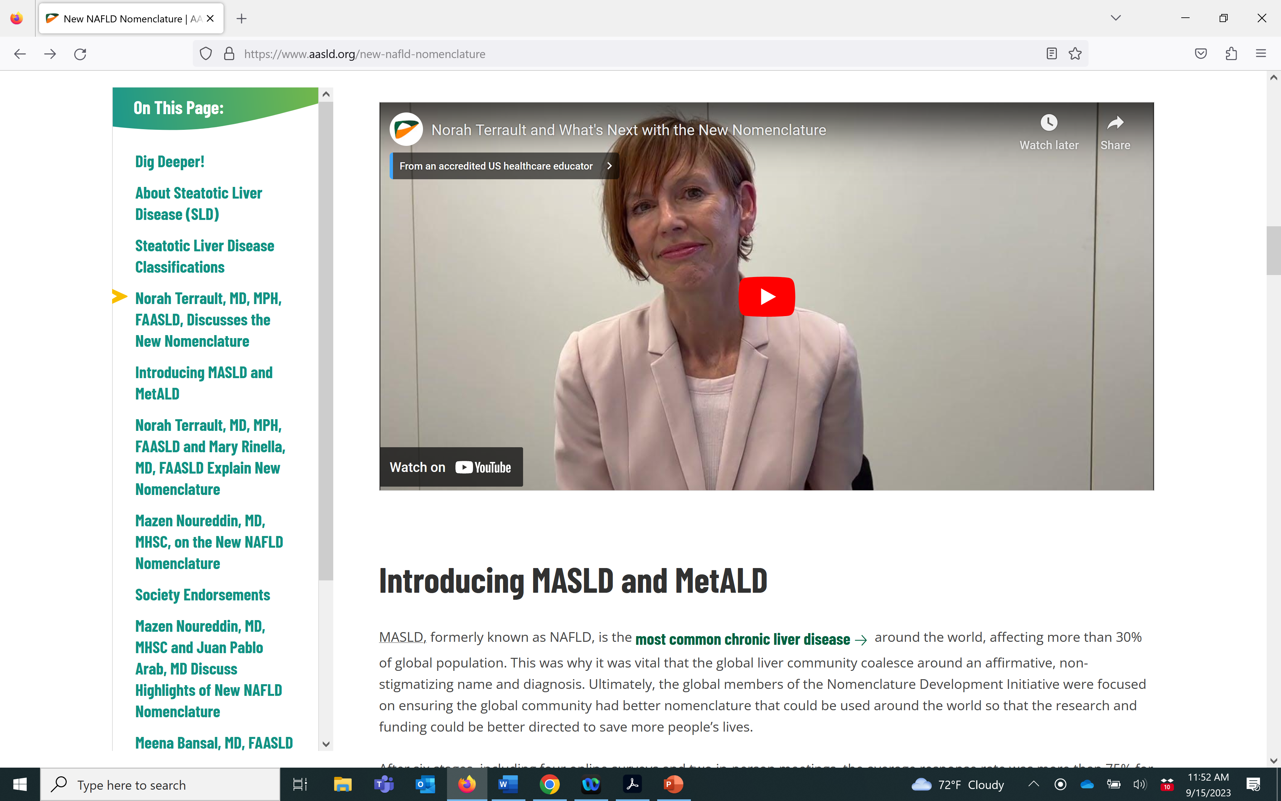
New Nomenclature = Steatotic liver disease
MASLD, formerly known as NAFLD, is the most common chronic liver disease around the world…
https://www.aasld.org/new-nafld-nomenclature

Slide 5
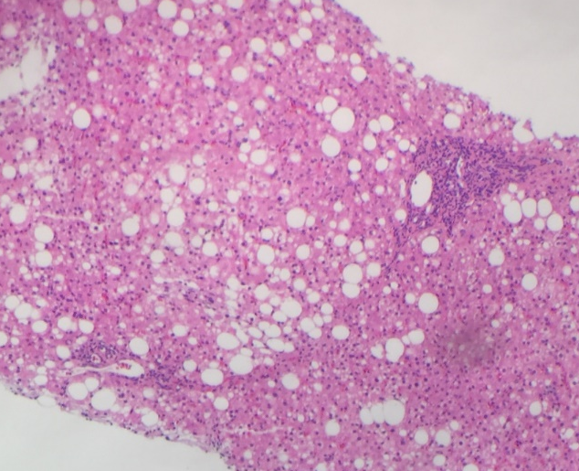
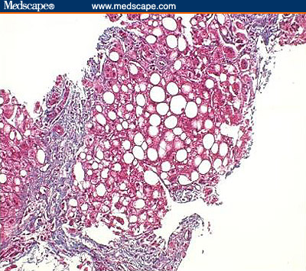
Spectrum of MASLD in Children
Metabolic Dysfunction Associated Steatohepatitis (MASH)
Steatosis
Cirrhosis
25%
1-2%
75%
Micro- and macrovesicular fat
Inflammation, hepatocyte ballooning, steatosis
Bridging fibrosis and MASH
Prevalence data from NASH CRN and Target NASH Cohorts

Slide 6
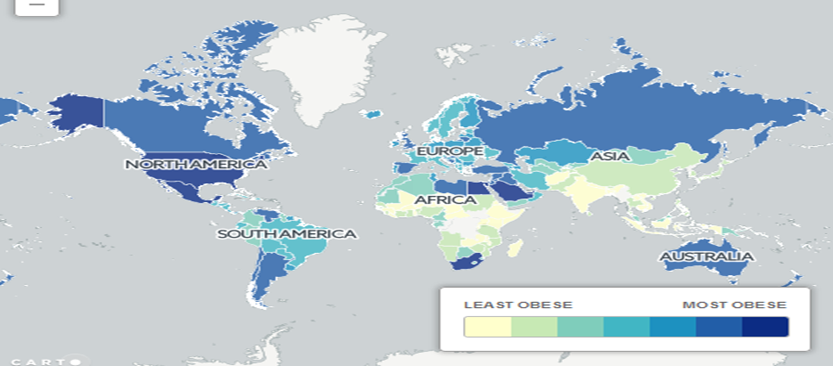
MASLD in Children Across Regions of the World
Global overall prevalence across the world is 25%.
5.7%
5.9%
6.5%
~25%
10%

Slide 7
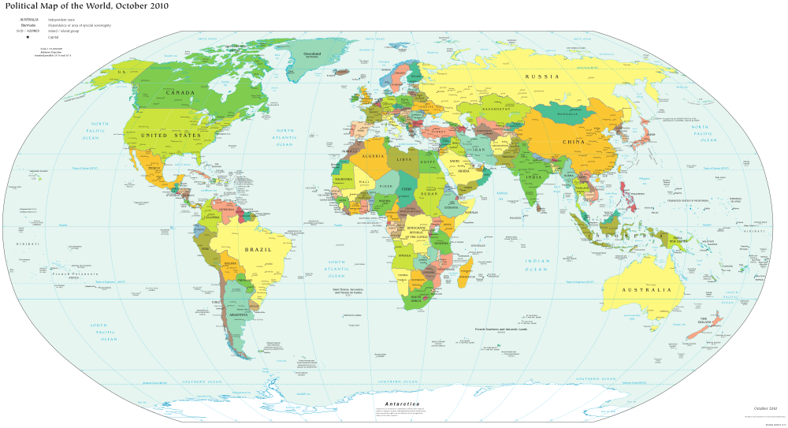
Prevalence increased in those with Obesity
25% of those with obesity have NASH/MASH
30-40% of those with diabetes have NASH/MASH
70% of T2D have NAFLD/MASLD
15% have clinically sig. liver fibrosis
28%
24%
53%
77%
24%
42%
Pacifico, World J Hep 2010
Cusi et al, Endo Practice 2022
By U/S or ALT in obese adolescents

Slide 8
Consequences of MASLD
Strongly associated with HTN, dyslipidemia, glycemia
Leads to early CVD
In obese adolescents, may be specific risk factor for early-onset type 2 diabetes….3-6% of adolescents with MASLD develop T2D annually
FEW studies track from childhood into adulthood
Rising rate of liver transplant for MASLD in young adults suggests negative outcome for some childhood onset
However, identification of NAFLD early may bring opportunities for treatment

Slide 9
The Problem
MASLD is the most common liver disease in the US & World
Having MASLD increases:
  Type II diabetes by 300%
  Heart attacks & strokes x 5
  End-stage liver disease in 10%
There is no single test for MASLD
Diagnosis: Labs for exclusion of 5 other chronic liver diseases, then imaging, then ±doing a liver biopsy = Expensive, +risk, burdensome
Labs
Hep C
Wilson’s
Alpha 1
Imaging
Ultrasound
MRI
Liver Biopsy
Risk of bleeding, pain, $$$
IGG
Notes:
Identification is expensive and inconvenient

Slide 10
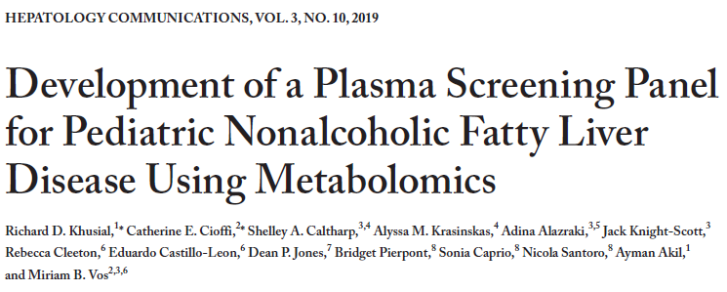
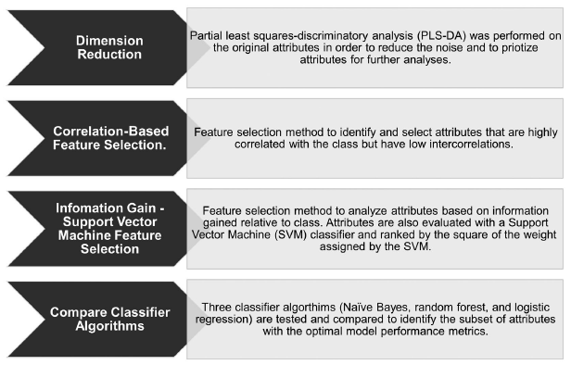
Study objective: Develop a NAFLD screening panel in youth using a machine learning approach applied to high-resolution metabolomics and clinical phenotype data
Untargeted metabolomics by LC-MS was performed on plasma samples from a combined cohort of children (NAFLD n=222 & non-NAFLD n= 337)
NAFLD was diagnosed by liver biopsy or MRI (gold standard)
Workflow of the machine learning-based approach
Khusial et al., Hep Communications, 2019
Notes:
In 2019, we began developing a novel diagnosis/screening panel. The proposed workflow consists of a dimension reduction technique, followed by a two-step machine learning approach. After a potential subset of features is obtained, algorithm mapping with three classifiers is explored to identify an optimal model.

Slide 11
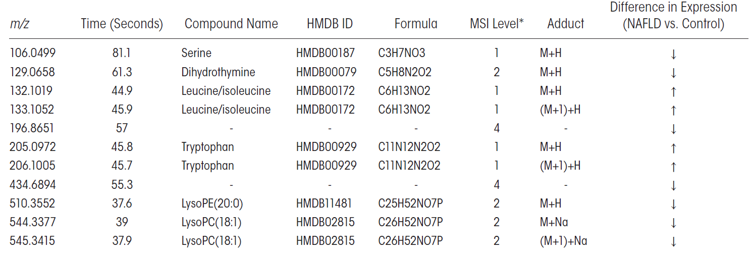
Clinical phenotype & Metabolic features retained after feature selection
Clinical phenotype variables: waist circumference, whole-body insulin sensitivity index (WBISI) & triglycerides.
Khusial et al., Hep Communications, 2019
Notes:
Table: *Confidence levels assigned according to MSI criteria, whereby level 1 is identified compounds, level 2 is putatively annotated compounds, level 3 is putatively characterized compound class, and level 4 is unknown compounds. Abbreviations: HMDB, Human Metabolome Database; MSI, Metabolomics Standard Initiative.

Slide 12
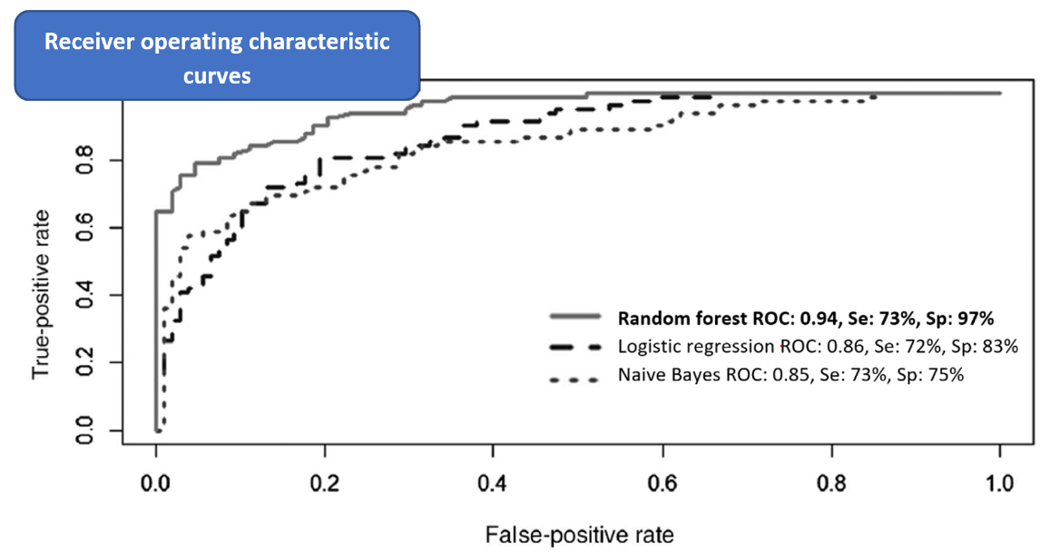
Results:
ROC curves for the classification models
Conclusion: We identified a panel of metabolites and clinical phenotype variables that offer potential as a screening tool for NAFLD by using HRM and clinical phenotype data combined with machine learning algorithms
***External validation
of the proposed panel is warranted……
Khusial et al., Hep Communications, 2019
Notes:
Our highest performing classification model was random forest, which had an area under the receiver operating characteristic curve (AUROC) of 0.94, sensitivity of 73%, and specificity of 97% for detecting NAFLD cases.

Slide 13
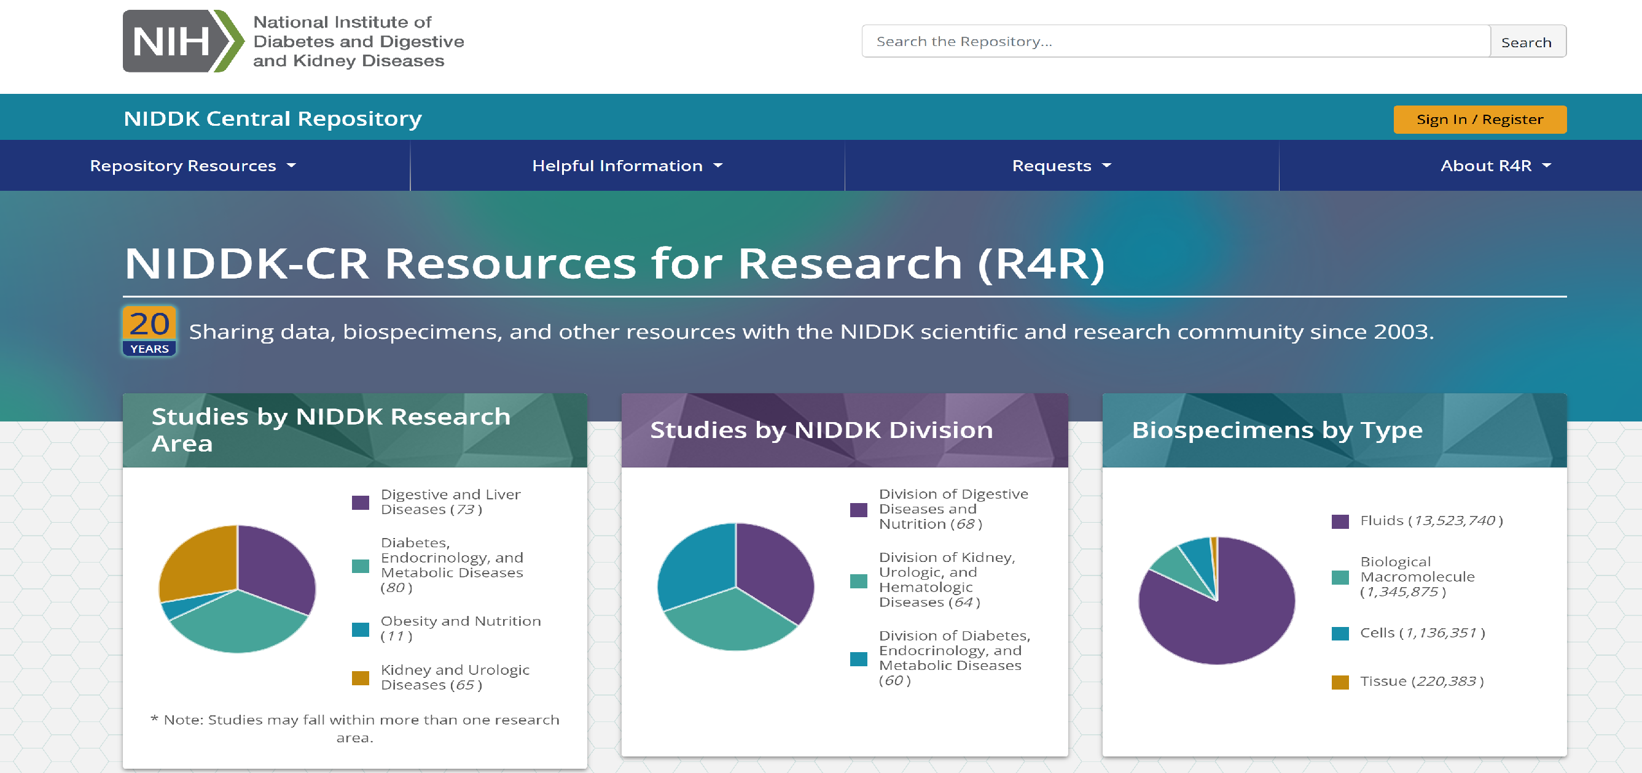
High quality data and samples

Slide 14
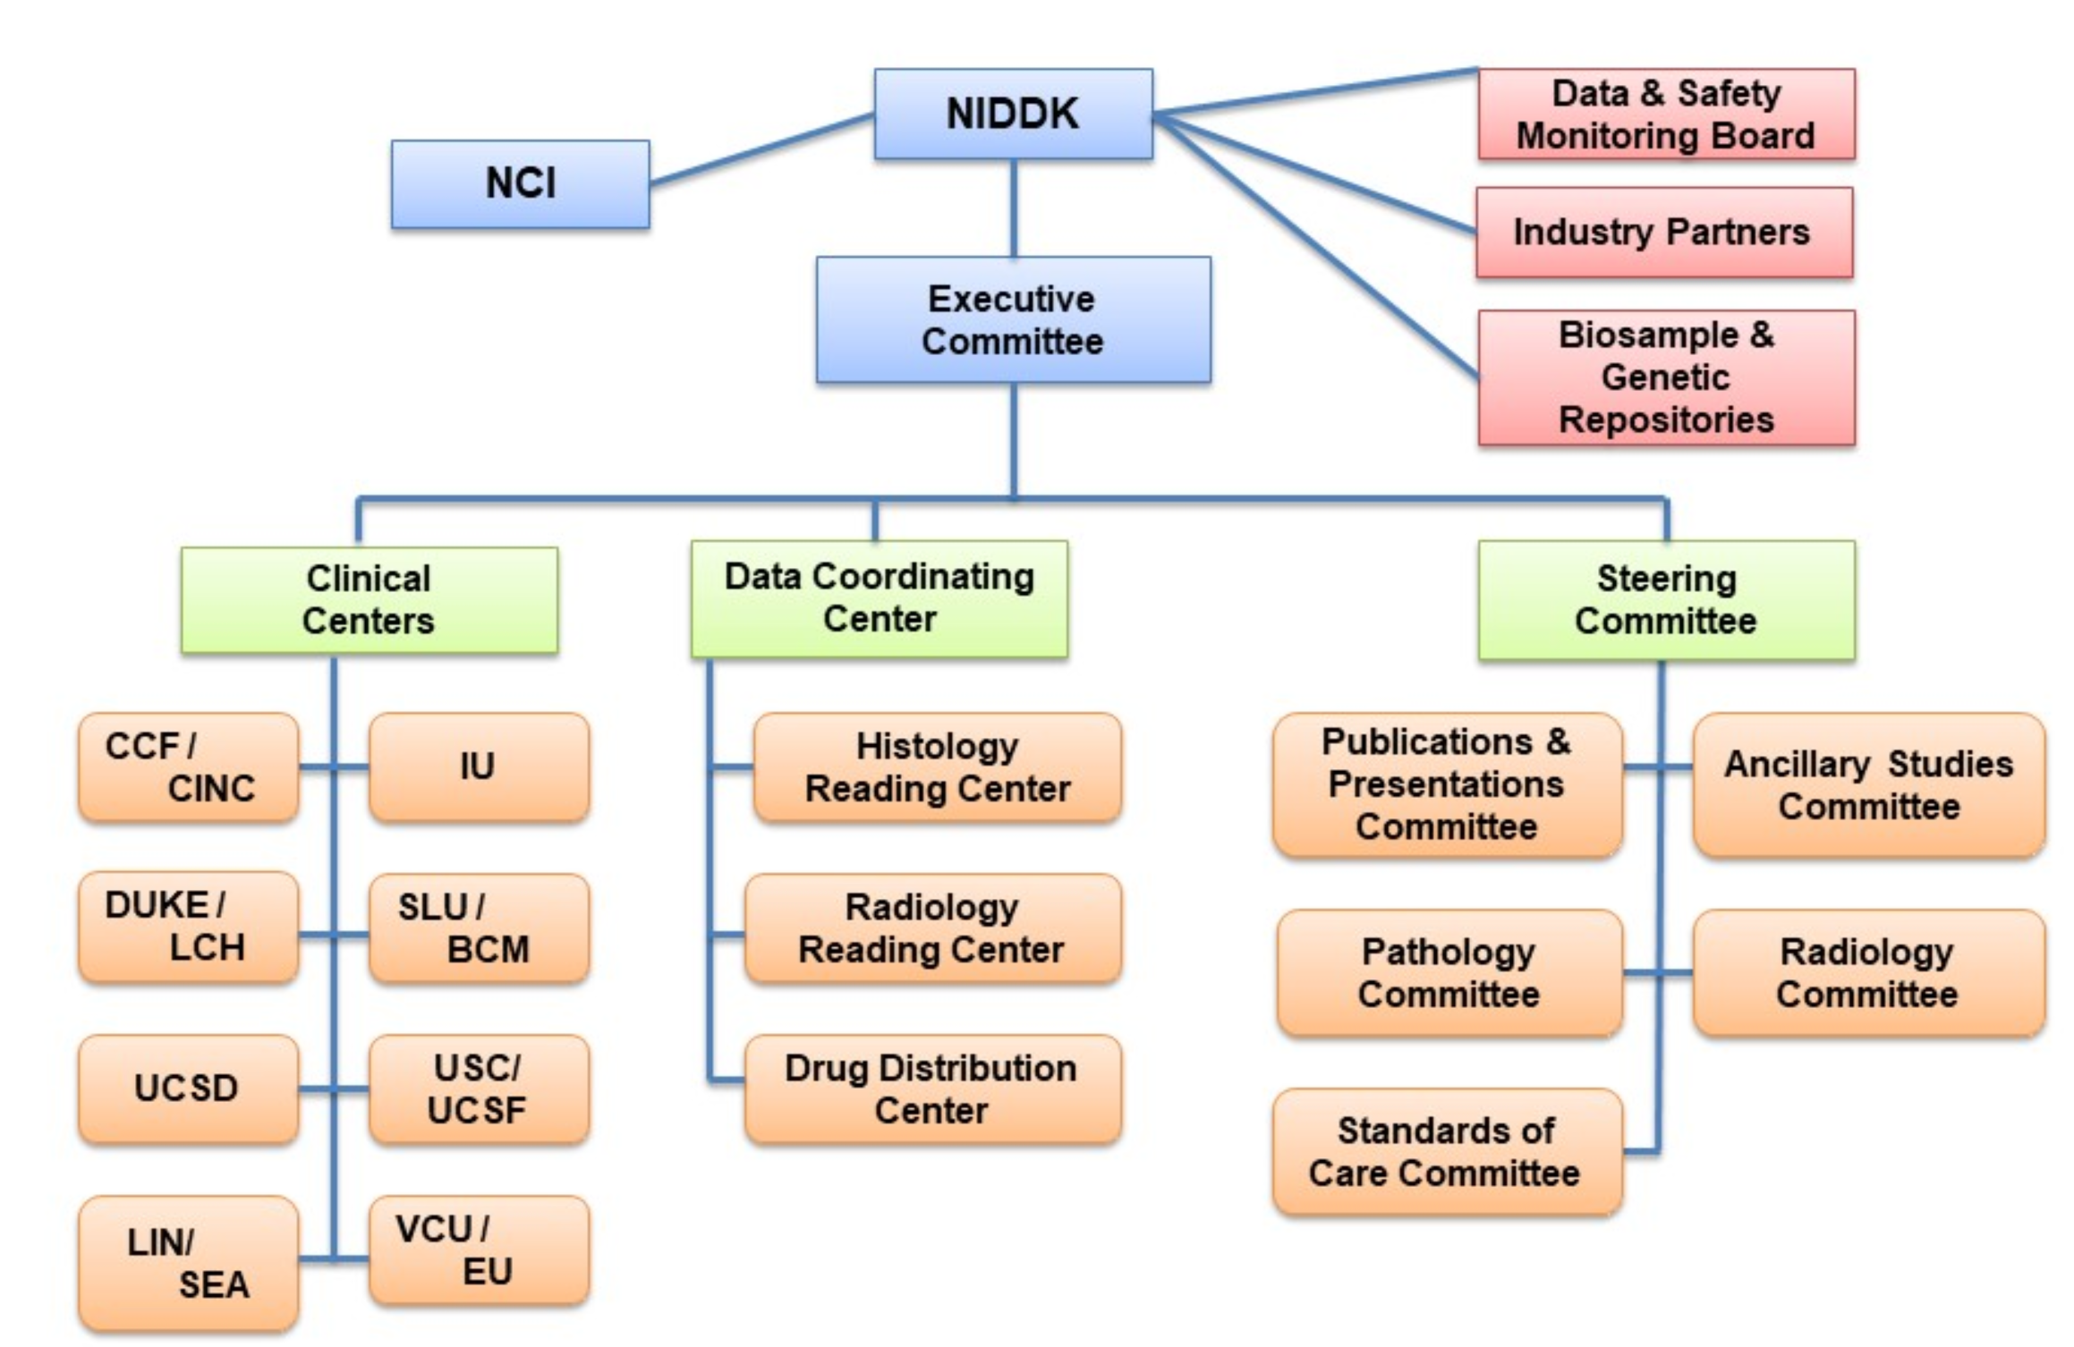

NASH Clinical Research Network –
Highly phenotyped cohorts
Consent to participate
Longitudinal data collection
Samples at baseline
After study completion, deposited into NIDDK repository.

Slide 15
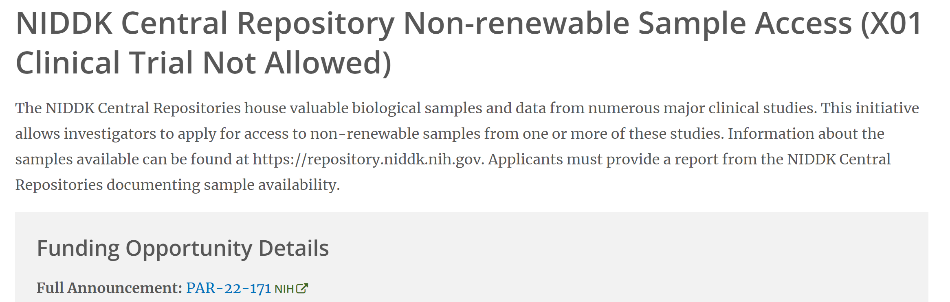
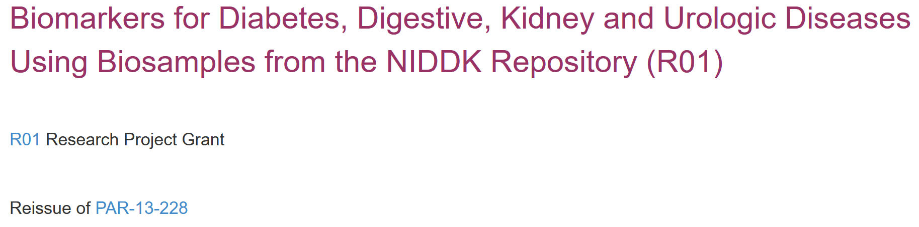
Samples?
EXPIRED
PAR-17-123

Slide 16
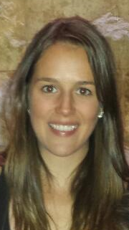
Validation of the Screening Panel
Samples from both the NASH CRN and Emory
  NASH Clinical Research Network (CRN) Treatment of NAFLD in Children (TONIC) trial (n= 105)
  NASH CRN Pediatric database study (n=25)
  Emory Project: Exposome Analysis in Child Health Cohort (PEACH) control study (n=31)
MASLD n=130, non-MASLD n=31
  MASLD based on the presence of hepatic steatosis (liver biopsy or MRI-PDFF confirmed liver fat ≥5%) and BMI ≥ 85th percentile for age/sex
  For validation, the metabolomics and clinical phenotype data sets were randomly split into training (67%) and test (33%) sets for testing the MASLD classification models using a Support Vector Machine (SVM) classifier and a random forest classifier algorithm
Manuscript in press at Hepatology Communications
Funding: R01DK125701
Helaina Huneault, RDN

Slide 17
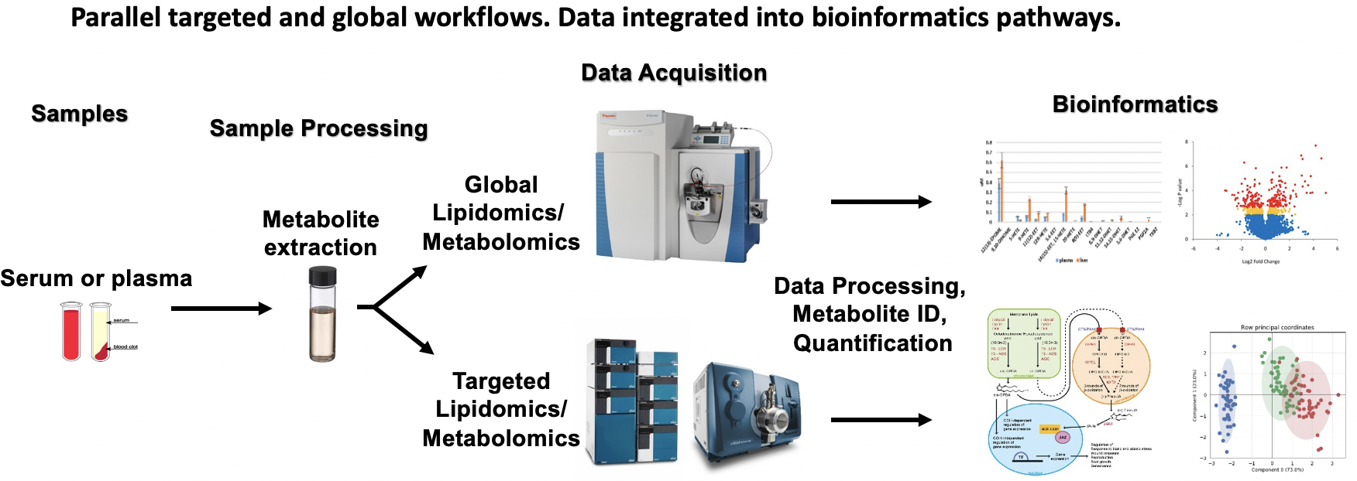
Metabolomics Workflows

Slide 18
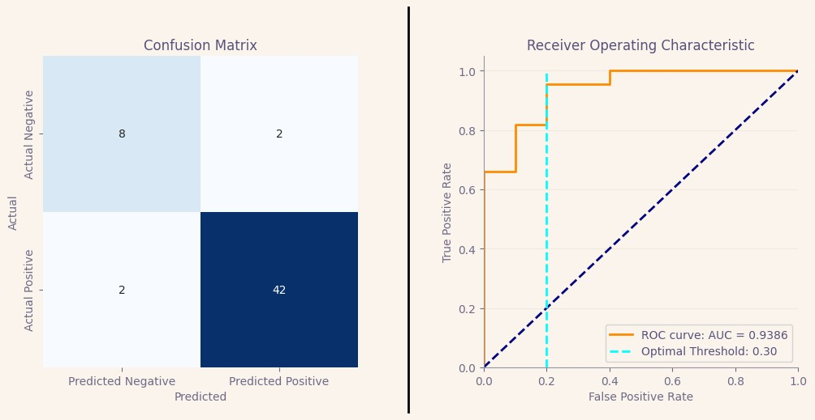
Results:
ROC curve
After further development, this panel could be used as a screening tool for identifying high risk for MASLD in children and adolescents using HRM & clinical phenotype data combined with machine learning algorithms
Notes:
Our paper is in press and will also be presented at the AASLD Annual Meeting in November so I am not showing you the final results. This is a figure showing how well another group of metabolites functioned to predict MASLD. ROC figure: The threshold values, used to define the cutoff as to whether to classify a patient as MASLD/non-MASLD based on the model score, were calculated to maximize the accuracy score in predictions on the test set.

Slide 19

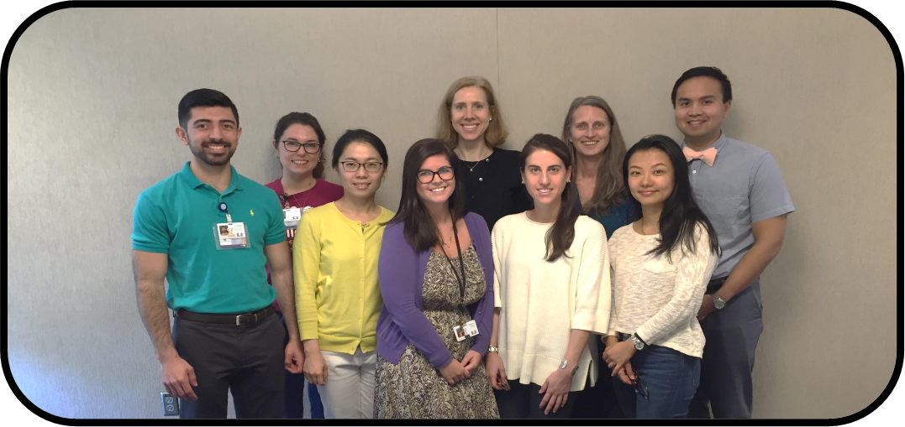
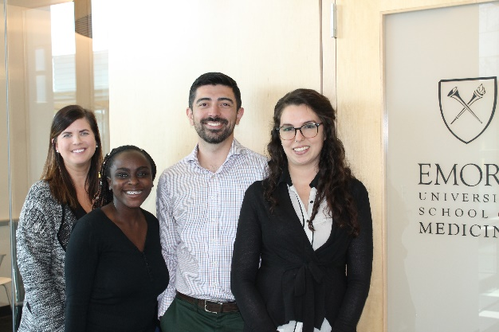
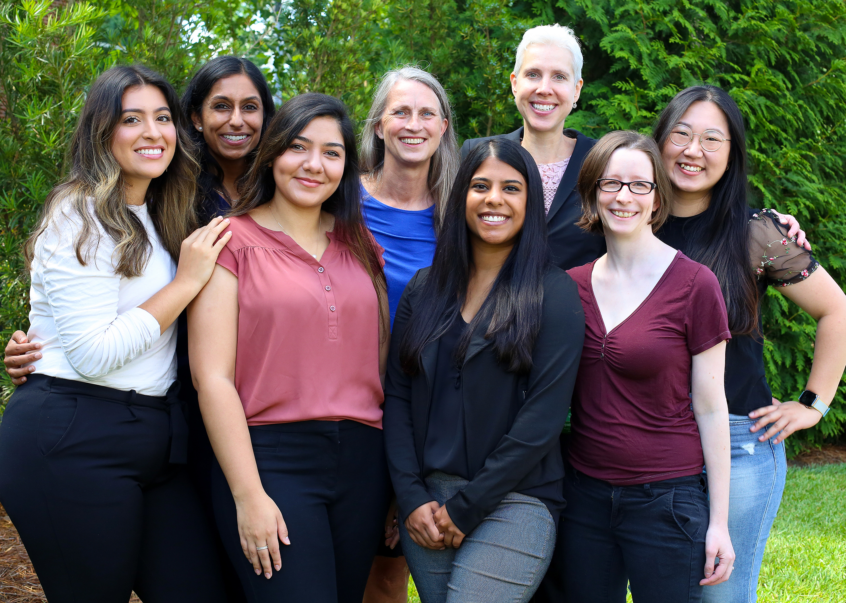
Thank you!
Mentors and Collaborators
Craig McClain (UofL), René Romero, MD, Dean Jones, PhD, William Dietz, MD, John Barnard, MD, Gary Miller, PhD, Diego Martin, MD, Jean Welsh, RN, MPH, PhD, Sonia Caprio, MD (Yale), Nicola Santoro, MD (KUMC), Carmen Marsit, PhD, Jeff Schwimmer, MD (UCSD), Melanie Cree, MD, PhD
Research Team and Mentees:
Rebecca Cleeton, MPH, Jessica Cruz, MD, Albert Hernandez, Hayley Braun, Maria Cordero, Jennifer Frediani, PhD, Ran Jin, PhD, Juna Konomi, PhD, Catherine Cioffi, RD, PhD, Ahlia Sekkarie PhD, Sarah Faasse, MD, Eduardo Castillo, MD, Elizabeth Sinclair, MD, Julia Tisheh, Risha Nayee, Carmen Garcia, Karla DeSantos RD, Helaina Hunealt, RD, Irene Pyo, Lucia Ramirez, RD, Jorge Garro, Claudia Yaranga, Lilliana Aguayo, PhD, Kelsey Chatman, MD
Support/Grants
NIH NIDDK, NIEHS, NICHD and NINR, Emory University (Atlanta) CTSA, The Obesity Society, Woodruff Fund, CDHNF/Nestle Nutrition Award, American Heart Association, Nutrition Science Initiative, Bristol Myers Squibb, Resonance Health, Sonic Incytes, Dexcom

