Slide 1
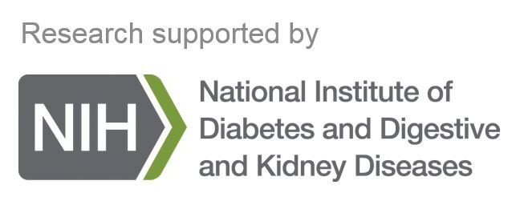
Peptidomics analysis reveals changes in small urinary peptides in patients with interstitial cystitis/bladder pain syndrome (IC/BPS)
Chemical approaches to understand peptide signaling in disease
James W. Checco, Ph.D.
Assistant Professor of Chemistry
University of Nebraska-Lincoln
Abid MSR, Qiu H, et al. Sci. Rep. 2022, 12, 8289

Slide 2
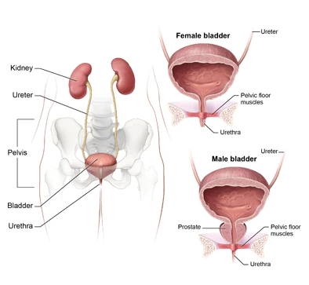
Overview
Interstitial cystitis/bladder pain syndrome (IC/BPS)
Chronic syndrome characterized by pain in the lower pelvis
Etiology not well understood. Some symptoms include:
Bladder pain
Increased urinary urgency
Frequent urination
Glomerations on bladder wall
Hunner’s ulcers on bladder wall
Many symptoms overlap with other bladder diseases
Highly invasive (cystoscopy, bladder biopsy, etc.)
There is a significant need for non-invasive and reliable biomarkers to aid in the diagnosis of IC/BPS
Urinary system
from niddk.nih.gov
Obtained human urine samples from female patients who participated in NIDDK’s Multidisciplinary Approach to the Study of Chronic Pelvic Pain (MAPP) research network – Administrative Review mechanism

Slide 3
Research work
Observations:
“APF peptide” appears to be potential biomarker for IC/BPS, but other small peptides have not been explored
Chronic inflammation and increased protease activity are associated with IC/BPS
Hypothesis: Small peptides (products of natural proteolysis) in urine may be useful as IC/BPS biomarkers.
Goals:
Non-targeted peptidomics analysis of urinary peptides in IC/BPS patient urine versus healthy control urine
Targeted relative quantitation of APF peptide in IC/BPS urine versus healthy control urine

Slide 4
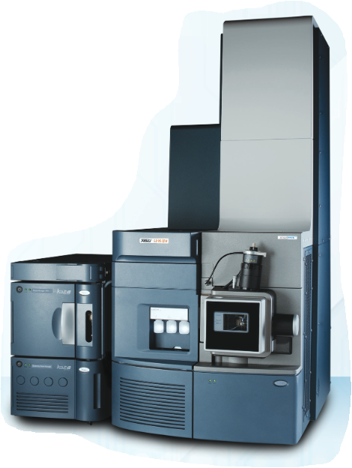
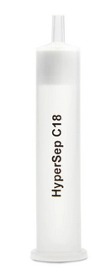
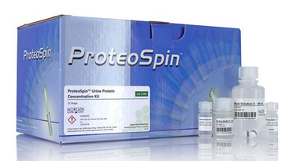
Scientific accomplishments
Higher control
Higher IC/BPS
100 μL patient urine
Desalt via solid-phase extraction
Urine peptide enrichment via “Proteospin”
LC-MS and LC-MS/MS analysis
Two-stage peptide enrichment
Processed 87 patient urine samples (43 IC/BPS, 44 control) from NIDDK CR
LC-MS/MS (DDA) followed by analysis in PEAKS Studio identifies >1000 peptides from >150 proteins (1% FDR)
71 specific peptides in higher abundance in IC/BPS patient urine relative to control urine
Red points indicate significant peptides with >1.5-fold change

Slide 5
Scientific accomplishments (continued)
APF peptide abundance
APF peptide detected in both patient and control urine samples, but absent from many samples
When present, APF peptide is in higher abundance in IC/BPS urine relative to control urine
Suggests that APF peptide alone (in this form) may not be definitive biomarker for IC/BPS.
**p<0.01, unpaired t-test

Slide 6
Scientific accomplishments (continued)
Hypothesis: Small peptides (products of natural proteolysis) in urine may be useful as IC/BPS biomarkers.
Goals and accomplishments:
Non-targeted peptidomics analysis of urinary peptides in IC/BPS patient urine versus healthy control urine General increase in small peptide abundance in IC/BPS Specific peptides may act as putative biomarkers
Targeted relative quantitation of APF peptide in IC/BPS urine versus healthy control urine APF peptide is not consistently found in IC/BPS patient urine, potentially limiting utility as biomarker.

Slide 7
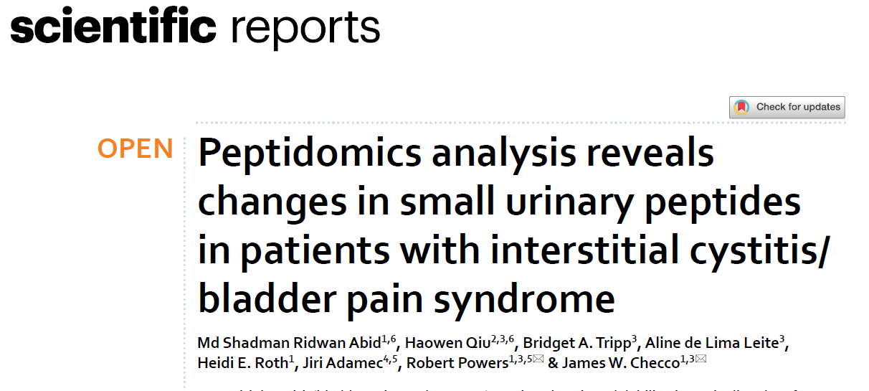
Scientific career journey
Began as Assistant Professor in August 2019
Received Ferring Innovation Grant to study peptides in IC/BPS in October, 2019 (lab’s first funding!)
Published results in 2022 (lab’s first research publication!)
Access to CR samples integral for getting my lab’s research off the ground in its early stages
Abid MSR, Qiu H, et al. Sci. Rep. 2022, 12, 8289

Slide 8
Helpful hints
Ask for minimal amount of sample required for study – if impact to collection is low, it may be possible to be approved by administrative review.
Reach out and ask questions to CR personnel!

Slide 9
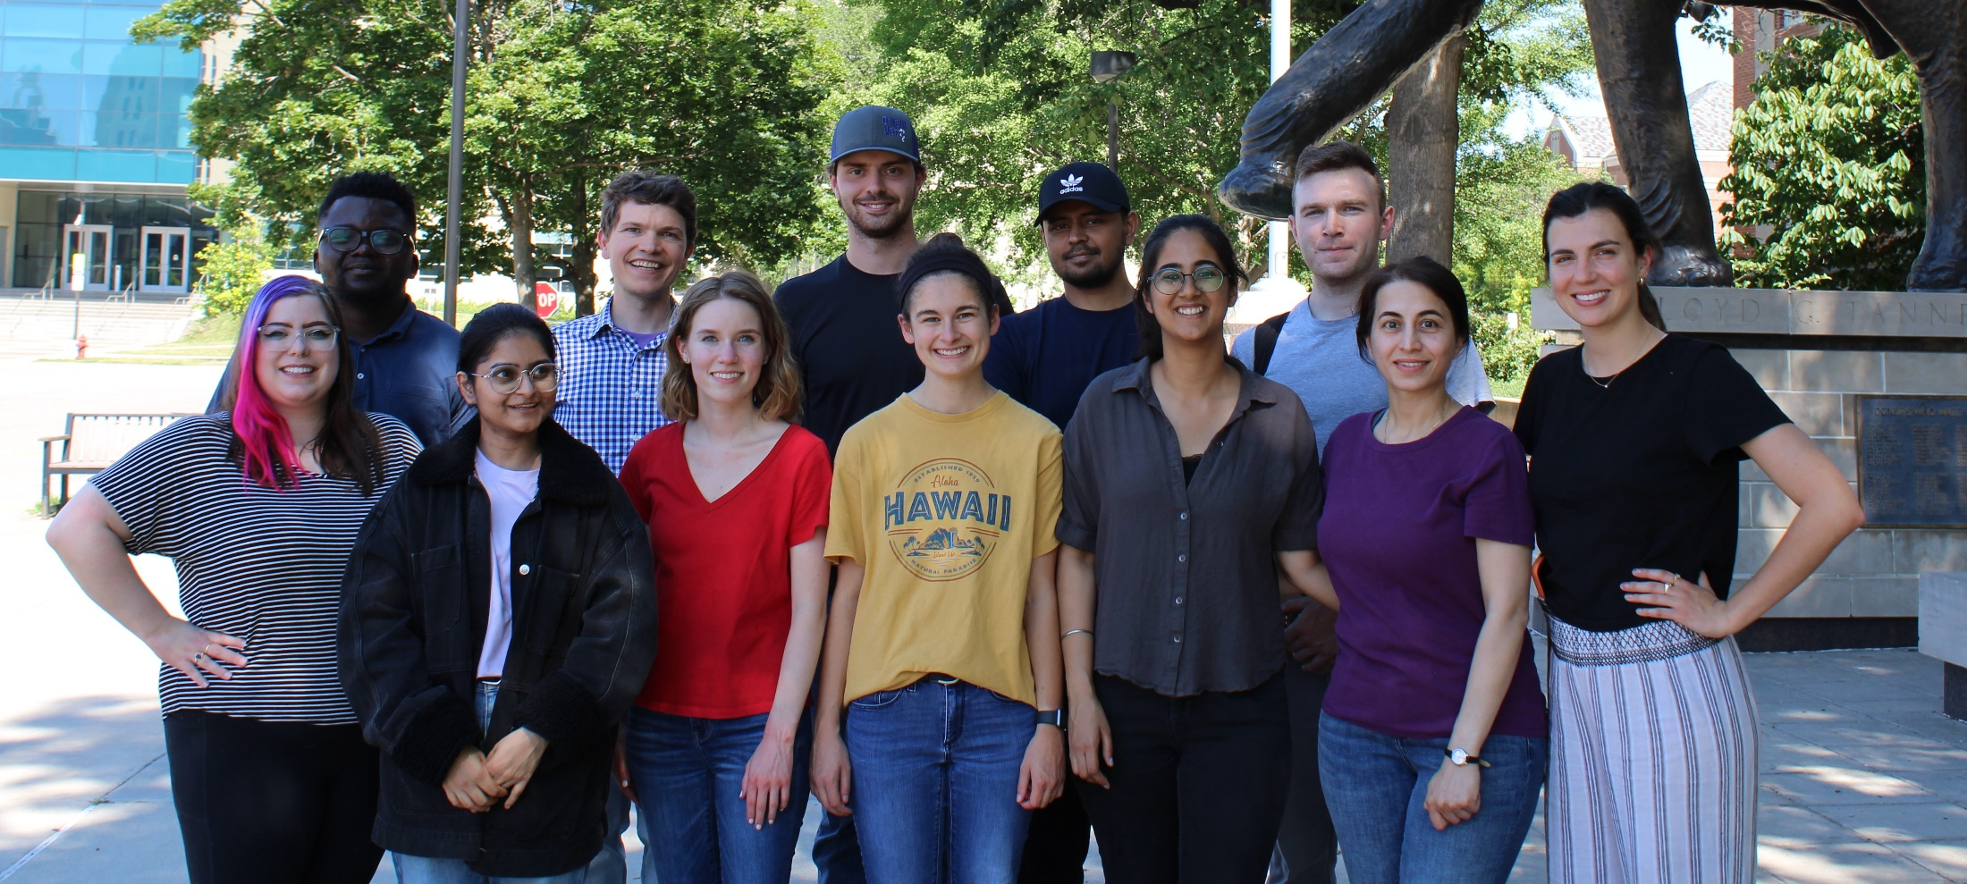
Acknowledgements
Checco Group
Md Shadman Ridwan Abid
Madeline Allen
Ashley Clifton
Alisha Doda
Jannat al Foisal
Somayeh Mousavi
Sheryl Sharma Chase Stebbing
Baba Yussif
Noelle Waltenburg
IC/BPS Collaborators
Max Qiu (UNL Biotechnology, CIBC)
Bridget Tripp (UNL CIBC)
Robert Powers (UNL Chemistry)
Heidi Roth (UNL Chemistry)
Aline de Lima Leite (UNL CIBC)
Jiri Adamec (UNL Biochemistry)
Funding
NIH/NIGMS MIRA (R35 GM142784)
Nebraska EPSCoR FIRST Award (OIA-1557417)
Ferring Innovation Grant (Ferring Pharmaceuticals)
Nebraska Center for Integrated Biomolecular Communication (P20 GM113126)

