Slide 1
Evolution of the Traditional Repositories
Session 3

Slide 2
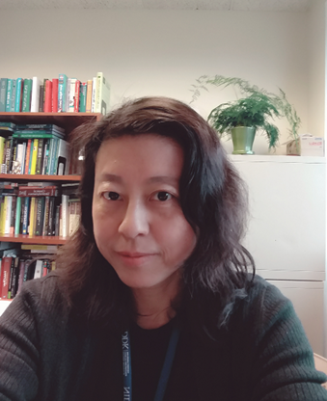
Xujing Wang, PhD Division of Diabetes Endocrinology and Metabolic diseases (DDEM)
Manages projects in the following areas:
Utilizing big data and advanced data science technologies
Developing and applying mathematical and computational approaches
Beta cell death, stress and survival pathways
Role as an NIH/NIDDK data steward :
Chair of the DDEM data science WG
Project scientist for the NIDDK information Network (dkNET), and the Human Pancreas Knowledgebase (PanKbase) program
Mentor of DDEM DATA scholar(s)
Serving as the NIDDK Rep on several transNIH WGs and programs
Repositories and Knowledgebases
Software tools
Joint NIH/NSF program “Smart and Connected heath in the era of Big Data and Artificial Intelligence”
Service on common fund programs:
Bridge2AI: project scientist, science officer, and communication contact
NPH (Nutrition for Precision Health): project scientist of it AI center

Slide 3
The challenges NIH traditional repositories face ⎯ in bringing different collections together to facilitate secondary work
No single repository can host all collections, same types or different
One major challenge: Interoperability
FAIR data principles: Findable, Accessible, Interoperable, and Reusable
The challenge is more outstanding for: non-omics data types (DK specific)
Examples:
Common data types: Cross talk between CMD-KP (Common Metabolic Disease Knowledge Portal), Adipose tissue cell Atlas (stored on Broad’s platform), PancDB (Pancreas DataBase), PancreAtlas
Non-common (DK-specific) data types: Calorimetry data
CalR, NORC, DRC, and MPMODs
Major causes: Data standards and ontologies, software tools best practice and interoperability
What we are experimenting:
NOT-DK-23-022 Administrative Supplements to Support Collaborations to Improve Data Interoperability/Re-use for Existing Type 2 Diabetes Relevant Data Sets
Notes:
Describe, from your perspective, the challenges NIH traditional repositories face in bringing different collections together to facilitate secondary work (provide one example).
Collections: data types, standards, ontologies, data types from special technologies
In data reuse, the power of AI is in integrating multiple data types to drive discovery
Centers for Metabolic Phenotyping of Mouse Models of Obesity and Diabetes (MPMOD).
non-omics data types (DK specific)
Survey data, blood/urine ;lab results
Physiological and Clinical measures, CGM and other diabetes technologies
ECG,
%% some data current not openly shared: ZIP, race/ethnicity, genetic sequence, traffic and accidents reports

Slide 4
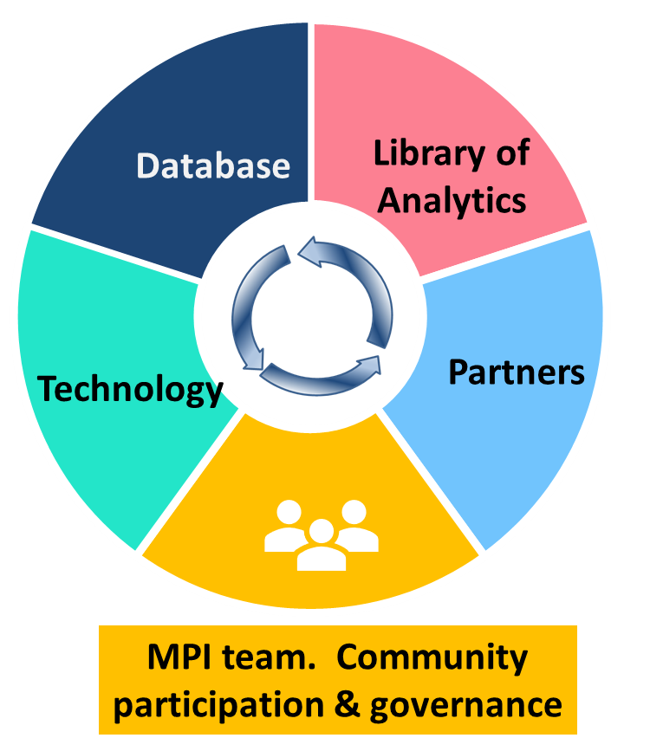
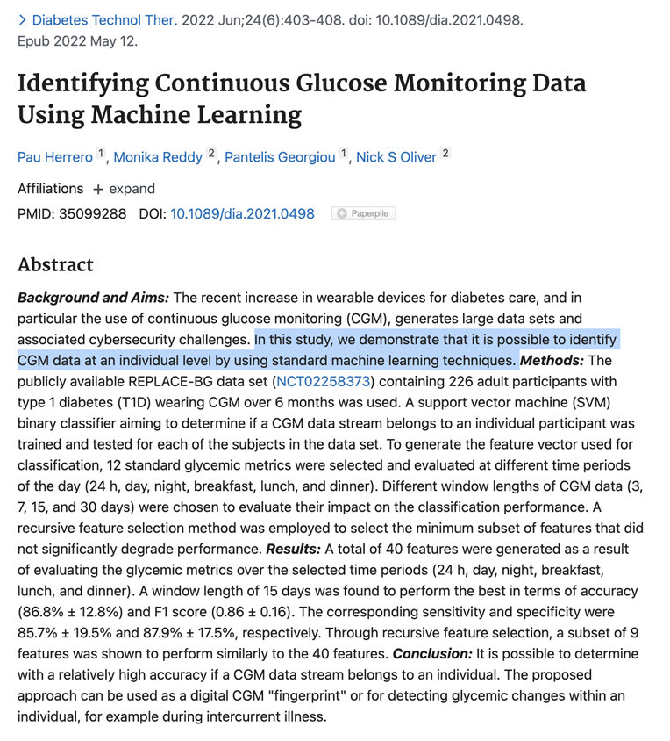
Opportunities and new technologies
Open collaboration, improving R&R
Powerful data integration and mining
Making knowledge machine actionable, integration of knowledge and data,
Platforms that link data, tools, knowledge
New discoveries that are not intuitive
…
But they will bring new challenges
PanKbase Program
(RFA-DK-22-018)
Notes:
Describe, from your perspective, opportunities to address some of these challenges through new technologies; where can and what new technology can be used to bring disparate collections together for new and innovative work (provide one example)?

