Slide 1
NHLBI BioData Catalyst
Regina Bures, PhD
Scientific Program Director, BioData Catalyst
Senior Scientific Advisor, Division of Cardiovascular Sciences, NHLBI
NIDDK Central Repository 20th Anniversary Seminar & Workshop: Promoting Secondary Research to Accelerate Medical Breakthroughs and Innovation, Sept 19-20, 2023
NIH Data Steward leading evolution of the NHLBI BioData Catalyst ecosystem: increasing data availability and accessibility, ensuring data governance and security, and developing a culture of data sharing and reuse for heart, lung, blood, and sleep data.

Slide 2
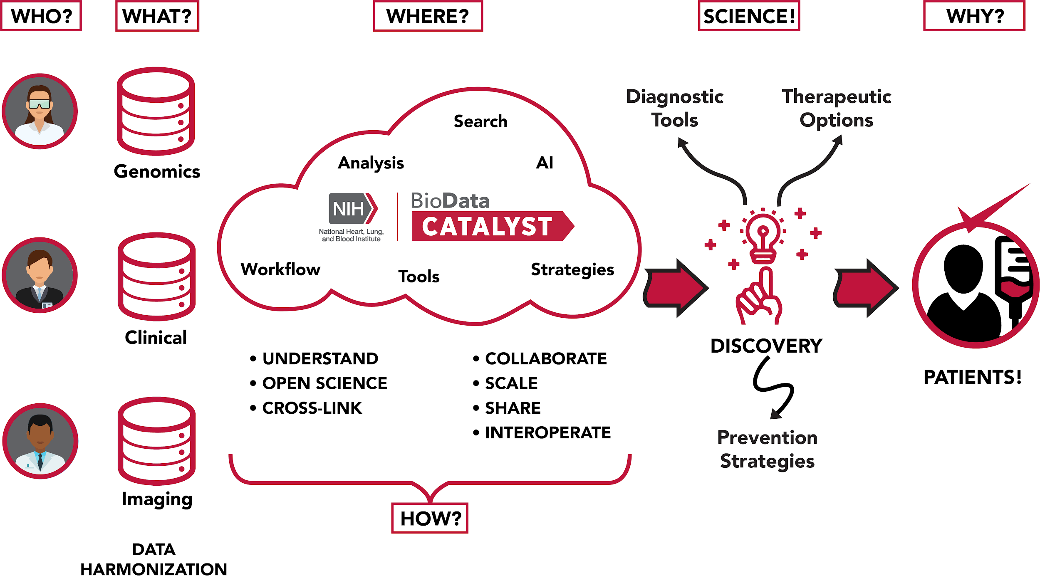

Slide 3
Challenges and Opportunities for NIH Repositories
Challenges
Data privacy and security: protecting privacy while maximizing data reuse
Data heterogeneity: genomics, EHRs, imaging, …
Data governance and interoperability: access controls and data exchange
Opportunities
Secure cloud-based analytic platforms
Open data standards and APIs
Large language models for search and harmonization of study- and variable-level data

