Slide 1
ImmPort – A Public Data Sharing Platform for Immunology Research and Clinical Studies
To provide curated data, reference data sets, and tools for collaboration and analysis from the programs and collaborations of Division of Allergy, Immunology, and Transplantation (DAIT), NIAID
To archive primary data to support research findings and enable reproductivity for the long term.
To reuse data to make new discoveries and generate hypotheses.
ImmPort: https://www.immport.org/home

Slide 2
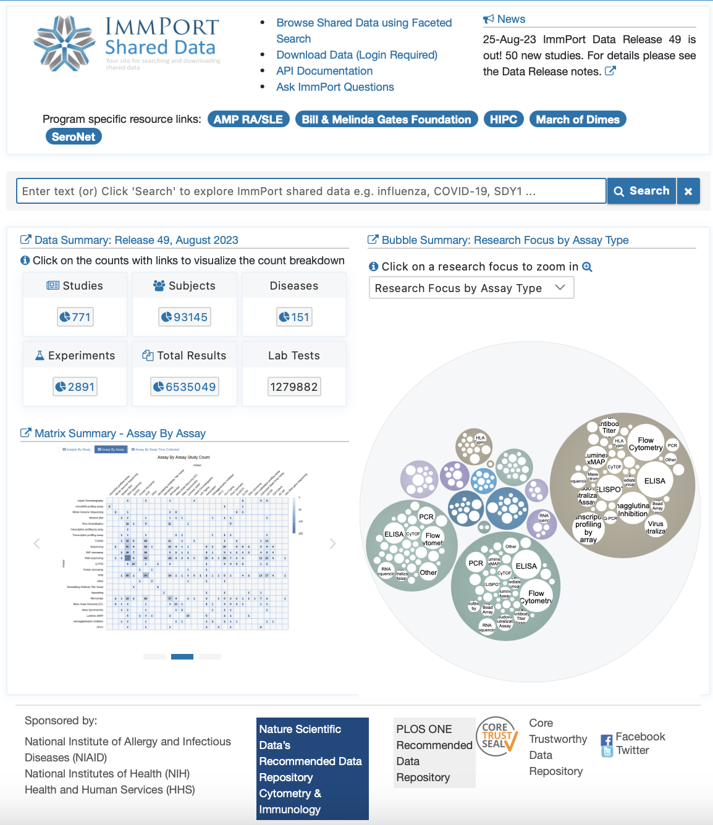
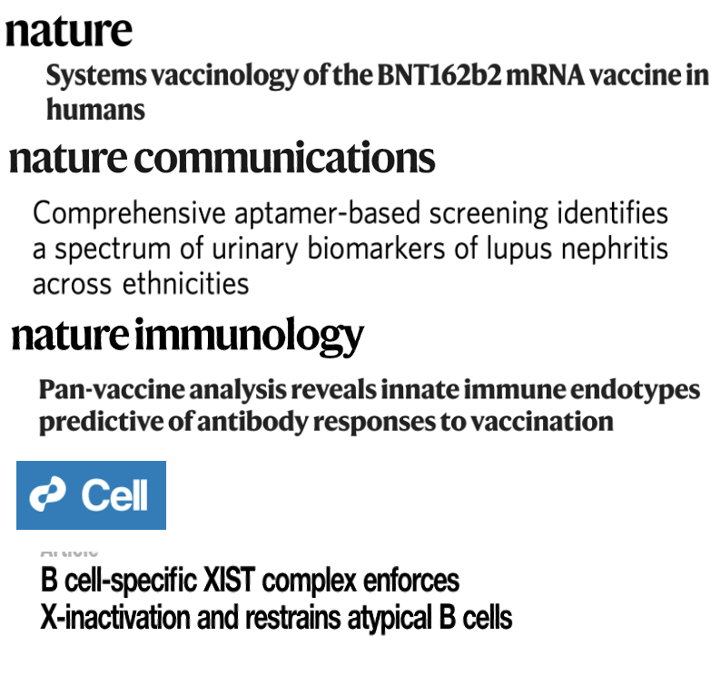
A Trustworthy Data Repository for Immunology
Data Highlights
771 studies shared (173 clinical trials)
Studies using both human jects and animal models
35+ variety of immuno-assays
Data Reuse
Sci Data. 2018 Feb 27;5:180015. doi: 10.1038/sdata.2018.15.
https://immport.org

Slide 3
ImmPort – Challenges and Opportunities
To Foster a culture where data sharing the norm.
Actively participate in the entire data life cycle.
Facilitate the implementation of the NIH Data Management and Sharing Policy Implementation.
To maximize the value of data for new discoveries and hypothesis generation.
Uphold the FAIR and TRUST Principles.
Serve as a versatile A plug-in-play data provider across diverse data ecosystems.

