Slide 1
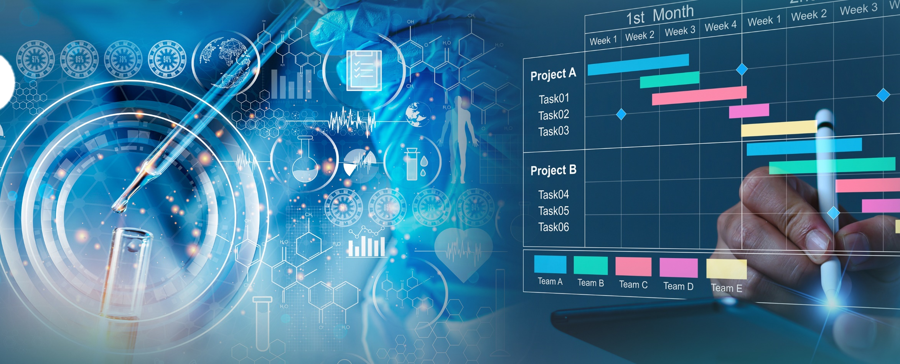
Reflecting on 20 Years of the NIDDK Central Repository: Embracing our Legacy and Shaping our Future
Reflecting on 20 Years of the NIDDK Central Repository: Embracing our Legacy and Shaping our Future
Rebecca Rodriguez, Ph.D.
Repository Program Director

Slide 2
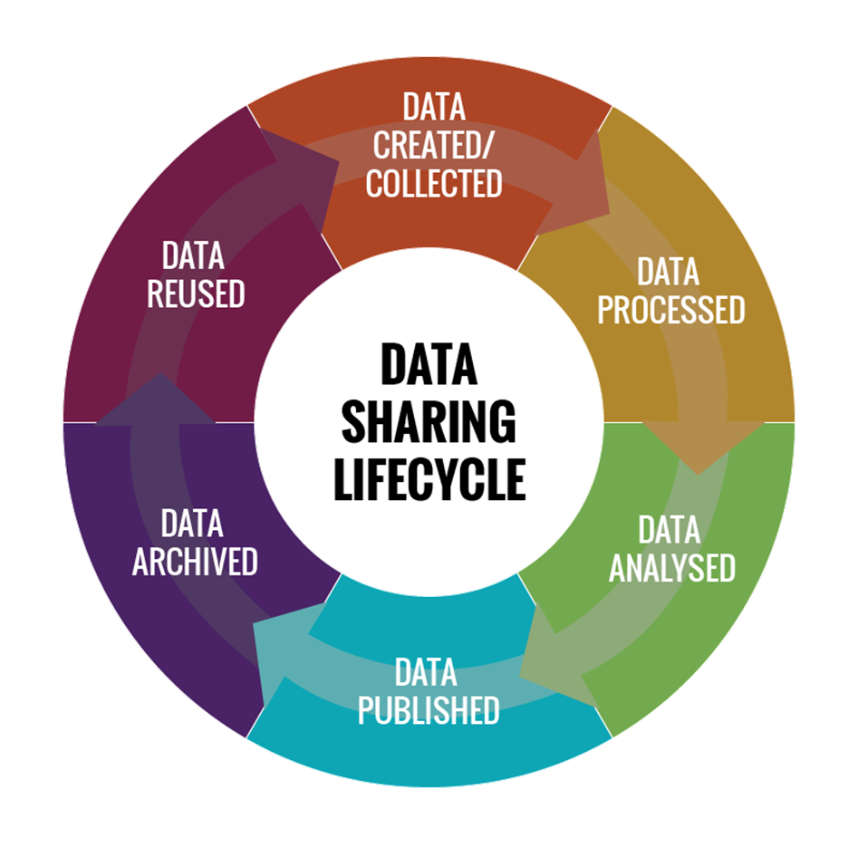
NIDDK Central Repository Vision and Mission
Our vision
Realize the full potential of existing resources to generate new findings and accelerate medical breakthroughs that impact health and healthcare outcomes
Our mission
Provide access to the wider research community, expanding the usefulness of extramurally NIDDK-funded multi-center clinical studies’ generated resources beyond the end of the study
Image by Booz Allen Hamilton under federal contract 75N94021D00001/75N94021F00001
Notes:
Support receipt and distribution of data and biospecimens in a manner that is ethical and equitable
Enable investigators not involved with the original work to test new hypotheses without the need to collect new data and biospecimens

Slide 3
NIDDK Central Repository Organizational Structure

Slide 4
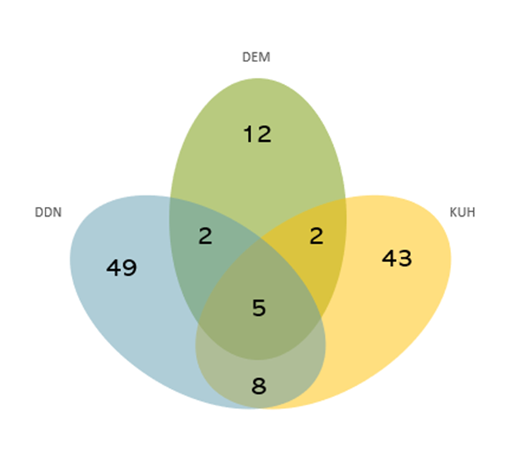
NIDDK Central Repository Collections
International resource, directly supporting extramurally NIDDK-funded active & concluded studies providing access to:
High-impact interventional and observational collections
High-quality quantitative and qualitative clinical phenotype data, including imaging and reference panels
Well-maintained wide range of human-derived material, including macromolecules, blood derivatives, cell/cell lines, tissue, urine, stool
§
Resources available for request from over 160 collections covering >100 diseases, disorders, or topics
across 6 major research areas within 3 divisions
§ Studies may cover multiple research areas
Notes:
We are one of 27 NIH-sustained supported controlled access repositories providing access to clinical data and associated biospecimens. We have grown to be an international resource supporting over 800 external investigators from all over the US, Canada, Western Europe, Asia, and Australia.

Slide 5
NIH/NIDDK-sustained supported controlled access repository providing access to clinical data and associated biospecimens to investigators across the US, Canada, Western Europe, Asia, and Australia
NIDDK CR relaunches its website as Resources for Research (R4R)
160 Collections
Alignment with FAIR and TRUST principles supported by Office of Data Science Strategy (ODSS) NOSI PAR-20-089
Certified by the Standards and Certification Board as a trustworthy repository
NIDDK establishes the Central Repository to increase the scientific value and utility of NIDDK-funded study-generated resources
Restructure under the Office of the Director (OD) and within the Office of Clinical Research Support (OCRS)
Development of automated request review and approval process
Observational
Establishment of the Central Repository Program receives council clearance
6 Collections
Query Tool Development
supported by NIH America Recovery and Reinvestment Act (ARRA)
NIDDK CR launches its data repository website with data collections available to the public
NIDDK-wide Disease Prevention and Management Planning Group recommends the Development of Repositories
Interventional
Data
RTI
IMS
BAH
Biosample
FBS
P4M
Genetics
RUCDR
Resource Acquisition: Cumulative resources acquired and curated and made available to the public since inception (Jul 2003-Jul 2023). Includes the cumulative total of resources (data and biospecimen) available for request to external investigators and ancillary requestors. Resources available only to ancillary or internal members of study consortia for ongoing studies are not shown.

Slide 6
NIDDK Central Repository Stats
Imaging Data
Clinical Data
Biospecimens
1394GB
9.7GB
6.2M
160 study collections, 144 with clinical phenotype data, 94 with samples available
>70 different material types
Compressed data available
Compressed data available
not including T1D studies
Website Users
Approved investigators
Public Releases
5732
>800
>500
total registered users and >57K annual visitors
Approved external and ancillary investigators
Reported from external and ancillary investigators
Notes:
When collections are acquired or become available, it is influenced by the repository support model used by the study.

Slide 7
Resources have supported varied scientific work, including meta-analyses, methods, statistical and algorithm research, biochemical and biomarker research
Data-centric challenge supported by NIDDK and ODSS under the America Competes Act
Administrative Review Pathway is established to reduce barriers to access
NIH NOT-OD-21-013 on data management and sharing “DMS” policy
PAR-13-228 (R01) is released to provide funding support for assays and associated data analysis of repository-held resources with an NIDDK-relevant disease research area focus
NIH NOT-OD-14-124 on genomic data sharing
PAR-11-350 (DP3) is released to use of archived samples from selected T1D studies
PAR-10-090 (X01) is released to promote utilization and equitable distribution of resources
NIH NOT-OD-03-032 on sharing research data is released
Resource Utilization: Cumulative Requests Submitted and Fulfilled or Pending since inception (Jul 2003-Jul 2023). Includes cumulative total of resource (data and biospecimen) requests made by external investigators and ancillary requests. Request for resources only available to internal members of study consortia for ongoing studies are not shown. External data and biospecimen requests have increased 5-fold in the last 10 years of operations.
Notes:
45% of all requests come from the external community; this includes renewable and non-renewable requests. Overall, 95% of all submitted requests are approved for release; for the external community, by request type, this is 91% approval for biospecimen and 98% for data requests. Of approved requests, 45% of the requests aims involve risk prediction (including AI/ML methods) in their primary aims, 19% involve understanding disease mechanisms, 13% statistical methods, 8% biomarker discovery, 6% preparatory to research and new trial design, 5% are comparative trials, 2% cost-effectiveness, and 2% involve meta-analyses. In 2023, 921 data and 169 biospecimen (5 fold increase in the number of requests approved since 2011)

Slide 8
NIDDK Central Repository Services and Features
Resources for Research (R4R) platform: Trustworthy data repository
Services and Features
Centralized resource access and dedicated request process support
Assist with project planning before data are collected and support during the life of the project*
Acquire, curate, maintain, and distribute resources
Controlled-access resources, NIH-STRIDES (AWS) cloud-based environment
Common format data file types
Data package version control and unique persistent identifiers (DOI)
*Select NIDDK-funded clinical studies
Notes:
Sustainable, domain-specific, with heterogenous resources within NIDDK
Since the inception, we continue to provide support to investigators that benefits early stage that is unique in this style of support not usually seen in open data repositories

Slide 9
Modernizing and Streamlining Processes
Embracing flexibility to continue to support NIDDK’s evolving mission
Modernizing database and implementing system security updates and adjustments to enhance and expand data types hosted and services provided to improve user experience
Streamlining the request application and review processes to reduce barriers to access and promote usability
Improving metrics to monitor and evaluate the impact of utilization and utility of resources
Actively participating within NIH and across industry to adopt, enhance, and contribute to best practices and data standards to promote sharing principles
Notes:
And plan to make equal modernization adjustments to enhance and expand material types hosted and services provided in the biorepository side of the house.
Equally making improvements to the submission process, providing guidance before resources are collected, implementing technology to facilitate the import of data into the platform, and the curation process to expedite the release of quality resources when these are still relevant
>>emphasize that the DKCR supports the resource generation and secondary utilization portions of the resource life cycle… both ends of the spectrum, start to end

Slide 10
Central Repository Strategic Goals
Expand the usefulness of NIDDK-funded research by enabling qualified investigators to reuse existing resources to generate new findings
Improve the quality of resources and minimize barriers that limit utilization
Increase the impact of resources, enhance navigation, and provide tools that facilitate new research
Advance understanding of best practices, develop and implement policies, and increase user engagement
Improve visibility into Repository holdings
Improved data quality, discoverability, and reuse through adherence to FAIR Principles
Promote Repository resources through readily available, improved documentation
Increase new research by external investigators and biospecimens use overall
Enrich study-level annotation from NIDDK datasets mapping to standardized terminologies and/or CDEs for cross-study research
Improve biospecimen metadata
Improve program efficiency, system, and website usability
Increase user engagement with new marketing approaches and teaching series
Preserve participant privacy and maximize interoperability and interconnectivity across numerous sources of data
Notes:
Expand the usefulness of NIDDK-funded research by enabling qualified investigators to reuse existing resources to generate new findings
Foster sharing practices that promote sharing and scientific progress

Slide 11
Supporting NIDDK Strategic Goals
Restructuring to support operations with novel R&D contract vehicles matching potential to modernize and advance NIDDK and the Central Repository activities in the biomedical data science space
Promote stability of the operations,
Increase flexibility, capability, and capacity of operations and services provided,
Maximize the potential for utilization of resources, associated scientific value and impact
Notes:
Reduce silos, facilitate federated access through a centralized catalog

Slide 12
Shaping NIDDK Data Ecosystem
-Continue modernization, establishing partnerships within and outside NIH, leveraging existing opportunities that align NIH and ODSS objectives
-Actively participating in efforts to increase the role of repositories in advancing the biomedical ecosystem
-Improve data harmonization across projects and AI readiness, engaging with different parts of the community and potentially increasing the pipeline of secondary researchers
Notes:
to implement and enhance FAIR and TRUST principles, advance understanding of best practices, improve resource sharing, and support sustainable and reliable repository operations.
Positioned the Central Repository for integration and interoperability of NIDDK data ecosystem in support of NIH Data Management and Sharing Policy making NIDDK-funded resources more accessible and visible
Modernize Central Repository data infrastructure to improve program efficiency, system processes, and user engagement

Slide 13
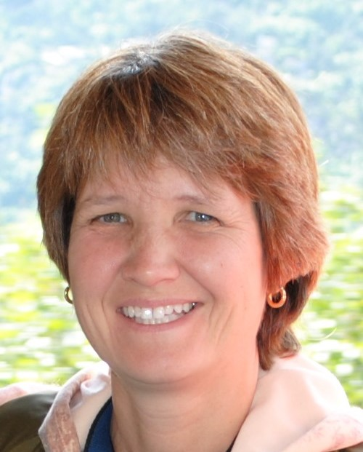
Repository Program Staff
NIDDK Repository Program Administration
Repository Executive Committee
Operations Support (Contracts)
Rebecca Rodriguez, Ph.D.
DDN
Jose Serrano, M.D., Ph.D.
Ludmila Pawlikowska, Ph.D. §
DEM
Beena Akolkar, Ph.D.§
Lisa Spain, Ph.D.
KUH
Afshin Parsa, M.D., M.P.H. §
Chris Mullins, Ph.D.
boldface Member of RPD access committee
§Member of dbGaP data access committee
Repository Program Director
Data Repository (Booz Allen Hamilton)
Contract 75N94021D00001/74N94021F00001
Mike Keller, Principal
Alexandra Shlionskaya
Alissa Fujimoto
Sharon Lawlor, M.B.A.
Advisor to the Repository Program
Biospecimen Repository (Precision for Medicine)
Dee Cooper, M.H.A.
Bridge Contract 75N94023C00013
Kurt Langenbach, Principal
Jessica Stahl
Repository Specialist

