Slide 1
Secondary research: Breakthroughs and Innovation
(an informaticist’s perspective) Yasir Tarabichi MD, MSCR
Chief Medical Information Officer, Ovatient Director of Clinical Research Informatics @ MetroHealth Associate Professor of Medicine @ Case Western Reserve University
Dall-E: data analyst trying to catch data
Notes:
Figure generated by DALLE

Slide 2
Disclosure
YT receives research funding and consulting fees from Beckman Coulter to support the development of novel biomarkers and early warning systems for sepsis.

Slide 3
Agenda
Ingredients for secondary data analysis success
Innovation, opportunities and breakthroughs
Unlocking healthcare data (standards and interoperability)
Advanced analytics (interoperability, aggregation and analytics)
Evolving platforms
Ethical concerns

Slide 4
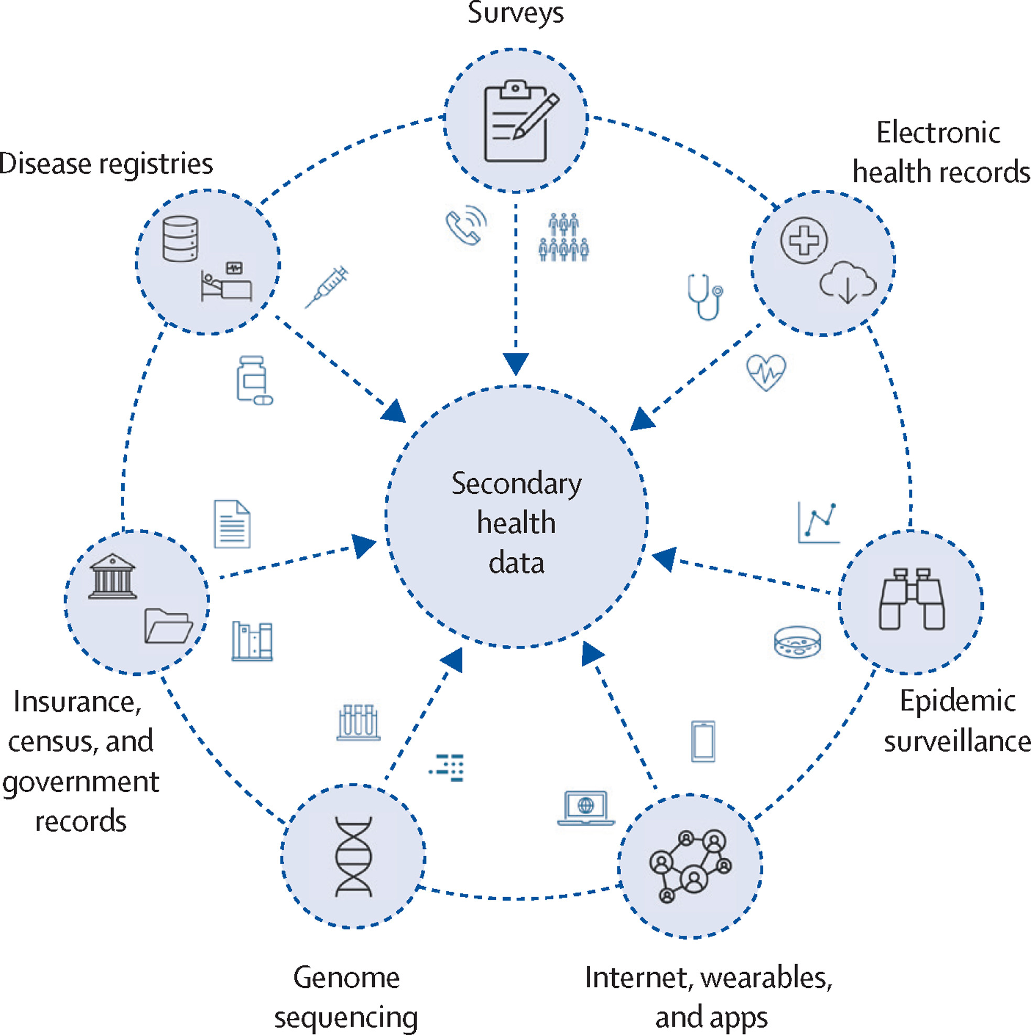
Secondary data sources and volume
“Today, approximately 30% of the world’s data volume is being generated by the healthcare industry. By 2025, the compound annual growth rate of data for healthcare will reach 36%. That’s 6% faster than manufacturing, 10% faster than financial services, and 11% faster than media & entertainment.”
https://www.rbccm.com/en/gib/healthcare/episode/the_healthcare_data_explosion; Accessed 9/10/2023
Naher et al. Lancet Digital Health. 2023.
Notes:
High volume, but siloed.
Internet medical of things.

Slide 5
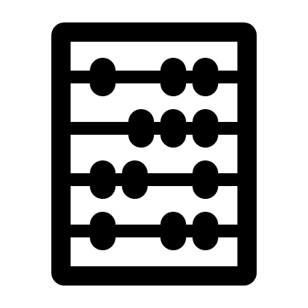
Ingredients for secondary data success
Data
Aggregation / Processing
Tools / Presentation
Standardized
High quality
Curated (context)
Harmonized
Semantic interop.
De-duplication
De-identification
Scalable statistical methods / pipelines
Advanced analytics platforms
Notes:
Standardized = CDM
High quality = reliability, QC
Curated = metadata
Harmonized = from different sources within same entitiy
Semantic interop = exchanging data with unambiguous shared meaning.

Slide 6
Innovations for secondary data success
Standards & Interoperability
AI / ML
Data
Aggregation / Processing
Tools / Presentation
Standardized
High quality
Curated (context)
Harmonized
Semantic interop.
De-duplication
De-identification
Scalable statistical methods / pipelines
Advanced analytics platforms
Platforms
Notes:
Comment: As informaticist I think about where we have been and where we are going in this space. Namely, the new opportunities and risks that develop in the technology and regulatory spaces.

Slide 7
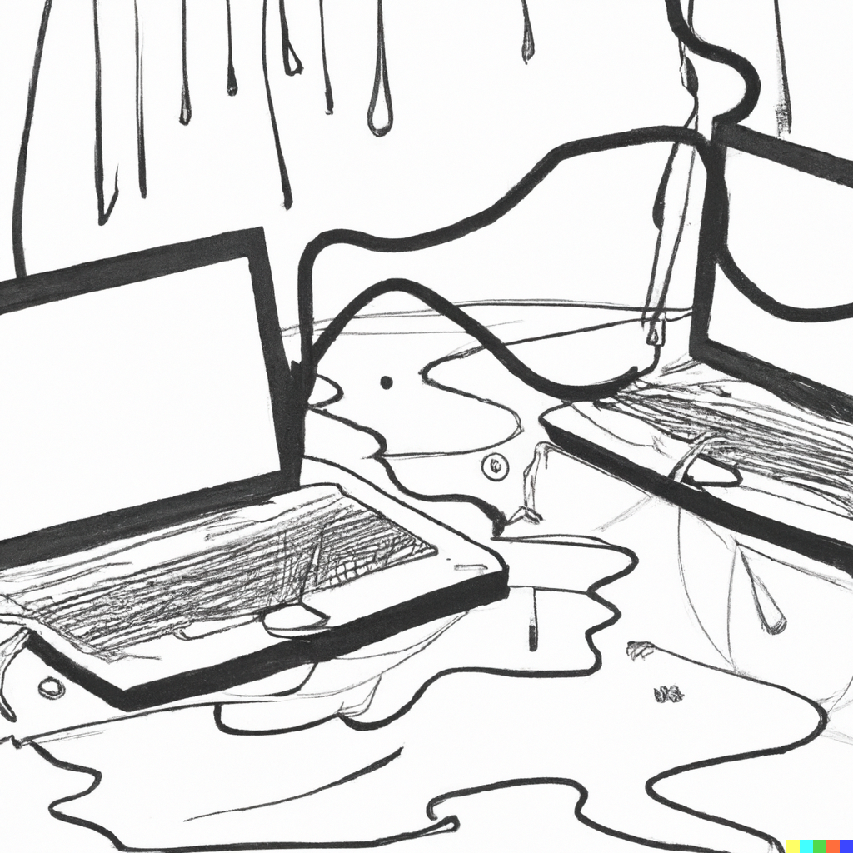
EHR data traps: -- False starts and bridges to nowhere
+ HITECH act (2009) - a resounding success promoting the widespread adoption of EHRs.
- Silos of development with varying local standards.
- Substantial data model and quality variability even within users of the same proprietary data models and platforms.
+ Lots of data and messaging standards development (LOINC, SNOMED, HL7 / FHIR) in the interim.
- Massive capital investments to boot, and even if orgs adopted these standards, interoperability was never assured.
Mandl et al. NEJM. 2012
Dall-E: Leaky computers connecting
Notes:
Comment: EHR rush was silod – few looked back and its too late and costly to do so now.

Slide 8
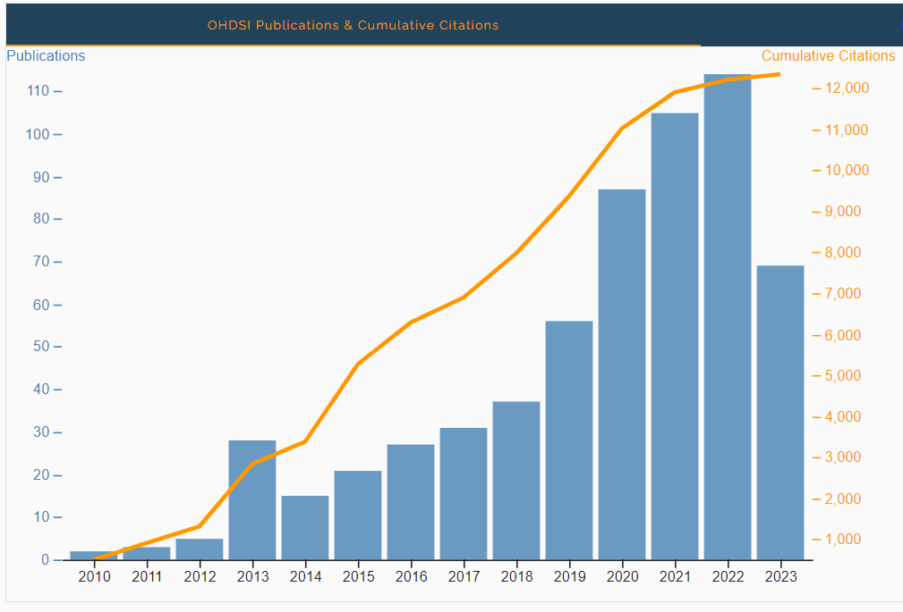
Data model standardization: Crowdsourcing to promote interoperability
Research-based data mart + collaborations:
OMOP CDM (open-science, OHDSI collab)
Numerous repositories - e.g. European Health Data & Evidence Network (EHDEN).
PCORnet CDM (born from the FDA’s Sentinel CDM).
Several research networks like INSIGHT (NYC) or Greater Plaines Collaborative (8 states)
+ Innovative multinational efforts + collaborations.
+ Standardized tooling for ETL and analytics.
- Substantial effort typically reserved to larger, academic sites.
- Quality and FAIR principles not guaranteed (no consensus on benchmarking or rules).
https://dash.ohdsi.org/pubmed accessed on 9/13/2023
Notes:
Comment: Valiant efforts to crowdsource solutions did not solve all of our problems.
Observational Health Data Sciences and Informatics
Observational Medical Outcomes Partnership
ETL Extract, Transfer and Load
Fair = Findable, Accesible, Interoperable and Reusable

Slide 9
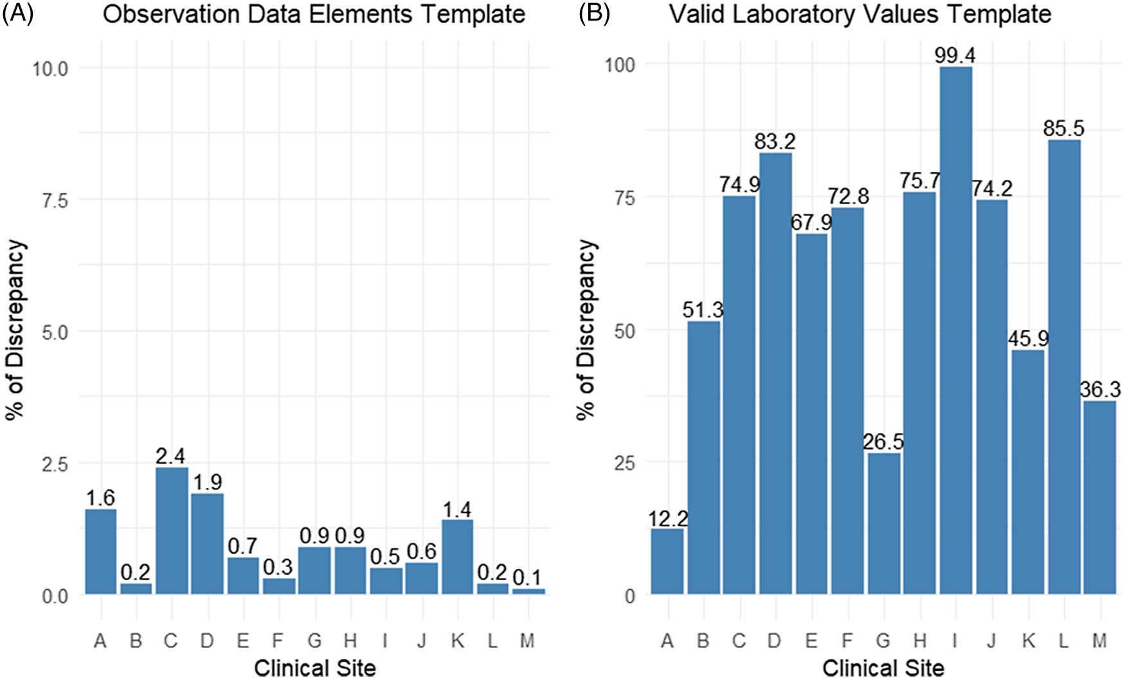
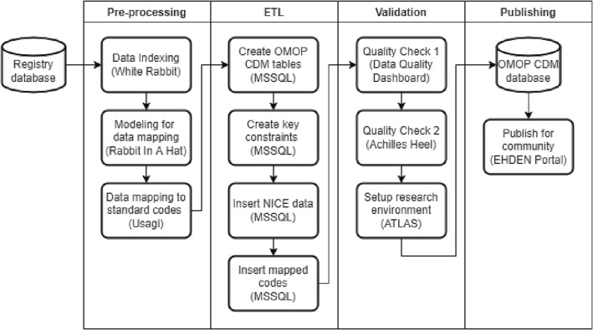
Quality (left) and FAIRness (right) not guaranteed
Correct LOINC codes
Vital signs outliers
Sampling of discrepant features from a 13-member PCORnet network data quality assessment.
Mohamed et al. Journal of Clinical and Translational Science. 2023.
Analysis of 2 ICU cohorts published to EHDEN (OMOP CDM). FAIRsFAIR framework scoring = 15.5/25 and 12/25!
Puttmann et al. Int. J. Med. Inform. 2023.
Notes:
Left:
Purpose: “To quantify data quality concerns across healthcare systems in a PCORnet Clinical Research Network, we used a previously tested rule-based framework tailored to the PCORnet Common Data Model to perform data quality assessment at 13 clinical sites across eight states.”
Conclusion: Rule-based EHR data quality methods quantify significant discrepancies across all sites. Medication and laboratory sources are causes of data errors.
Comment: Illogical vitals were less frequent than mis mapped labs.
Right:
Materials and methods: Two researchers involved in the OMOP CDM conversion of separate Dutch Intensive Care Unit (ICU) research databases each manually assessed their own database using seventeen metrics.
The main omissions in supporting FAIRness were the lack of globally unique identifiers such as Uniform Resource Identifiers (URIs) in the OMOP CDM and the lack of metadata standardization and linkage in the EHDEN portal
Comment: Many standardized tools in OMOP setup but mapping remains a human-driven process.

Slide 10
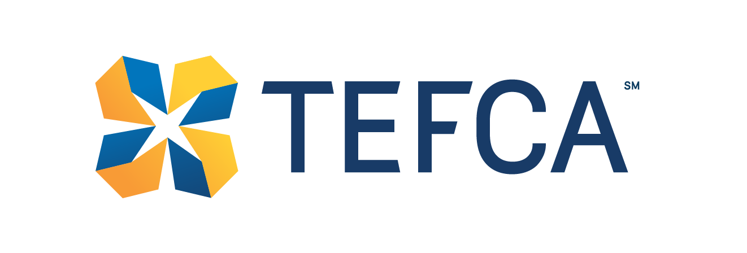
Promoting standardization and interoperability through regulation
CMS’ Meaningful use -> Promoting interoperability.
Consolidated document architecture standards (≠ interoperability). (D’Amore et al, 2014)
Encourage HIE.
21st Century Cures act:
Prohibition of “information blocking” (≠ interoperability).
Leaning on evolving FHIR resources as the proposed standard.
TEFCA – universal “floor” for interoperability across a national health information exchange network (voluntary).
Trusted Exchange Framework and Common Agreement (TEFCA) | HealthIT.gov
Notes:
Comment: regulation and incentives force organizations to reveal their data (and all the horrors it contains).
MU – e-prescribing and PH reporting, CPOE, documents, HIE and health registry submissions
21st Century cures act -
TEFCA is a public-private partnership authorized in the 21st Century Cures Act, a bipartisan congressional initiative to advance interoperability across the country.

Slide 11
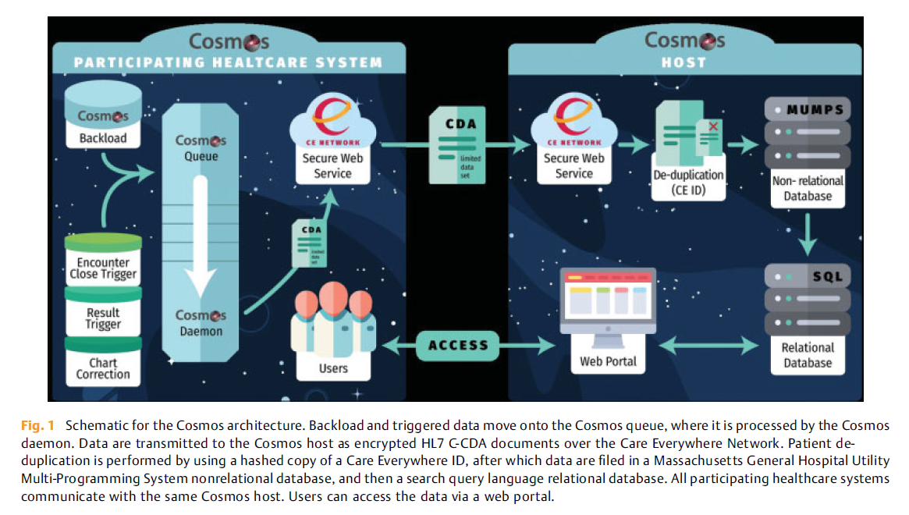
Our own research interoperability breakthrough… Placing the development burden back on the vendors
Tarabichi et al. Applied Clinical Informatics Open. 2021.
Notes:
Comment: EHR vendors are the best suited to solving the mess they started.
Members pushed the vendor to answer.
Epic (more than 50% EHR coverage in the US) did.
Used its own software, proprietary data model to ETL data (limited data set) and harmonize.

Slide 12
>200 million unique patients… in 2 years!
The initiative scaled rapidly because it leverages pre-existing :
agreements
health information exchange networks
data standards
strong patient de-duplication
Cosmos uses statistical process informed by OHDSI for semiautomated mapping and continuous QC
Community (user) feedback is also encouraged for improvements
Cosmos success is due to it’s low-barrier of entry.
Dall-E: Gorilla connecting two computers

Slide 13
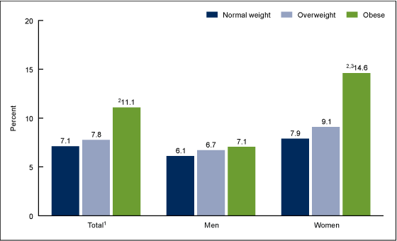
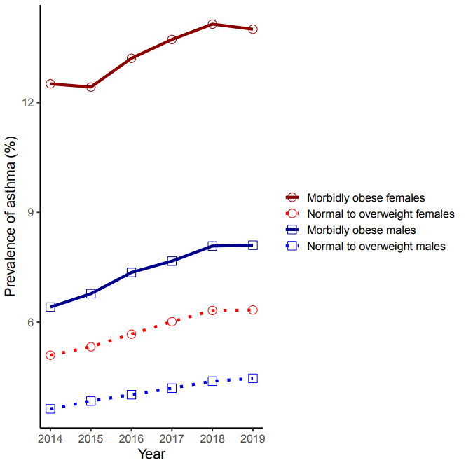
Chronic Disease Surveillance Asthma Prevalence by Weight
CDC NHANES
Cosmos BMI, demos and diagnosis codes (SNOMED)
Current asthma prevalence among adults aged 20 and over, by weight status and sex: United States, 2011–2014
The annual prevalence of asthma within different obesity classes, stratified by sex
https://www.cdc.gov/nchs/products/databriefs/db239.htm

Slide 14
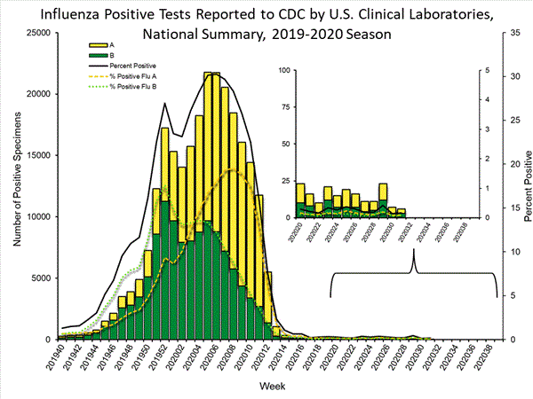
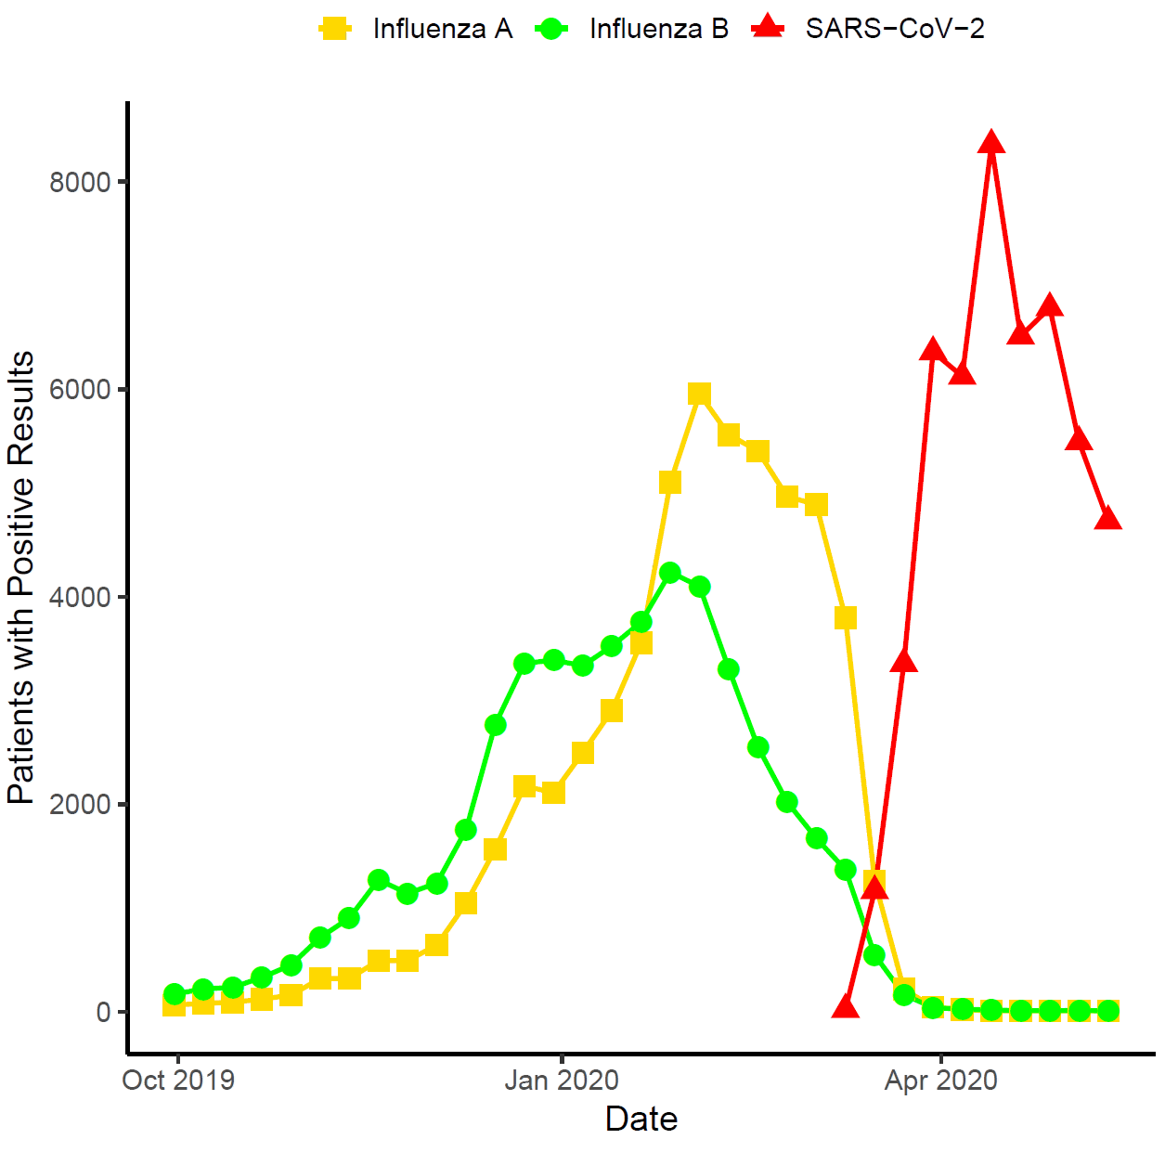
Syndromic Surveillance Seasonal influenza and the novel coronavirus
CDC Surveillance
Cosmos Test result data (LOINC)
Counts of positive influenza A and B assays, as well as SARS-CoV-2 assays in Cosmos
https://www.cdc.gov/flu/weekly/index.htm

Slide 15
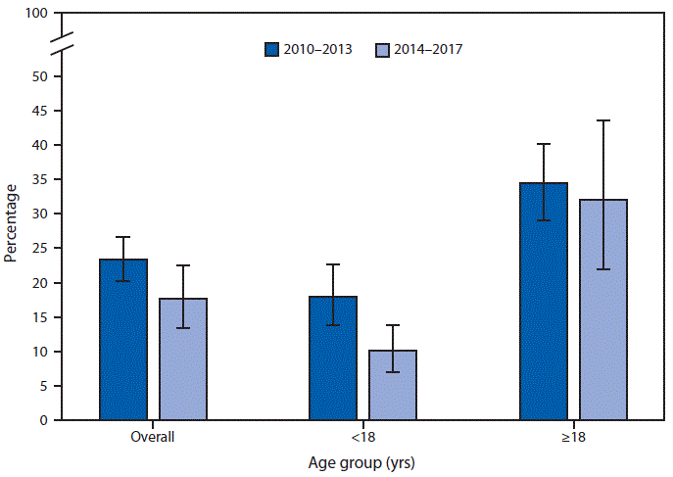
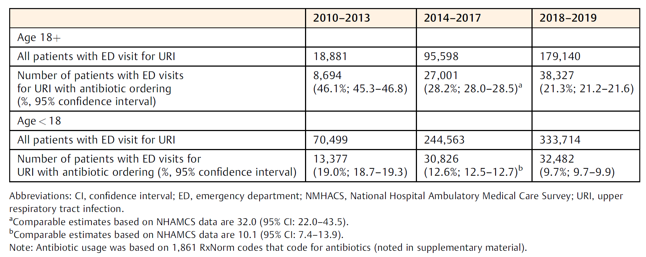
Health Services Research Antibiotics for Upper Respiratory Infections (URI)
CDC: NHAMCS
Cosmos
Emergency department visits for URI during which an antibiotic was given or prescribed. United States, 2010–2017
Emergency department visits for URI (SNOMED) during which an antibiotic (ERX) was given or prescribed. United States, 2010–2019
Ashman JJ. MMWR Morb Mortal Wkly Rep. 2020
Notes:
QuickStats: Percentage of Emergency Department Visits for Acute Viral Upper Respiratory Tract Infection† at Which an Antimicrobial Was Given or Prescribed,§ by Age — United States, 2010–2017
Ashman JJ. QuickStats: Percentage of Emergency Department Visits for Acute Viral Upper Respiratory Tract Infection at Which an Antimicrobial Was Given or Prescribed, by Age — United States, 2010–2017. MMWR Morb Mortal Wkly Rep. 2020(69:174).

Slide 16
Immunization Utilization and Adherence HPV Vaccination Compliance by Race
Cosmos CVX and demographic data
Immunization Information Systems
Black adolescents vaccinate at rates equal to or greater than white adolescents. However, they are less likely to complete the series.
Jeudin P et al. Clinical therapeutics. 2014

Slide 17
Vaccine Adverse Event Reporting MMRV and Febrile Seizures
Vaccine Safety Datalink
Cosmos
8 years of data reviewed
Query for 11 to 23-month-olds who received MMRV or MMR+ and SNOMED-CT diagnosis of febrile convulsion within 10 days
MMRV an excess risk compared to MMR+V
MMRV vaccination led to febrile seizures in 4.3 per 10,000 doses
MMRV : 55/110,644 Patients
MMR+V : 312/1,041,705 Patients
Overall : Febrile seizures excess risk of 2 per 10,000 MMRV doses (p<0.01).
Klein et al. Pediatrics. 2010
Notes:
Klein et al reviewed 8 years of data from the Vaccine Safety Datalink.
They showed that when compared to MMR+, MMRV vaccination led to an excess risk of febrile seizures (4.3 per 10,000 doses).

Slide 18
Decentralized identifiers reconstruct patient journeys
“Care Everywhere ID” uses probabilistic patient matching algorithm without a centralized MPI.
Studies have shown that the CE ID correctly identifies the same patient in different EHRs at least approximately 85% of the time.
A more recent study in Los Angeles revealed no false positives and an estimated false negative rate of close to 3%.
Notes:
MPI = master patient index

Slide 19
Cosmos limitations (shared by many)
Structured data only
Cohort counting (though expanding)
Statistical risk of site or patient re-identification limits variables at large (err on side of caution)
Analytical complexity remains limited
Access is severely limited (by design)

Slide 20
Vendor DB
Vendor DB
Vendor DB
Vendor Q
Appliance
Appliance
Appliance
Check
Check
Check
HCO 1
HCO 2
HCO 3
CDM
CDM
CDM
HCO 1
HCO 2
HCO 3
HCO 1
HCO 2
HCO 3
 | Vendor Specific | Appliance based | Query to data
Examples | Cosmos | TriNetX | PCORnet MDPHnet
Deduplication | Yes | Yes | No
Effort | Low | Moderate | High
Control | Low (all/none) | Low (all/none) | High
Diff EHRs | No | Yes | Yes
Notes:
Just to present the lay of the land for different approaches.
Effort and control vary at the customer level.

Slide 21
Innovations for secondary data success
Standards & Interoperability
AI / ML
Data
Aggregation / Processing
Tools / Presentation
Standardized
High quality
Curated (context)
Harmonized
Semantic interop.
De-duplication
De-identification
Scalable statistical methods / pipelines
Advanced analytics platforms
Platforms

Slide 22
Innovations: unlocking unstructured data
Most data in healthcare is unstructured, and worse, uncaptured (lost).
Signals and monitoring devices (telemetry) – often flushed and generally minimized in care if able.
Vision - pathology slides, radiology and dermatology- **most robust AI development.
Text (NLP and… LLMs?)
Audio (dictation, ambient)
Video (scopes and patient monitoring)
Kong et al. Healthc Inform Res. 2019
Dall-E: Analyst trying to catch data
Notes:
Comment: Various data modalities that are unstructured. How can we extract more meaning?

Slide 23
AI Supported Harmonization: Why
Most work is manual. AI can provide:
Consistency (good or bad)
Adaptability to data creep and new types.
Scalability
Contextual understanding (LLM) and zero-shot opportunities with newer modalities
!!! Cost reduction
Dall-E: Digital bandaid connecting computers
Notes:
Comment: AI can help us prep data…. For AI

Slide 24
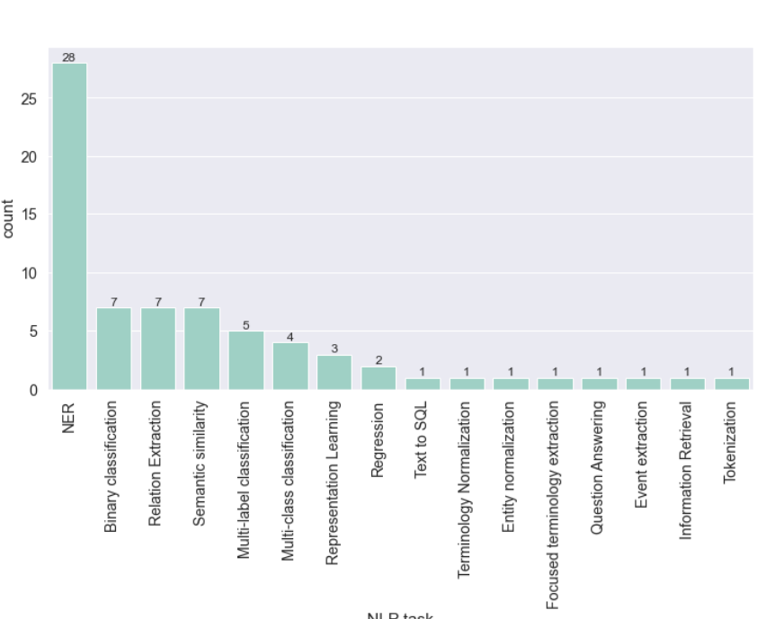
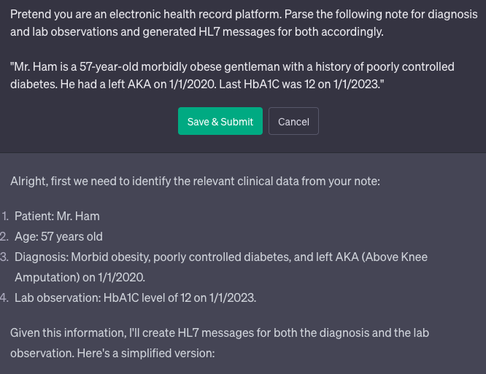
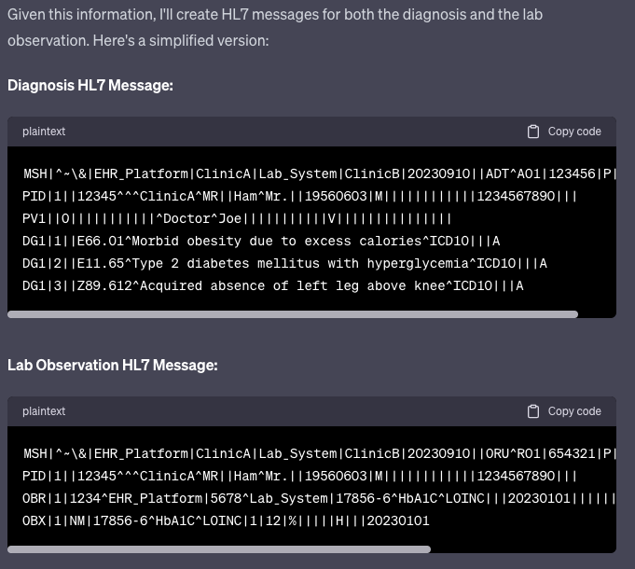
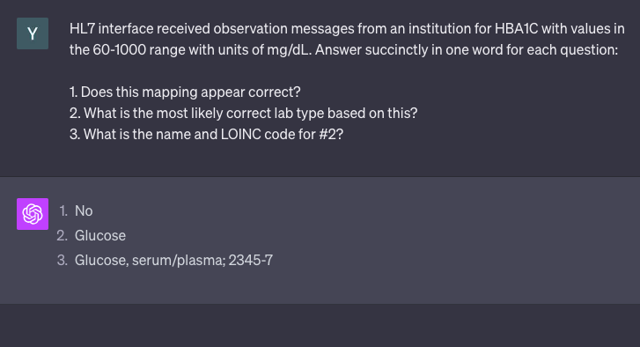
Transformer opportunities: Semantic interoperability
Even with relatively robust standards and ontologies (LOINC, HL7), health information extraction and exchange suffer.
Worsened by the addition of currently “invisible” data coded in unstructured notes.
arXiv:2304.02768 [cs.CL]
Notes:
Most transformers function to extract information, primarily in the form of “Named Entity Recognition.”
Transformers can codify notes into standardized messaging schema. It can also point out inappropriate mappings for HL7 messaging.

Slide 25
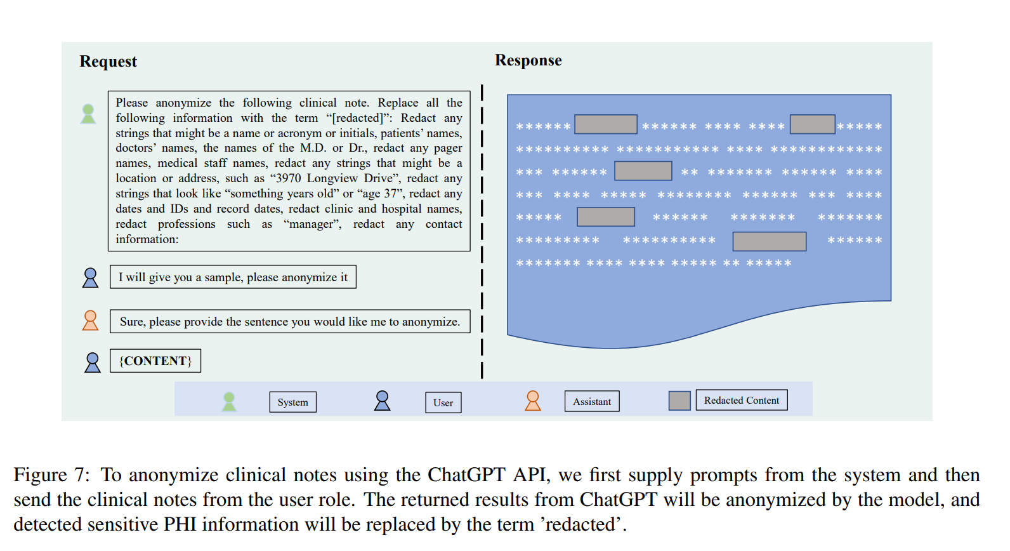
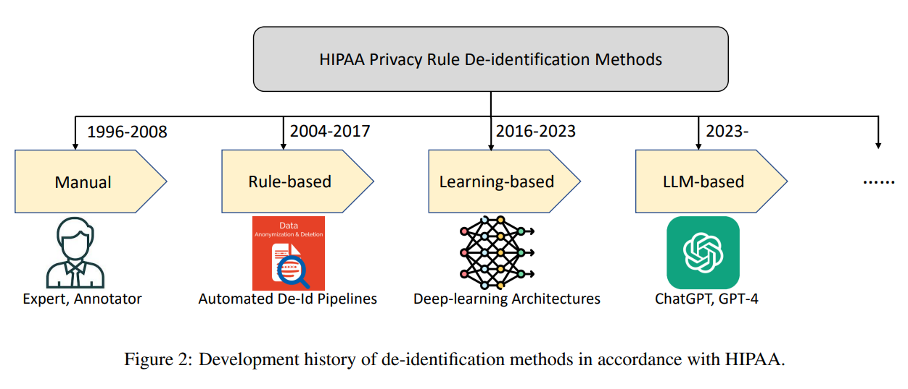
LLM play: Data de-identification
Rule-based (heuristic)
(is this a name? date?)
NLP based approaches – current industry standards-
“>99% accuracy”
LLM-based:
Zero-shot (out of box, sans tuning) meets current industry standards.
arXiv:2303.11032 [cs.CL]

Slide 26
Innovations for secondary data success
Standards & Interoperability
AI / ML
Data
Aggregation / Processing
Tools / Presentation
Standardized
High quality
Curated (context)
Harmonized
Semantic interop.
De-duplication
De-identification
Scalable statistical methods / pipelines
Advanced analytics platforms
Platforms

Slide 27
New(er) methods: (HTE)
“Heterogeneity of treatment effects (HTE) refers to the non-random variation in the magnitude or direction of a treatment effect across levels of a covariate, as measured on a selected scale, against a clinical outcome.”
Predictive HTE: Patient-centered estimates of outcome risk (particularly in RCTs)
Model risk of outcome
Model effect: i.e. treatment x interactions
Kent, D. M. et al. Ann. Intern. Med (2019)

Slide 28
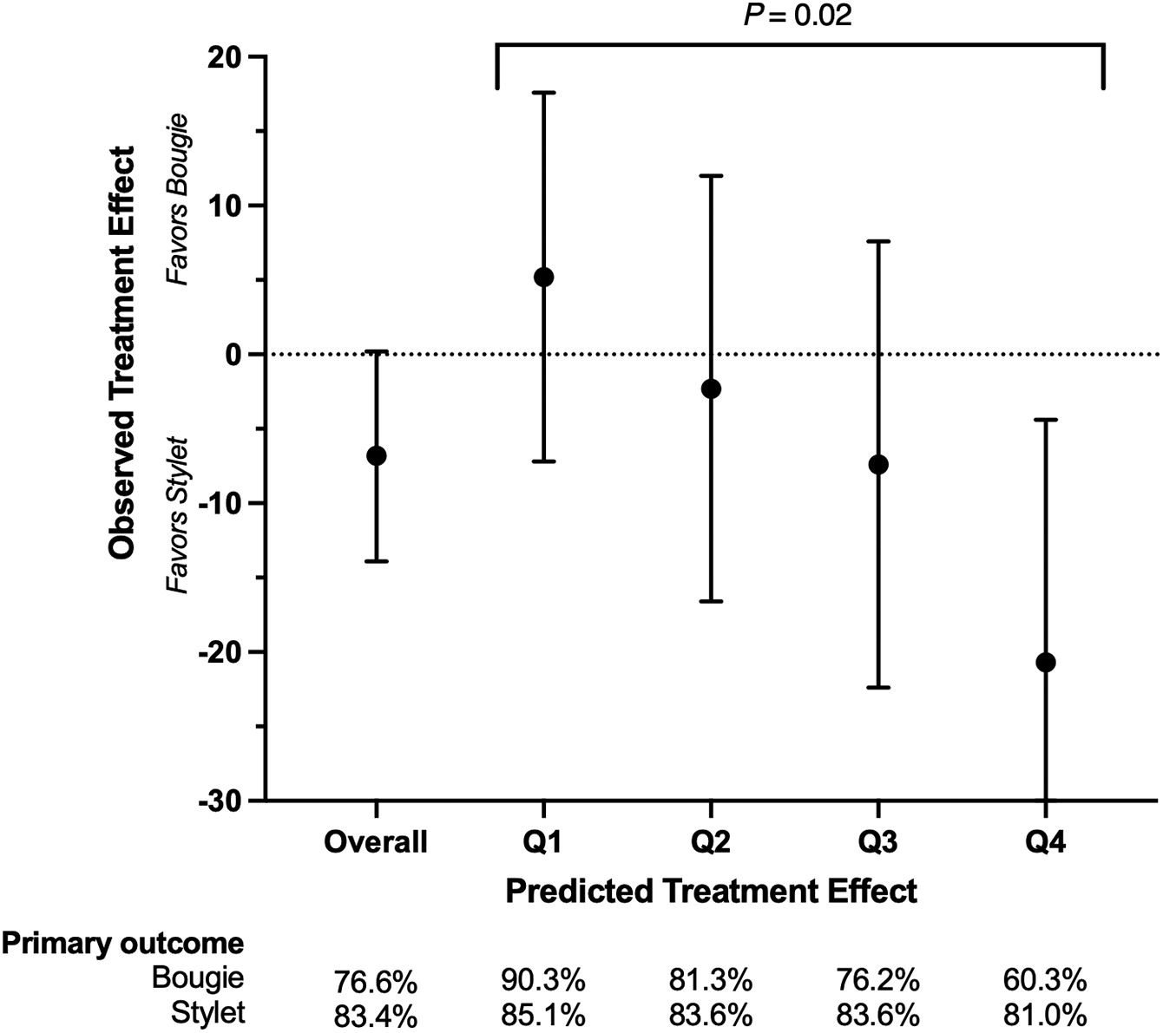
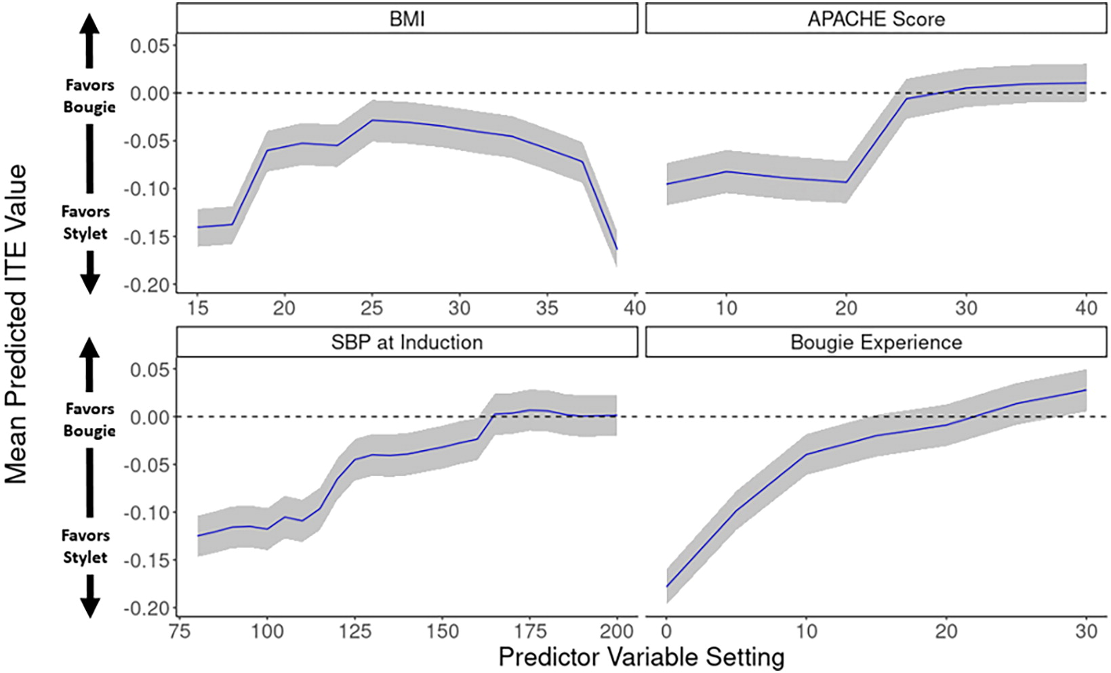
RCT example of predictive HTE
Bougie vs stylet for intubation – 1K patient RCT with negative result
Secondary analysis - split data:
½ Causal forest algorithm to predict individual treatment response.
½ Validate!
Seitz, K. P. et al. Am. J. Respir. Crit. Care Med. 2023.
Notes:
F1: Different risk groupings in validation group
F2: Predictors contributions.

Slide 29
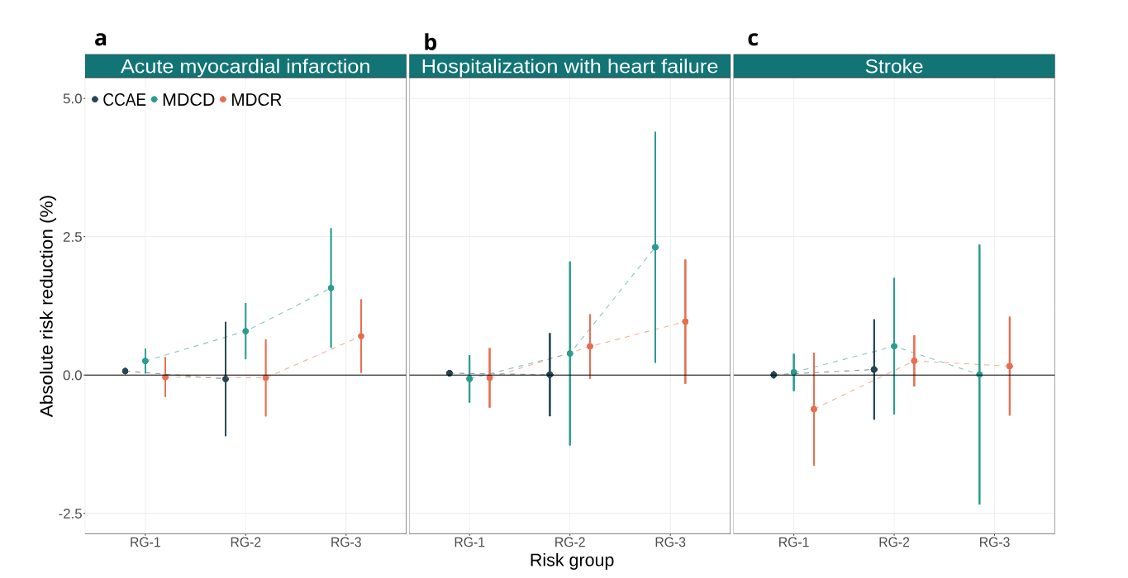
HTE applied to large scale observational data
LEGEND-HTN: OMOP-based observational study that assessed the effect of several first-choice antihypertensives (thiazides vs ACEI).
Rekkas et al applied risk-based HTE analysis in OMOPified DBs to cnform. Then freely shared extensible “pipeline” on GitHub.
Rekkas et al. npj Digit. Med. 2023.
Notes:
-- ACEI vs thiazide diuretics (thiazide favored over 0)

Slide 30
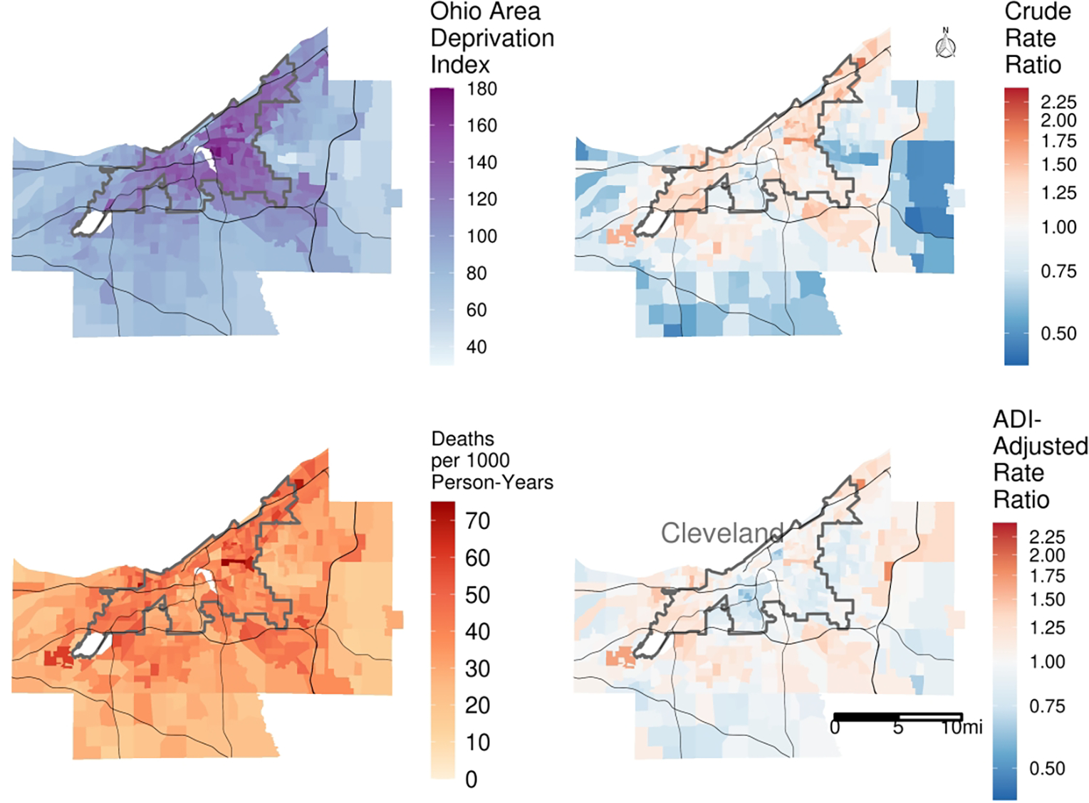
Place and heterogeneity
Data from 2 EHRs in Cleveland.
Poisson event rate model incorporating spatial autocorrelation to identify rates of death and ADI adjusted death in Cleveland.
58.2% of the tract-level variation in death rates was accounted for by ADI.
==> Substantial effect of racial segregation and socioeconomic deprivation.
Dalton et al. Med. Decis. Mak. 2022.

Slide 31
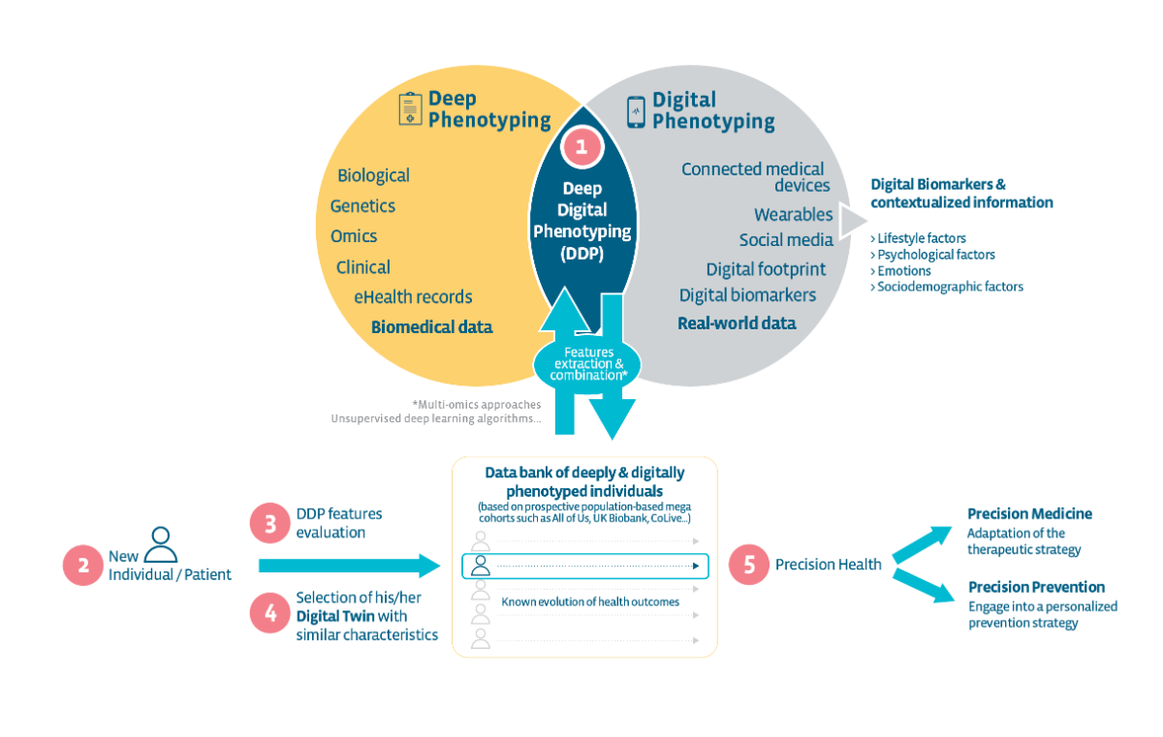
Culmination: Digital twins
Coming soon…
1R01AG080486-01
Digital Twin Neighborhoods for Research on Place-Based Health Inequalities in Mid-Life
i) establish community- and privacy-focused procedures for constructing Digital Twin Neighborhoods which incorporate EHR data;
ii) evaluate the efficacy of a DTN approach to understanding mechanisms of place- based health inequities in mid-life across multiple health conditions and geographies; and
iii) examine the generalizability and scalability of the DTN approach for studying place-based mid-life health inequalities.
Fagherazzi. JMIR. 2020
Notes:
“Achieving the true purpose of precision health requires integrating, from scratch, features from the “digitosome” (ie, all data generated digitally by individuals online or by their smartphones or connected devices) [6]. Deep digital phenotyping is the combination of deep phenotyping (defined for almost a decade now as the “precise and comprehensive analysis of phenotypic abnormalities in which the individual components of the phenotype are observed and described”) [7], with digital phenotyping, (defined as the moment-by-moment quantification of the individual-level human phenotype in situ using data from personal digital devices [8]). If clinically relevant [9], the power of digital data [10] will give us insights, usually in an automated and objective way, about the lifestyle, psychological state, sociodemographics, and environment of a given individual and thus will help capture the bigger picture and reach the full potential of precision health (see Figure 1). “

Slide 32
Innovations for secondary data success
Standards & Interoperability
AI / ML
Data
Aggregation / Processing
Tools / Presentation
Standardized
Curated (context)
High quality
Harmonized
Semantic interop.
De-duplication
De-identification
Scalable statistical methods / pipelines
Advanced analytics platforms
Platforms

Slide 33
What should a good platform do today?
+ Building a scalable pipeline that can harmonize data with the least amount of effort required from the customer.
+ Clear versioning.
+ Democratizing advanced analytics to end users (built in propensity analyses, for example).
+ Generative AI for appropriate analytics and presentations.
+ Dynamic variables (for org and patient privacy).
+ Willingness to share data with the appropriate permissions (e.g. public health).
+ Transparent financial model.
+ Transparent algorithms, quality checks and controls

Slide 34
Burning considerations, far from an ideal solution
Privacy & permissions
Who owns the data, who benefits and what is the incentive?
[Sola-Morales et al. Value in Health. 2023]
What is the threshold for de-identification with rich data?
[Chikwetu. Lancet Digital Health. 2023]
Bias, fairness and equity
“we must actively resist the view that data and algorithms merely inform, support, or issue decisions that impact distributions of particular goods. In particular, we must confront directly the role data and algorithms play in actively mediating and normalizing the discourses and social conditions against which decisions about distributions can be made in the first place”
[Hoffman. Information, Communication and Society. 2019]

Slide 35
TL;DR
As an operational research informaticist, I believe that unlocking research potential of secondary data comes down to:
Curating excellent data at the source
Promoting interoperability for meaningful data aggregation
Democratizing access to high value analytical tools and data platforms sitting on #2
Legislative and customer pressures, AI and novel statistical approaches are only accelerating these processes.
Questions of privacy, data ownership and bias are becoming increasingly more important and far from answered in this space.

Slide 36
End

Slide 37
Research success
Clinical success
Data quality & interoperability
…those in which “science, informatics, incentives, and culture are aligned for continuous improvement and innovation, with best practices seamlessly embedded in the delivery process and new knowledge captured as an integral by-product of the delivery experience.”
McGinnis JM et al. National Academies Press; 2007.
Notes:
Clinical research informatics guiding principal

