Slide 1
LIGHTENING TALK SESSION II
Investigating Type 1 Diabetes Etiology
Using Advanced Computational Methods
Sejal Mistry, PhD
MD-PhD Candidate
University of Utah Health

Slide 2
Islet autoantibodies are biomarkers in type 1 diabetes mellitus (T1DM),
but their clinical utility is limited
Autoantibodies against:
Glutamic Acid Decarboxylase (GADA)
Tyrosine Phosphatase Islet Antigen-2 (IA-2A)
Insulin (IAA)
Islet Cells
Immune Mediated
β-cell Destruction
T1DM Risk Assessment
Islet Autoantibody Characteristics
Binary assessment of islet autoantibody presence
Timing
Type
Titers
GADA
IAA
IA-2A
(Insel et al., Diabetes Care, 2015)
(Ziegler et al., JAMA, 2013;
Steck et al, Diabetes Care, 2015)
(Achenbach et al, Diabetes, 2014;
Barker et al., JCEM, 2004)
(Parikka et al., Diabetologia, 2012;
Steck et al., Diabetes Care, 2011)
(Parts of figure adapted from Servier Medical Art)
Notes:
Research Work: Briefly describe the research work conducted using repository data
High-level description of your research project(s), including the primary aims and knowledge gaps
How do the repository data accelerate medical breakthroughs and innovation in your research?

Slide 3
Stratifying risk for onset of T1DM using islet autoantibody trajectory clustering
Determine if a data-driven model incorporating islet autoantibody timing, type, and titer
could stratify risk for T1DM in children with high-risk HLA genotypes.
Notes:
Research Work: Briefly describe the research work conducted using repository data
High-level description of your research project(s), including the primary aims and knowledge gaps
How do the repository data accelerate medical breakthroughs and innovation in your research?

Slide 4
Study design and research methods
Repository Request
Dataset Details
Unsupervised Machine Learning
Timing
Infer mathematical relationships to identify patterns in data without making apriori assumptions on disease status
Year 1
Year 2
Year 3
Year 4
Year 5
Year 6
Year 7
Year 8
Year 9
Year 10
Year 11
Year 12
https://diabetes.ufl.edu/teddy-study/
Clustering
Type
GADA
IA-2A
IAA
(Genolini et al, Comp Methods Programs Biomed, 2013)
Titers
Relative to:
Laboratory
Immunoassay
Antibody
https://repository.niddk.nih.gov/home/
Notes:
Overview: Briefly describe the resources received and your research work
What dataset(s) did you request? Did you request single or multiple studies?
What type of work did you conduct with the data you received (secondary analyses, meta-analyses, replication, methods, machine learning, etc.)?

Slide 5
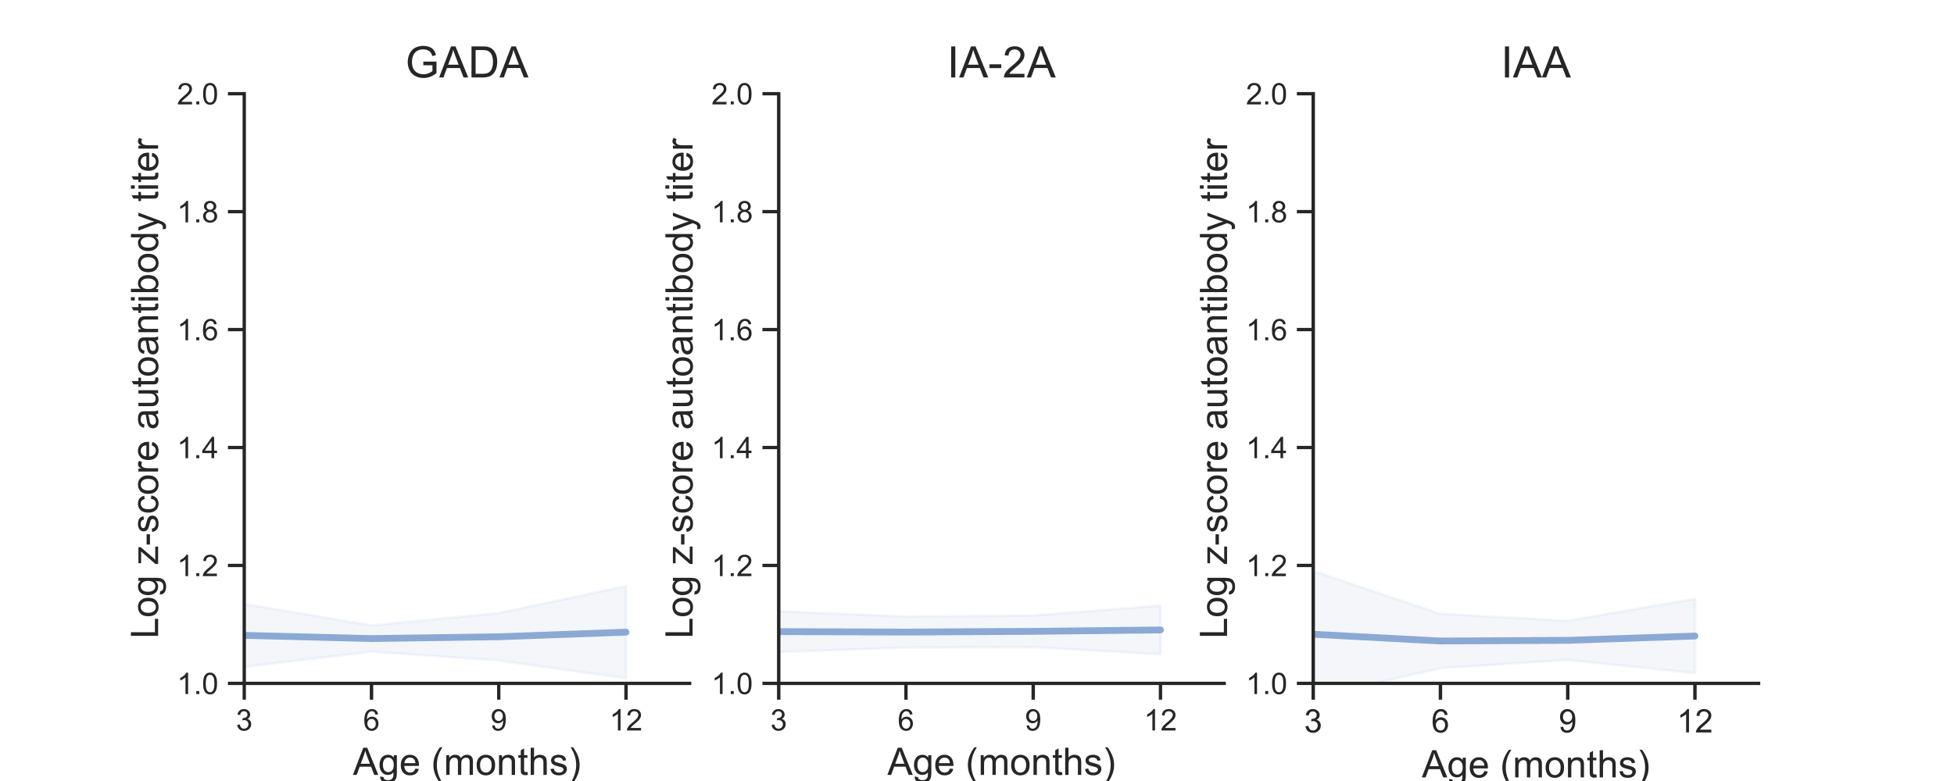
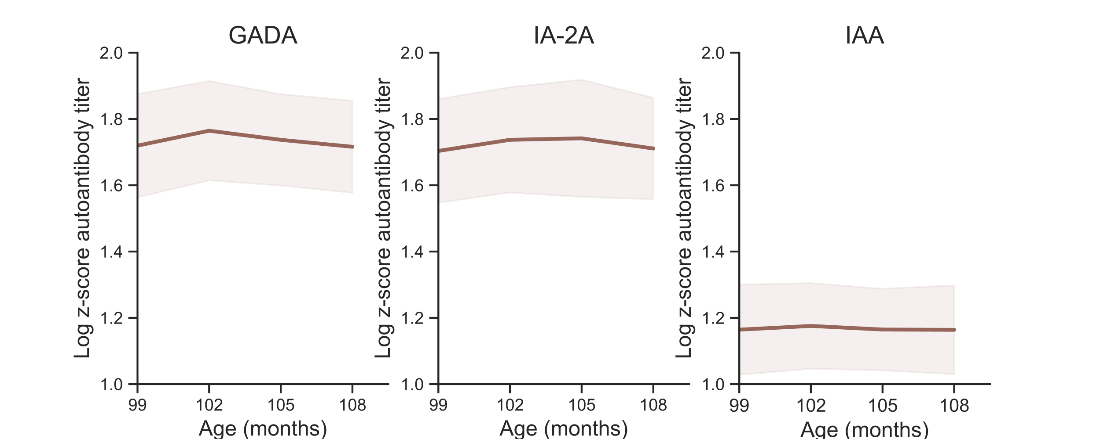
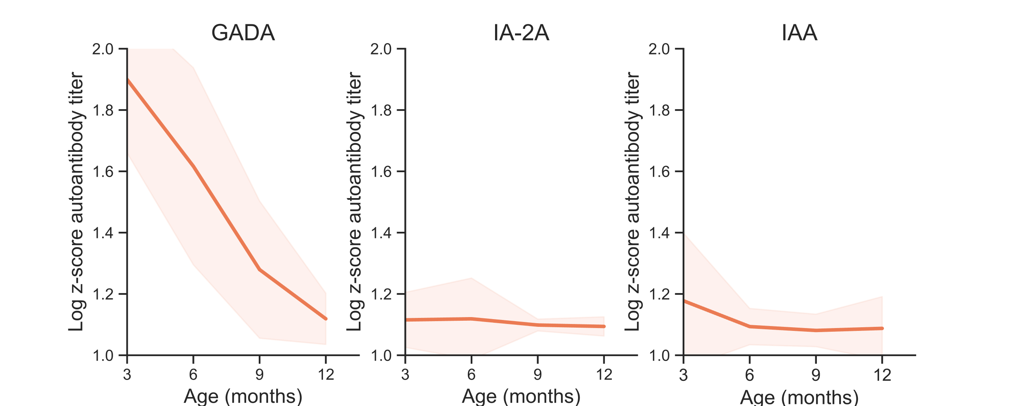
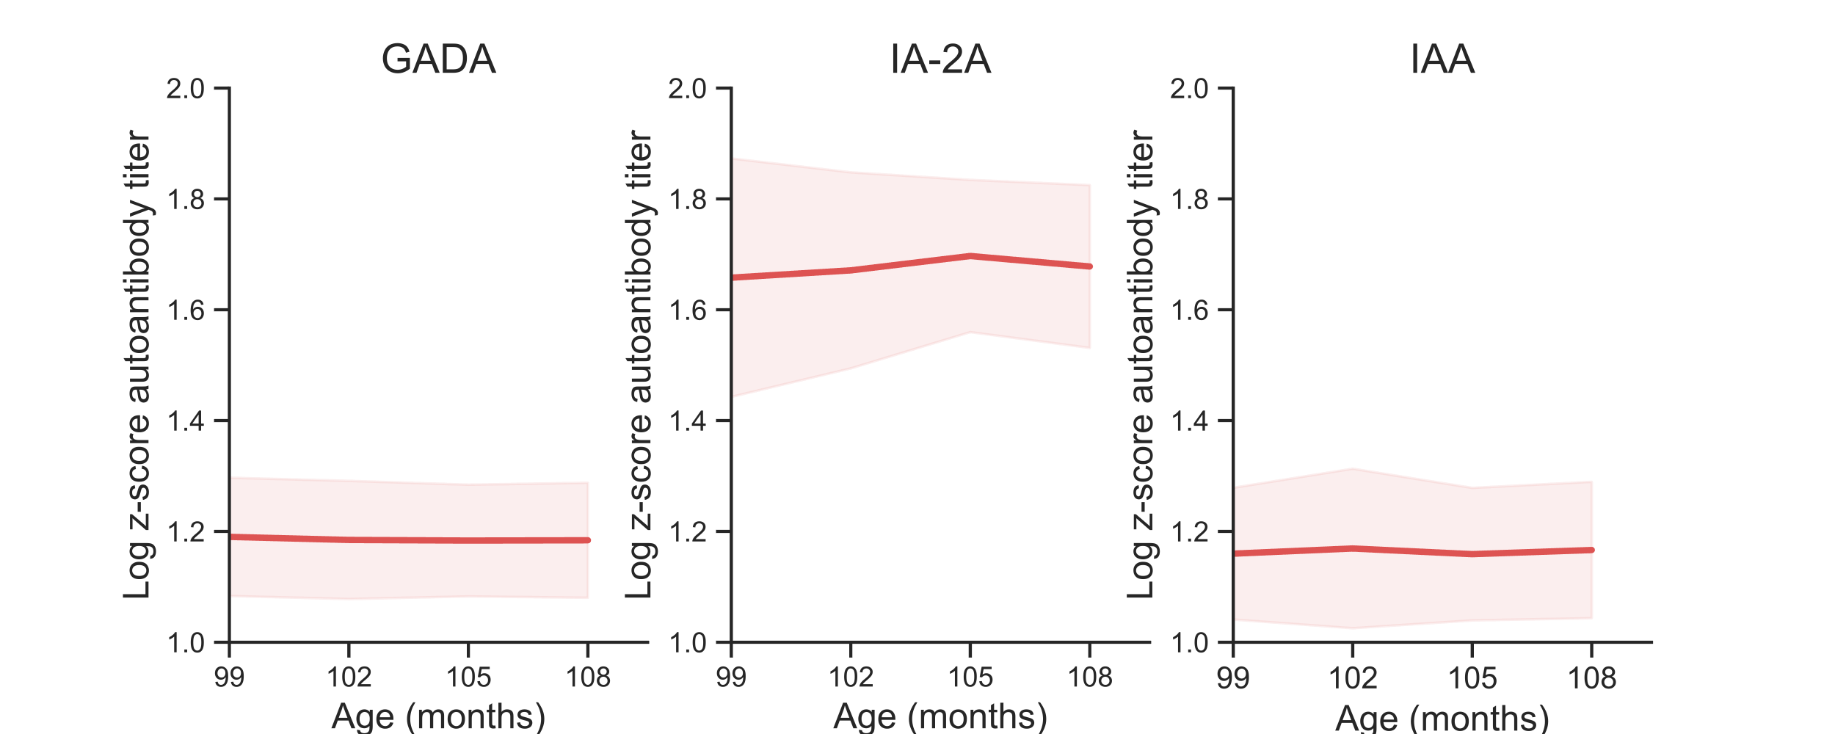
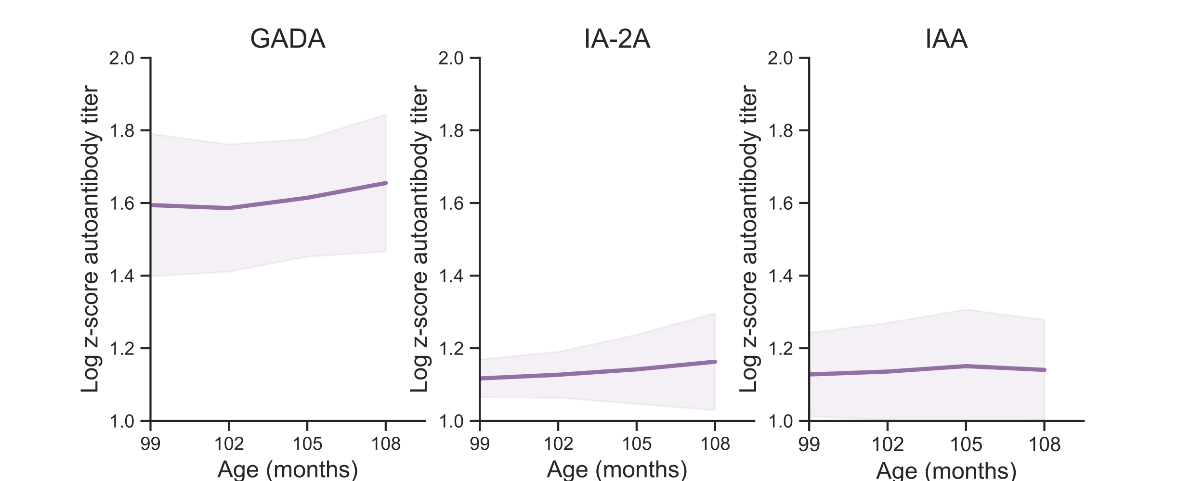
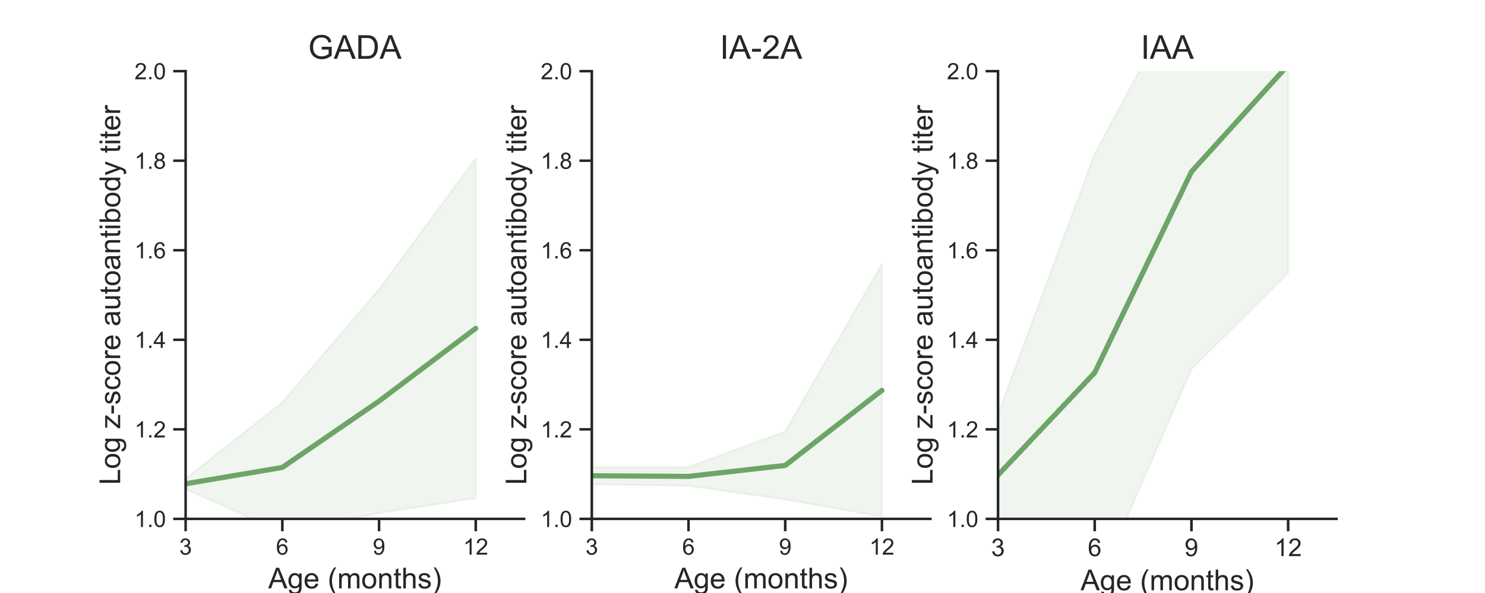
6 distinct clusters of islet autoantibody development emerged across ages 1 – 12
Baseline
clusters
All declining
clusters
All increasing
clusters
IA-2A dominant
clusters
GADA dominant
clusters
GADA & IA-2A dominant
clusters
(Mistry/Facelli et al., Diabetologia, 2023)
Notes:
Research Work: Briefly describe the research work conducted using repository data
High-level description of your research project(s), including the primary aims and knowledge gaps
How do the repository data accelerate medical breakthroughs and innovation in your research?

Slide 6
Clusters of islet autoantibody timing, type, and titer stratify risk for T1DM
Baseline
clusters
All declining
clusters
All increasing
clusters
IA-2A dominant
clusters
GADA dominant
clusters
GADA & IA-2A dominant
clusters
Year 1
(3 clusters)
Years 2 – 3
(2 clusters)
Years 4 – 8
(3 clusters)
Years 9 – 12
(4 clusters)
Year 1
Years 2 - 3
Years 4 - 8
Years 9 - 12
>20
10-20
T1DM Risk %
<10
(Graphical Abstract adapted from Mistry/Facelli et al., Diabetologia, 2023)
Notes:
Research Work: Briefly describe the research work conducted using repository data
High-level description of your research project(s), including the primary aims and knowledge gaps
How do the repository data accelerate medical breakthroughs and innovation in your research?

Slide 7
Islet autoantibody timing, type, & titer stratify risk for T1DM
Clinical Impact:
Age-dependent risk profiles may help to improve screening and enrollment in etiologic studies
Insights into delivery of preventative therapeutics
Novel opportunities to investigate why different antibody patterns despite similar genetic risk
Technical Innovation:
Unsupervised methods for analyzing multivariate temporal data
Linking machine learning with statistical methods for clinically-relevant insights
Notes:
Research Work: Briefly describe the research work conducted using repository data
High-level description of your research project(s), including the primary aims and knowledge gaps
How do the repository data accelerate medical breakthroughs and innovation in your research?

Slide 8
The role of repository data in my scientific career journey
Facilitation of Research:
PhD dissertation, “Temporal Machine Learning and Data Mining Methods for Diabetes Research”
Stratifying risk for onset of type 1 diabetes using islet autoantibody trajectory clustering, Diabetologia, 2023
Sequential data mining of infection patterns as predictors for onset of type 1 diabetes in genetically at-risk individuals, Journal of Biomedical Informatics, 2023
Career Journey:
Reaffirmed my interests in using advanced computational methods to understand T1DM etiology
Novel research directions in investigating identifying novel targets for molecular mimicry in T1DM
Notes:
Scientific Career Journey: Briefly describe your scientific research journey
How did access to repository data facilitate your research?
What impact, if any, it had on your career journey?

Slide 9
Helpful hints for future repository users
Data Structures:
Careful review of data dictionaries and understanding of data structures
Understanding of different data formats and conversion to analysis resources that fit your needs
Breath of Repository Data:
Multi-site studies across various disease pathologies
Role of Repository Staff:
Integrity of review process
Timely responses and contact with primary study coordinators
Notes:
Helpful Hints: List useful hints for (new) investigators seeking access to repository resources.

Slide 10
Mentors
Funding
Julio Facelli, PhD
Ramkiran Gouripeddi, MBBS, MS
Vandana Raman, MD
National Library of Medicine (T15LM007124)
National Institute of Diabetes and Digestive and Kidney Diseases (F30DK134113)
National Center for Advancing Translational Sciences (UL1TR002538)
Datasets
Resources & Facilities
University of Utah Center for High Performance Computing
Protected Environment - NIH Shared Instrumentation Grant (1S10OD021644-01A1)
https://diabetes.ufl.edu/teddy-study/
This research was performed under the auspices of the TEDDY study group, a collaborative clinical study sponsored by the National Institute of Diabetes and Digestive and Kidney Diseases (NIDDK), National Institute of Allergy and Infectious Diseases (NIAID), National Institute of Child Health and Human Development (NICHD), National Institute of Environmental Health Sciences (NIEHS), Juvenile Diabetes Research Foundation (JDRF), and Centers for Disease Control and Prevention (CDC).
The data from the TEDDY study reported here were supplied by the NIDDK Central Repository. This manuscript was not prepared in collaboration with Investigators of the TEDDY study and does not necessarily reflect the opinions or views of the TEDDY study, the NIDDK Central Repository, for the NIDDK. We did not receive funding support from the TEDDY study.
Disclosures
Some figures were generated using Servier Medical Art, licensed under a Creative Commons Attribution 3.0 unported license
Permission granted from Spring Nature for use of figures from PMID: 36446887

Slide 11
THANK YOU!
Questions?

