Slide 1

Founding of the NIDDK Repository
Rebekah Rasooly, PhD
September 2023

Slide 2
What led NIDDK to create sample and data repositories?
The 1990’s saw NIDDK increasing its support of large, multi-site clinical trials
In May 2001, NIDDK’s Council recommended creating central repositories so that other researchers could access the resources from these studies
Team effort - The planning group and NIDDK steering group always included representatives from all 3 NIDDK Divisions.

Slide 3
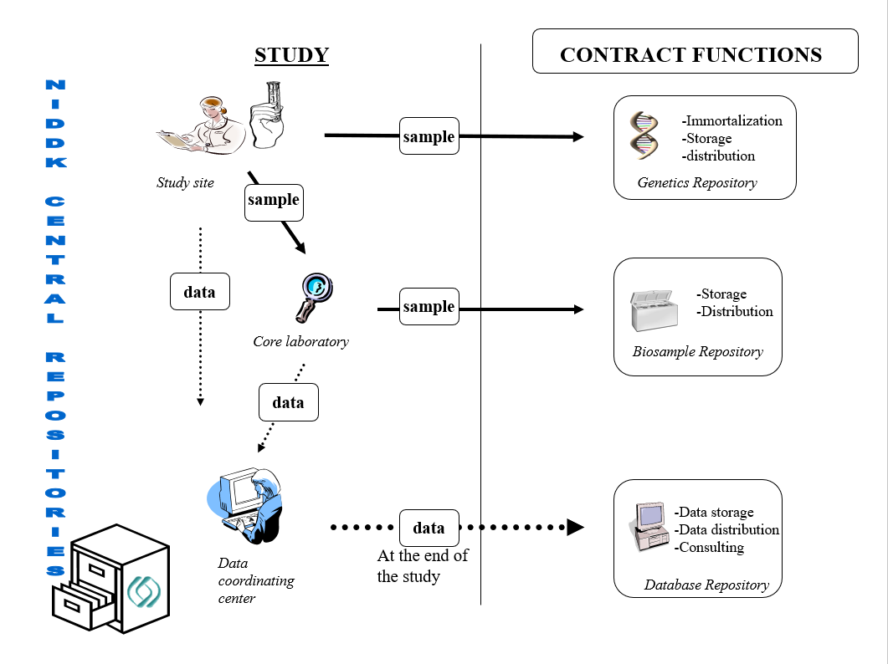

Slide 4
Very, very, very brief history
The first 3 contracts were awarded in 2003, for separate Data, Biosample and Genetics repositories.
The contracts were renewed several times.
Funds from ARRA were used in 2010 to expand the capacity of the repository
In 2016, the Biosample and Genetics repositories were merged into a single entity

Slide 5
The biggest challenges in 2003
Developing model informed consent and RFA language
Developing governance policies
AND
Persuading studies to reposit samples and allow them to be shared. Started with 0 samples!

Slide 6
By 2016 – the Repositories caught on
Storage equipment (2016)
Current sample total in 2023 = 16,226,349

Slide 7
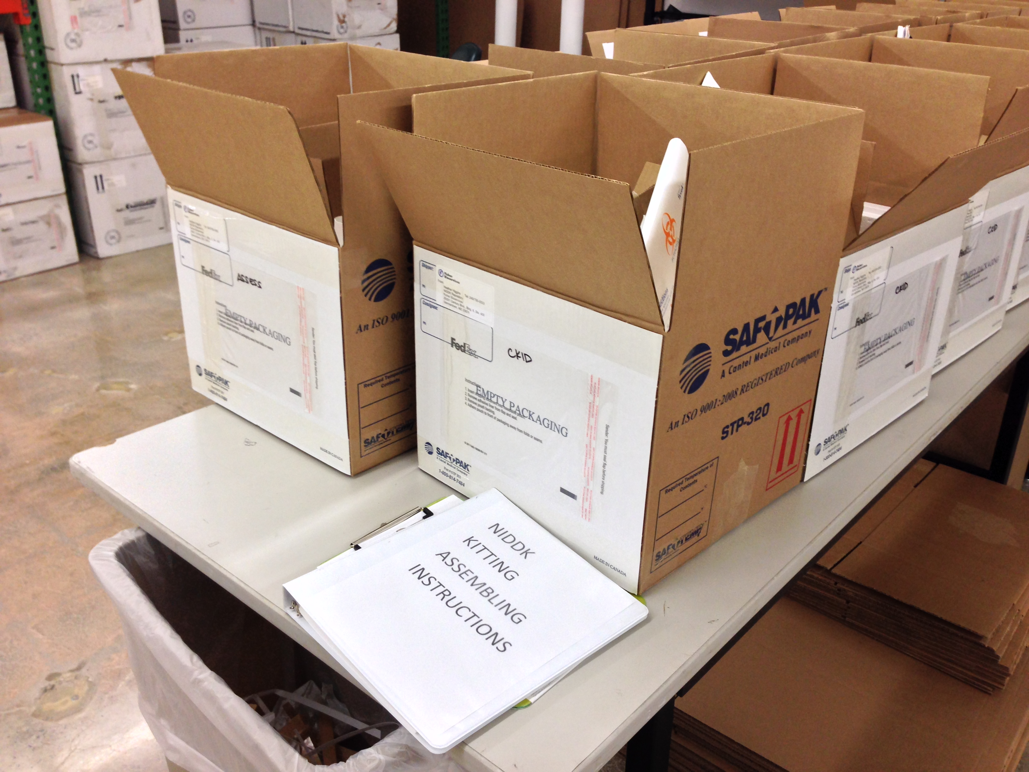
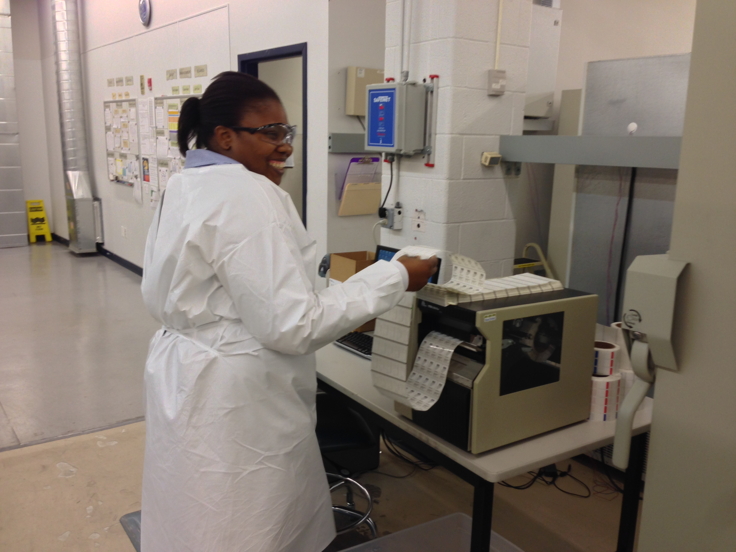
The biggest challenges in the sample repository 2016
Providing custom service to studies (including labels and kits)
Reviewing consents to ensure that submitted samples were eligible for sharing and creating a searchable record keeping system (>75 studies, some with >100 sites)

Slide 8
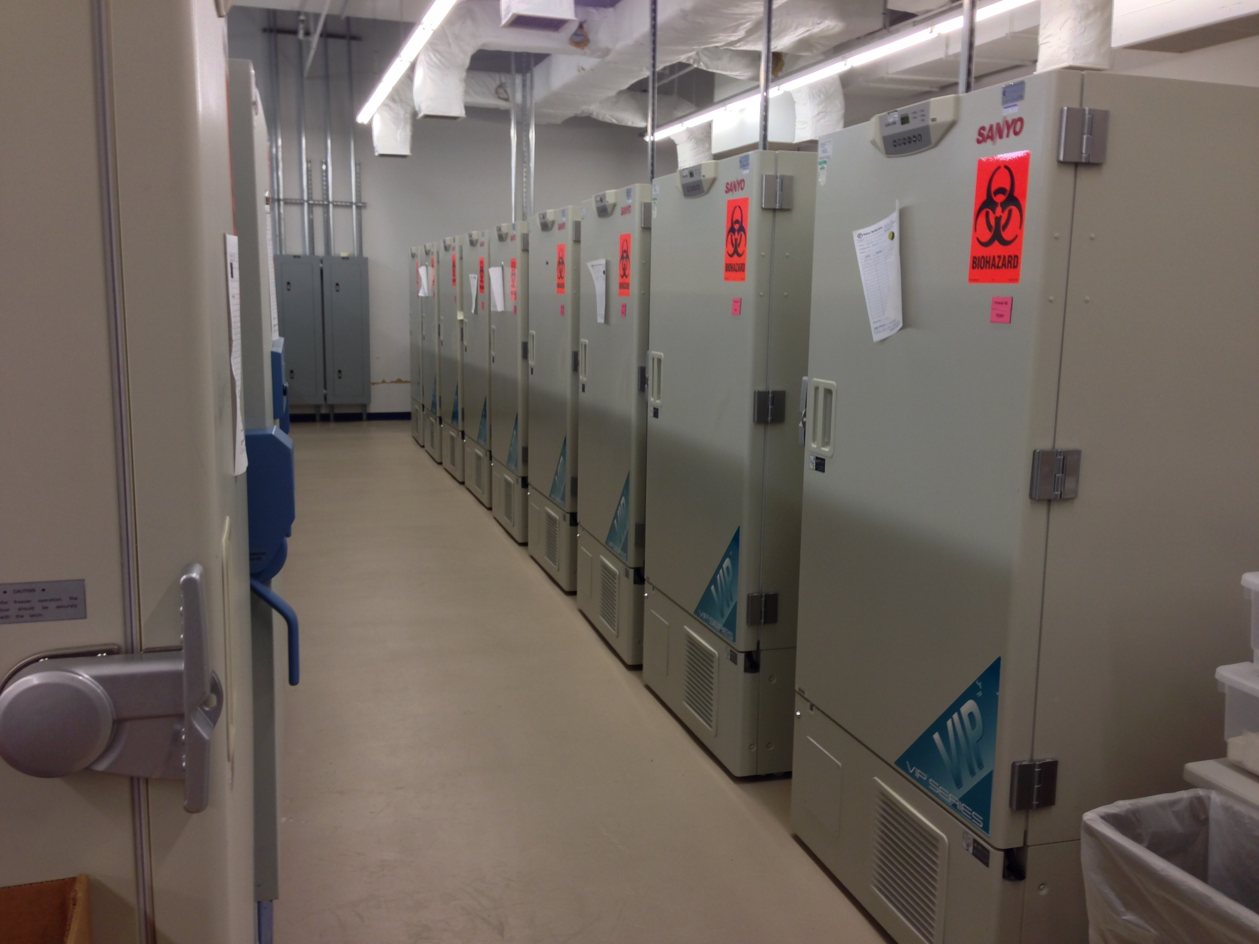
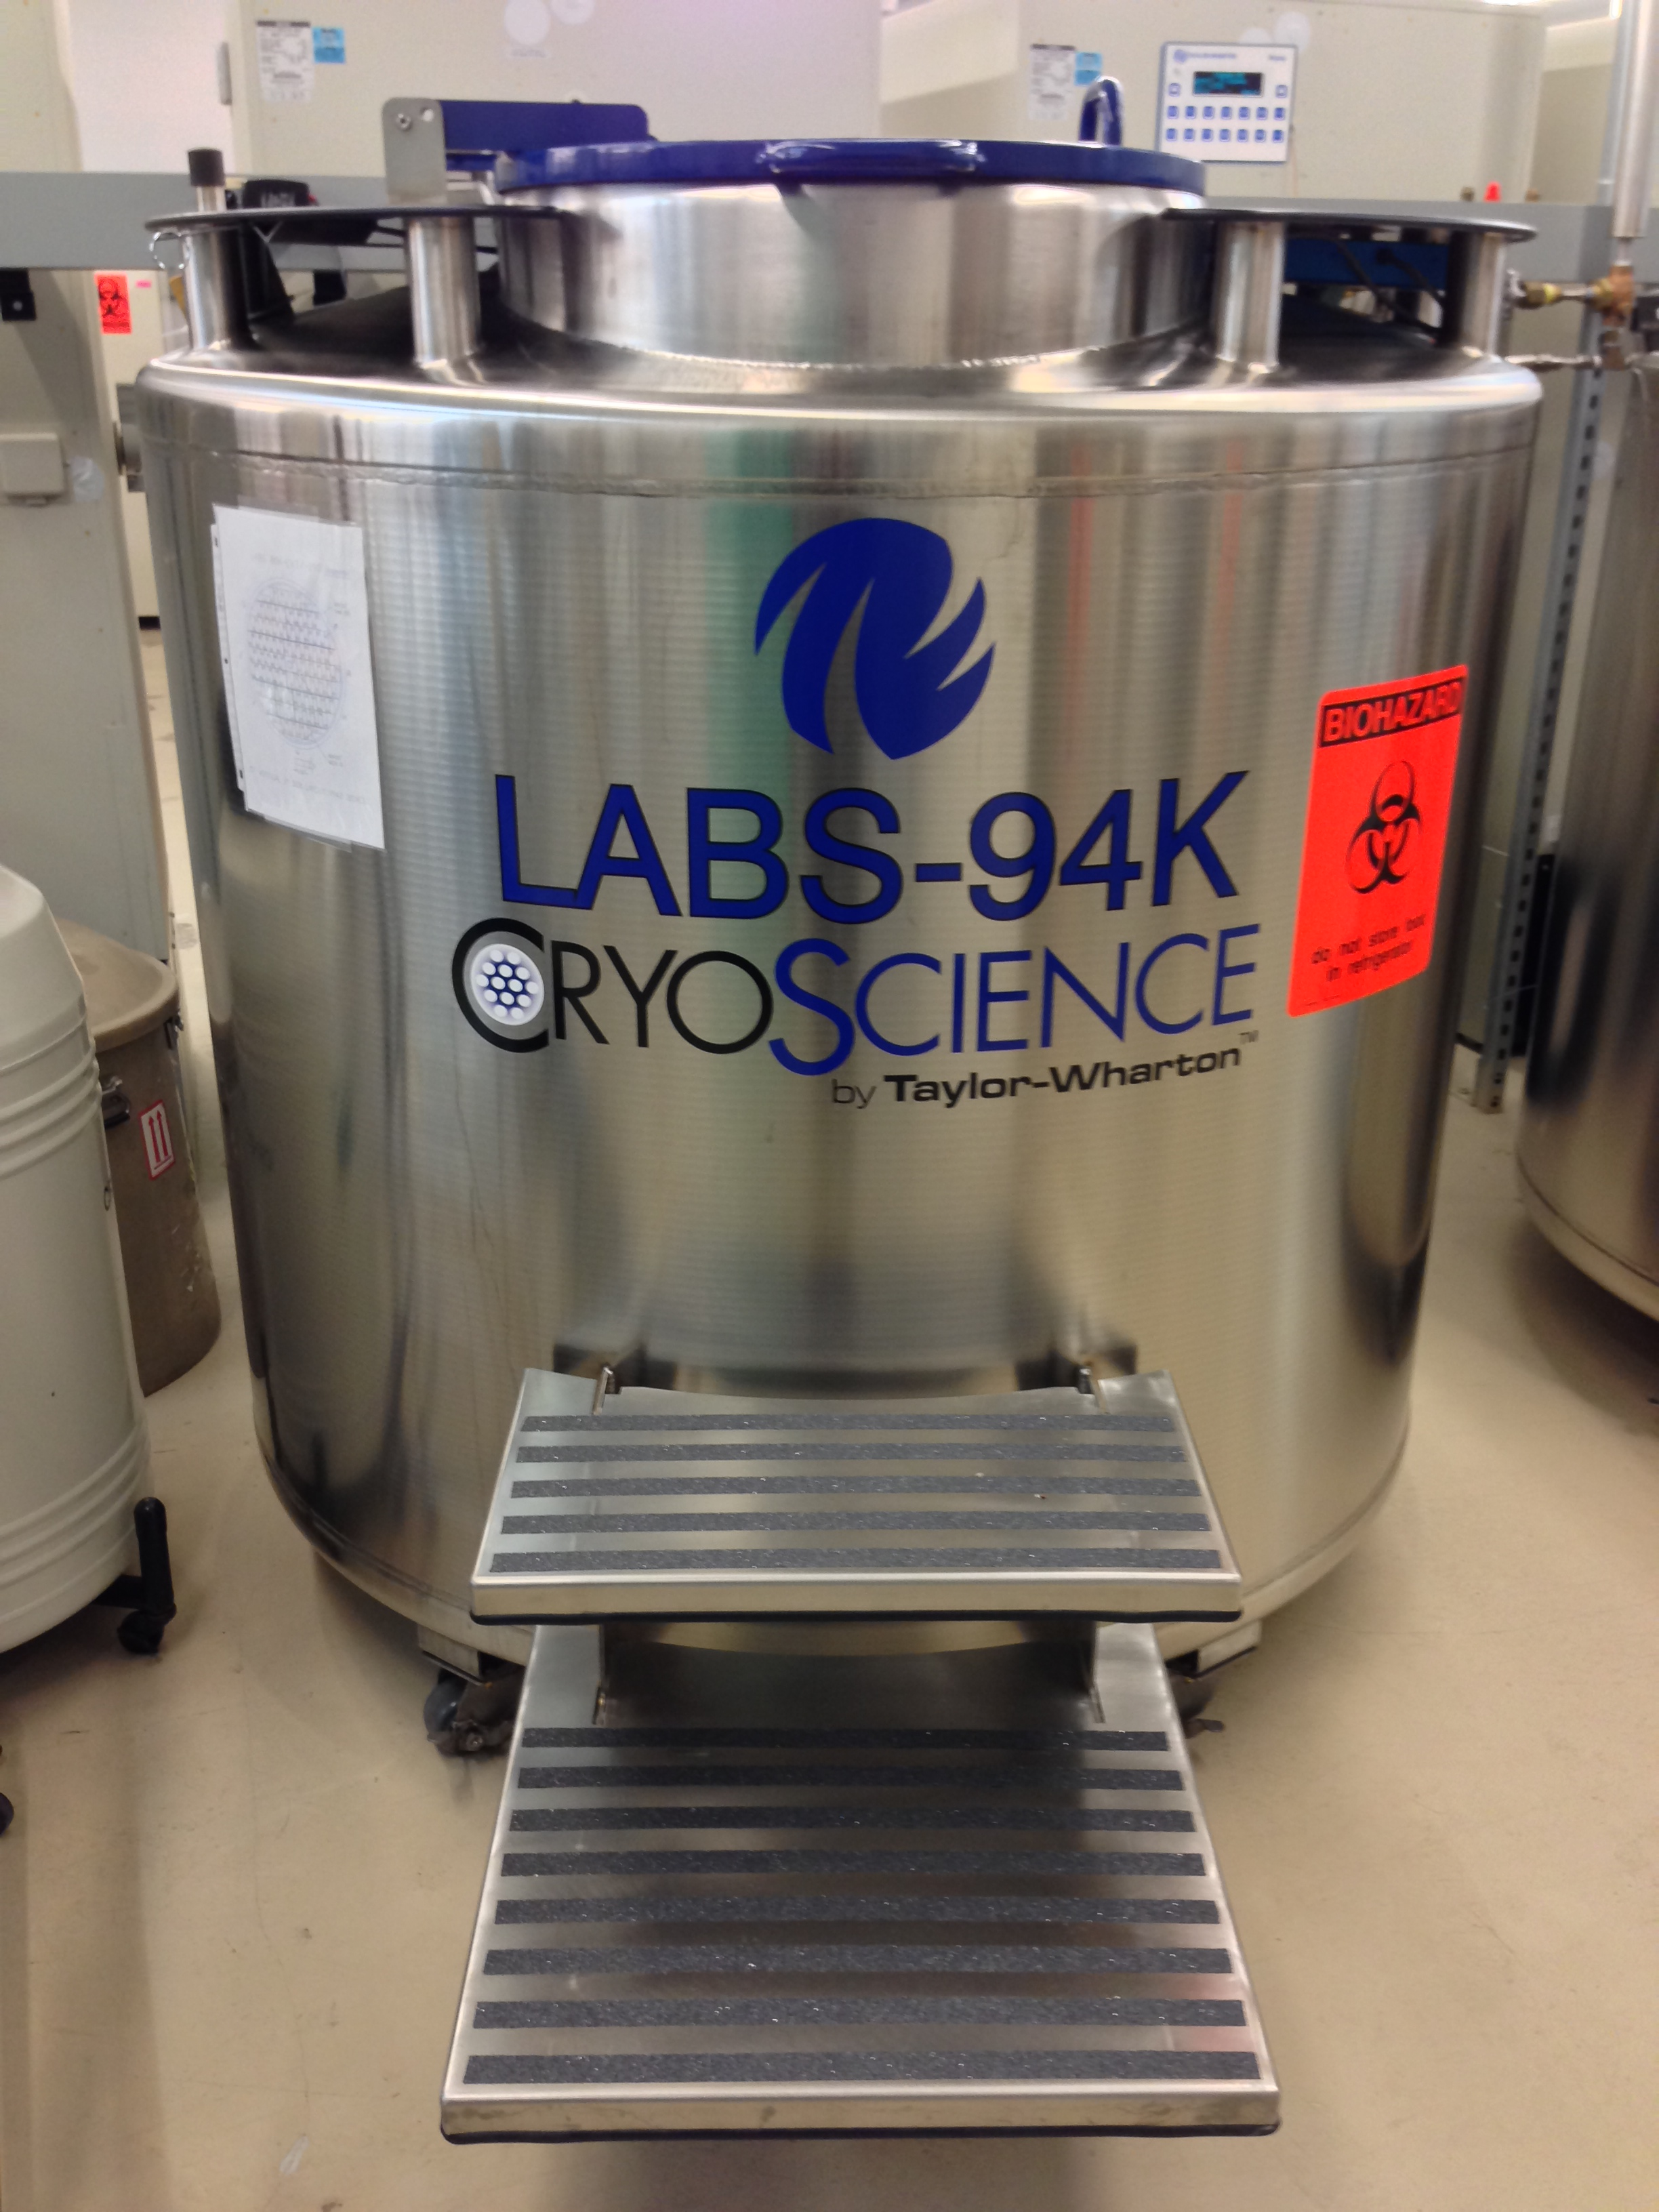
The biggest challenges in the sample repository 2016 (cont.)
Too many samples!
And too little interest in using the samples
Fulfilled requests

Slide 9
Opportunities for repositories going forward
Making a larger amount of data more searchable and accessible, even to non-specialists
Identifying opportunities to use samples for significant research
Creating virtual catalogues to facilitate searching collections across different repositories

Slide 10

The Repository team from 2001 - 2017

Slide 11
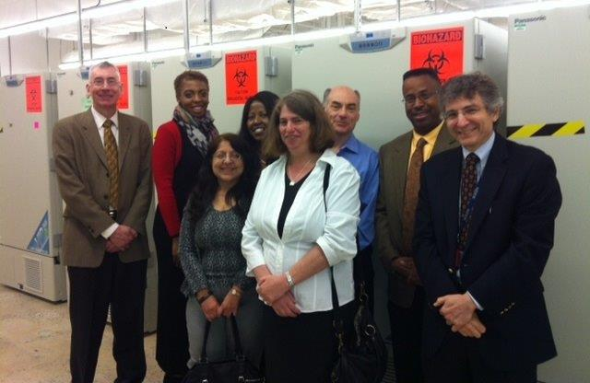
Thanks all!

