Slide 1

Use of the NIDDK repository resources to uncover a new pathway for cardiovascular disease complications in type 1 diabetes
Myra Lipes, MD
Joslin Diabetes Center, Harvard Medical School

Slide 2
Overview
Study collection: DCCT/EDIC (Diabetes Control and Complications Trial/ Epidemiology of Diabetes Interventions and Complications) study
Resources: Serum, genomic DNA, clinical datasets
Type of work: Mechanistic, pathogenic processes
Access pathway: R01 DK103609: “Cardiac Autoantibodies as Biomarkers of Heart Disease in Type 1 Diabetes”

Slide 3
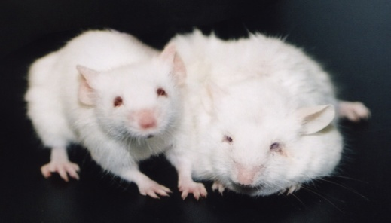
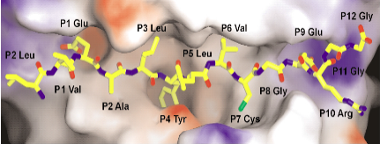
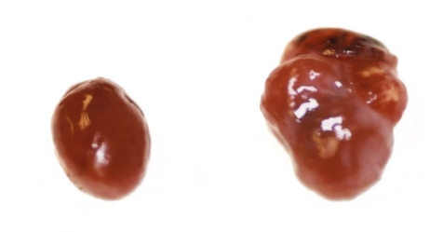
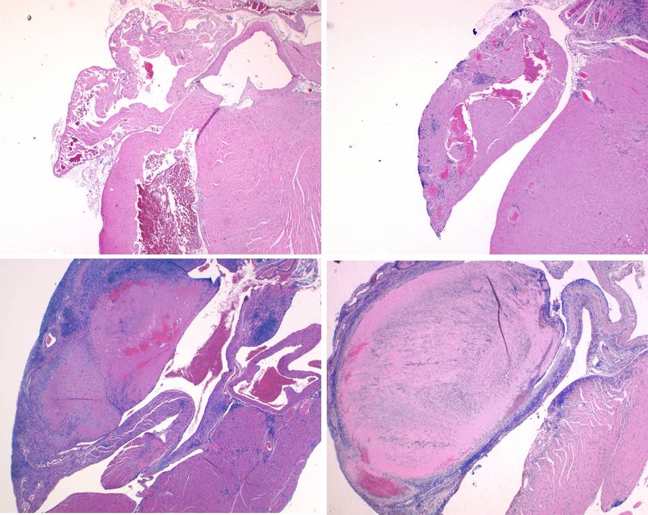
Background: What led to these studies?
Original goal: Create a humanized transgenic mouse model of T1D
Unexpectedly, DQ8⁺NOD mice died prematurely from heart failure
HLA DQ8
mII^{-/-}
DQ8⁺mII^{-/-}
DQA1*0301
DQB1*0302
DQ8
DQ8: Postulated to direct the autoimmune attack to pancreatic β-cells
Insulin peptide
Lee, Nat Imm 2001
Dilated
heart
Normal
heart
Transgenic DQ8⁺mII^{-/-} NOD mice
Autoimmune
myocarditis
=
Autoimmune diabetes?
NOD = Nonobese diabetic

Slide 4
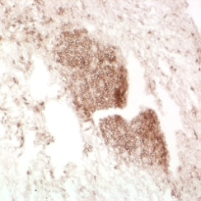
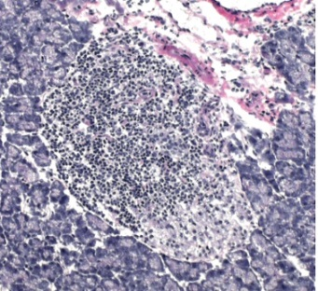
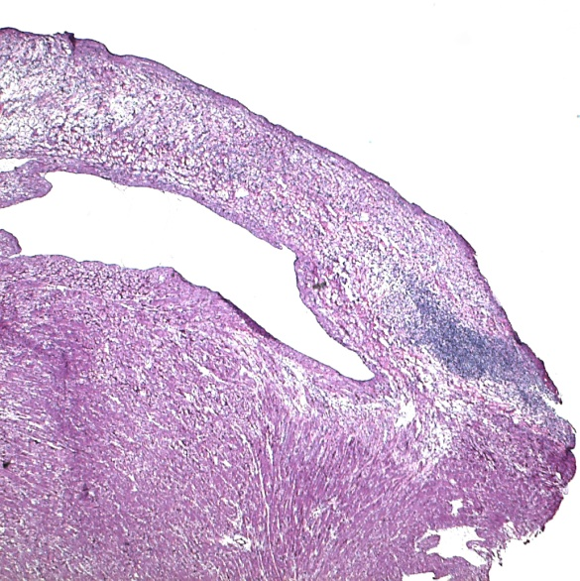
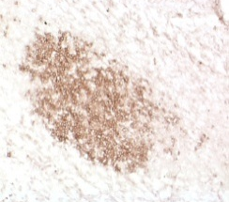
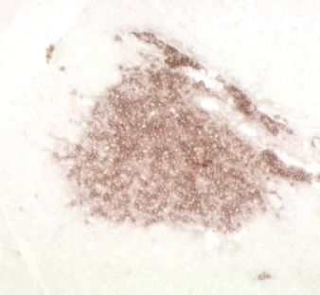
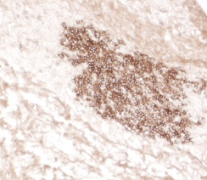
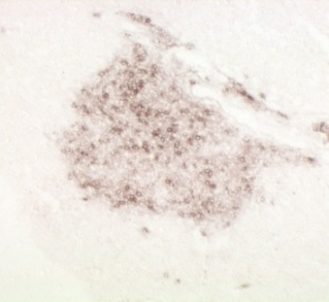
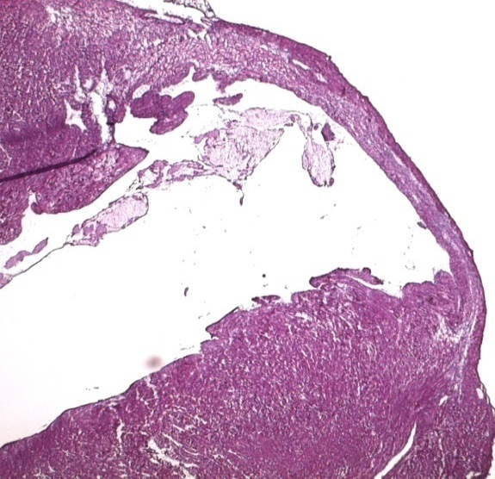


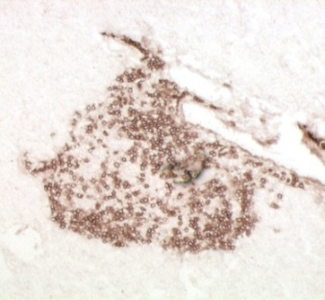

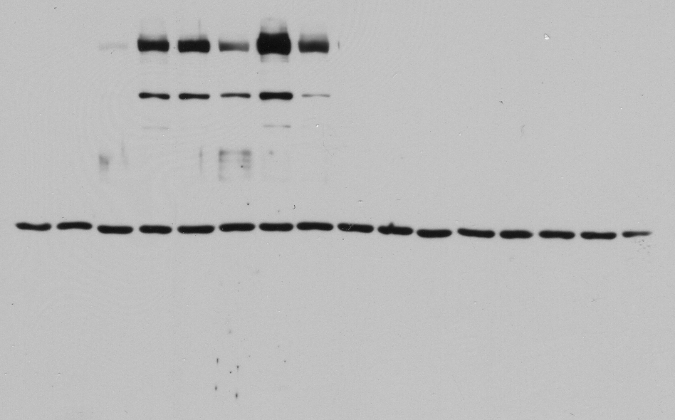
Experimental myocardial infarction (MI) induces
cardiac autoimmunity in NOD mice
“Autoimmune diabetes inflames the heart”
NOD pancreas
Cardiac Autoantibodies
NOD heart
Western blots of heart lysates
Infarct expansion
Insulitis
NOD sera
CD4
Pre-MI
Post-MI
kD
#1
#2
#1
#2
#3
#4
#5
#6
250
CD8
150
Similar lymphocytic composition
100
CD4
B220
Control B6 heart
Control B6 sera
Normal infarct
Pre-MI
Post-MI
CD4
kD
#1
#2
#1
#2
#3
#4
#5
#6
CD8
250
150
CD8
100
B220
B220
Gottumukkala et al. Science Translational Medicine 2012
Notes:
4
TO FURTHER EXPLORE THIS WE EXPERIMENTALLY INDUCED MYOCARDIAL INFARCTON IN NOD MICE WHO DO NOT SPONTANEOUSLY DEVELOP MYOCARDITIS .
This slide shows histology though the infarct zone. For orientation, the bottom left panel shows a normal infarct healing with a scar formation
From a B6 control mouse. In contrast, the infarcts from NOD mice were edematous and expanded, with dense lymphocytic infiltrates in the periinfarct zone known to be key role in infarct healing. Immunohistochemical analyzis showed that the cellular composition –CD4 T cells, CD8 T cells and B200 B cells mirrors the composition of native insulitis lesions of the same NOD mice

Slide 5
Created a panel of assays for cardiac autoantibody detection
in humans
Fluid-phase radiobinding assay format, the ‘gold-standard’ format for measuring islet autoantibodies in T1D
Cardiac antigen panel:
MYH6 (encodes full-length α-myosin), the primary/initiating autoantigen in DQ8⁺NOD myocarditis (Lv, JCI, 2011)
S1-MYH6
S2-MYH6
4. MYH7 (encodes full-length β-myosin)
5. cTnI (cardiac troponin I)
S2-MYH6
S1-MYH6
25,000
50,000
20,000
MYH6
~220 Kd
Discovered a high prevalence of cardiac autoantibodies
in ischemic cardiomyopathy patients with T1D, but not T2D
Gottumukkala et al. Sci Trans Med 2012
Notes:
WE NEXT DEVELOPED A NOVEL……………………………………………..TO EXAMINE CARDIAC AUTOIMMUNITY IN PATIENTS
Our cardiac Ab assays were modelled on the widely used ….and described before in the references below encompass:
-a-MyHC which is the dominant autoantigen in humanized DQ8+NOD mouse model of myocarditis and patients with myocarditis (Lv JCI 2011).
Because of its immense size (220kd) and known hydrophobicity and our interesting in capturing reactivity in as many patietns as possible we also examined responses to smaller overlapping S1 and S2 fragments of Mysoin
-B MyHC is the most abundant myosin expressed in heart muscle comprising over 90% of the total myosin
-cardiac troponin I – another major cardiac muscle protein

Slide 6
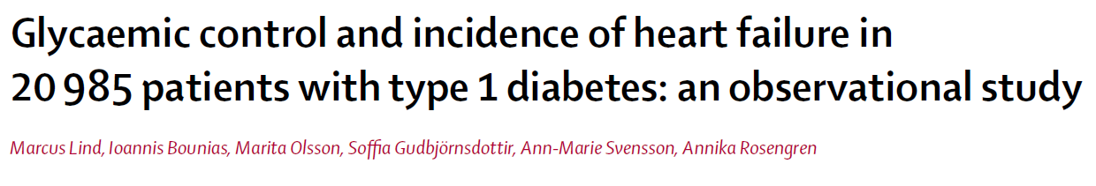
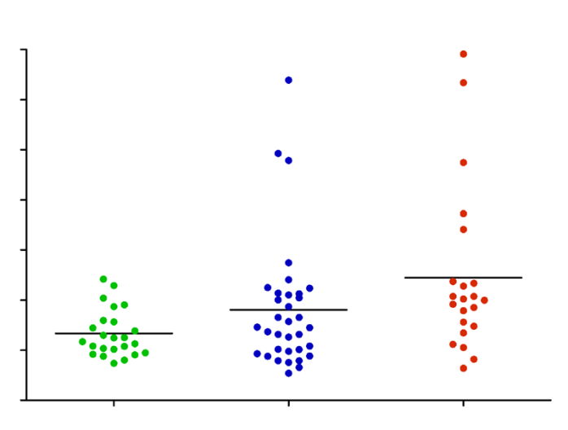
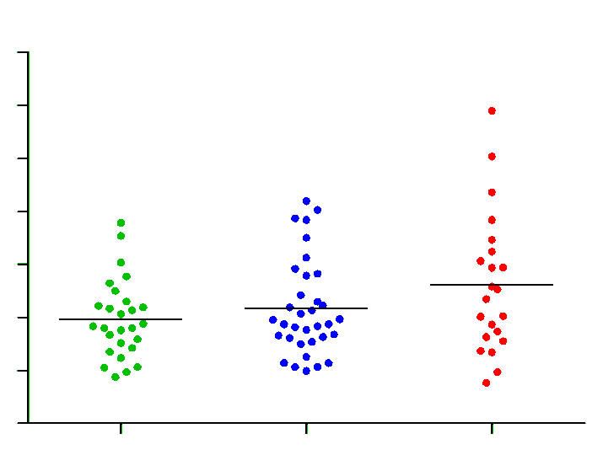

A surprising finding:
Cardiac AAb positivity in young adults with T1D and poor glycemic control
20
41–45 years
P = 0.003
3.5
15
3.0
It-95*
41–45 years
2.5
It-24*
10
2.0
It-91*
MYH6-S1 AAb index
1.5
5
1.0
0.5
0
0
Adjusted incidence of heart failure
per 1000 patient-years
40
3.5
56–60 years
3.0
30
2.5
It-91*
2.0
It-24*
It-95*
cTnI AAb index
20
1.5
1.0
10
0.5
0
8.1-8.5 8.6-9.5 >9.5 HbA1c (%)
0
6
7
8
9
10
11
(n=24) (n=34) (n=22)
HbA1c (%)
Alfonso Galderisi, Lipes lab
Notes:
In our previous MI studies we used healthy control subjects; however, the ideal control would be T1D without CVD. Unexpectedly in studying a cohort of young adult patients seen in an outpatients clinic, we noticed that a subset of patients with the poorest glycemic control had cardiac Aabs. Furthermore the same T1D subjects were positive for two different AAb specificities.
Swedish registry-based studies suggest that HF is associated with poor glycemic control a stepwise fashion, with an inflection at the highest H1c levels . Similar trend in AAb increasing at the highest A1c levels..

Slide 7
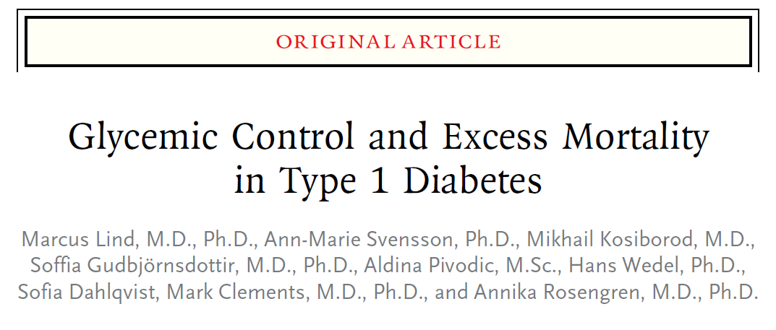

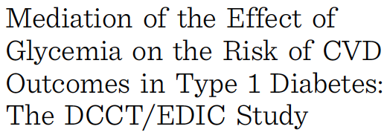


“For patients with diabetes who had very poor glycemic control, the risks of death from any cause and of death from cardiovascular causes were 8 and 10 times as high, respectively, as those in the general population.”
Only ~50% of the effect of hyperglycemia on the risk of CVD in the DCCT/EDIC cohort was explained by traditional risk factors
Could cardiac autoimmunity be a “missing link” between poor glycemic control and excess CVD risk in patients with T1D?
Notes:
There is evidence from population based Swedish registry studies that poor glycemic control increase the risk for….
In addition…

Slide 8
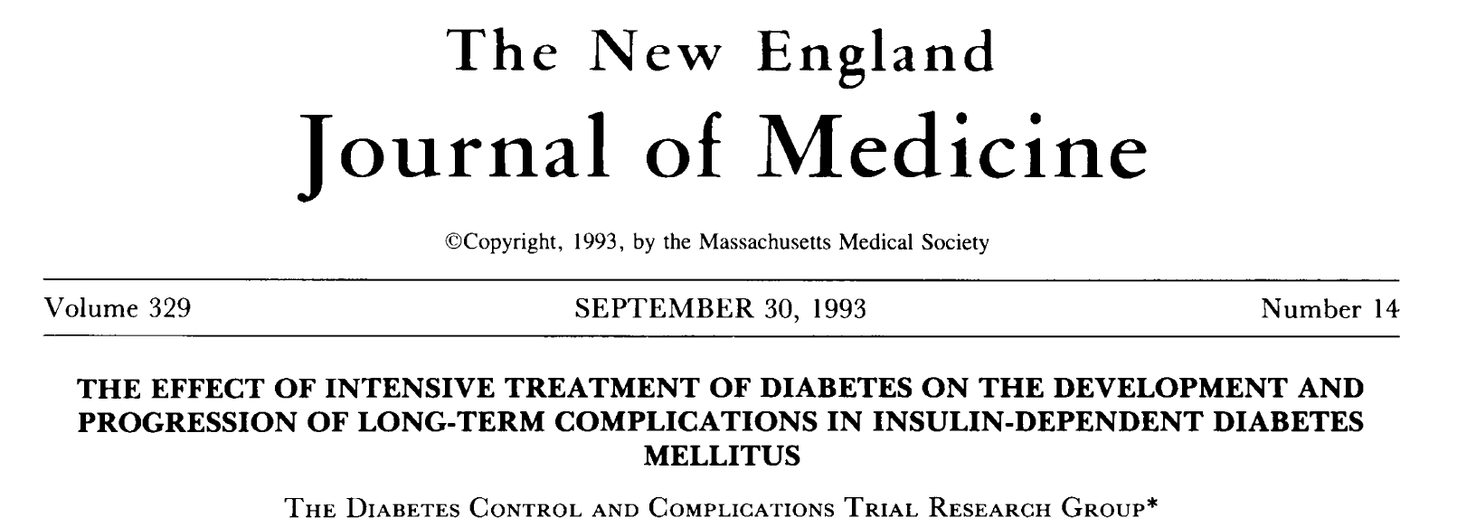
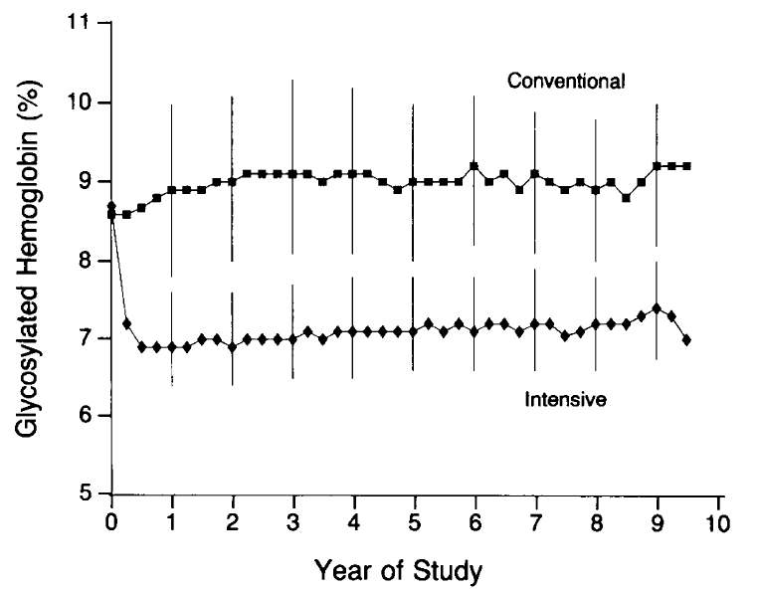
How to best define a possible association between
glycemic control and cardiac autoimmunity in T1D?
Unique advantages of the DCCT cohort:
The two treatment groups achieved markedly different mean A1C levels during the DCCT
The Primary Prevention cohort was relatively healthy, young (mean, 27 y) with a short duration of T1D (mean 2.6 y) and devoid of diabetes complications at baseline
Availability of longitudinal serum samples from the DCCT and rich clinical datasets with a 30-yr follow-up from the NIDDK CR
Mean A1c=9.1%
Mean A1c=7.2%
Notes:
Availability of longitudinal samples...Provided a unique opportunity to test this hypothesis…

Slide 9

Study Design
DCCT Primary Prevention Cohort
n=726
Contact the NIDDK CR support staff as early as possible to assess sample availability
Exclusions:
Diabetic kidney disease or CVD events during the DCCT
711 eligible participants
367 CONV treatment group/344 INT treatment group
CONV treatment group:
mean HbA1c ≥9.0% during the DCCT
INT treatment group:
mean HbA1c ≤7.0% during the DCCT
191 participants
163 participants
Sample availability
and
1:1 case/control matching
83 cases
234 longitudinal samples
83 controls
266 longitudinal samples
Special thanks to the NIDDK CR staff

Slide 10
Apart from HbA1c levels, the two groups had similar CVD risk factors at the beginning and end of the DCCT
Characteristic | DCCT baseline (1983–1989) |  | P value | DCCT closeout (1993) |  | P value
 | HbA1c ≤7.0% (n=83) | HbA1c ≥9.0% (n=83) |  | HbA1c ≤7.0% (n=83) | HbA1c ≥9.0% (n=83)
Age, yr | 28±6 | 26±7 | 0.03 | 34±6 | 32±7 | 0.04
Male sex (%) | 46 (55) | 46 (55) | 1.00 | 46 (55) | 46 (55) | 1.00
Diabetes duration, yr | 2.5±1.2 | 2.5±1.4 | 0.86 | 7.8±1.9 | 7.9±2.3 | 0.63
HbA1c, % | 8.0±1.2 | 9.1±1.4 | <0.001 | 6.5±0.3 | 10.0±0.7 | <0.001
Current smoker, (%) | 13 (16) | 14 (17) | 0.83 | 10 (12) | 15 (18) | 0.26
Body-mass index, kg/m² | 23.1±2.5 | 24.0±2.8 | 0.03 | 25.3±3.0 | 25.4±3.2 | 0.84
Blood pressure, mm Hg
Systolic | 114±12 | 114±11 | 0.89 | 114±11 | 116±11 | 0.16
Diastolic | 72±8 | 73±9 | 0.43 | 73±9 | 75±8 | 0.09
Hypertension, (%)* | 0 | 0 |  | 4 (5) | 1 (1) | 0.17
Lipids
HDL cholesterol, mg/dl | 52±13 | 52±13 | 0.91 | 52±13 | 53±13 | 0.61
LDL cholesterol, mg/dl | 111±33 | 108±28 | 0.47 | 110±25 | 114±28 | 0.36
Total cholesterol, mg/dl | 176±36 | 173±33 | 0.58 | 177±28 | 184±33 | 0.16
Triglycerides, mg/dl | 68±25 | 69±25 | 0.74 | 75±38 | 83±50 | 0.22
Hyperlipidemia, (%)† | 0 | 0 |  | 16 (19) | 21 (26) | 0.33
Microalbuminuria, AER (%)‡
30 to <300 mg/24 hours | 0 | 0 |  | 1 (1) | 4 (5) | 0.17
Sousa et al. Circulation 2019
Notes:
I would like to point out that ideal..short duration of T1D, young heatlhy with no hypertension, hyperllipdemia or macroalbuminuria. The development of cadiac autoimmunity could be analyzed in the absence of potential CVD confounders…

Slide 11
Temporal dynamics of cardiac autoantibody expression during the DCCT
Mean S1-MYH6 AAb levels
HbA1c ≥9.0% group
Mean AAb Index
HbA1c ≤7.0% group
DCCT year
Mean HbA1c levels
HbA1c ≥9.0% group
Mean HbA1c level (%)
HbA1c ≤7.0% group
DCCT year
Sousa et al. Circulation 2019
Notes:
The impact of glycemic control on cardiac Aab expression was demonstrated by several findings. This slide shows the trajectory of cardiac myosin AAb levels over time in DCCT, exemplied by S1 =MYH6 AAb with modest differences in both groups at year 1 and then divergence with progressive increase in AAb ttiier in the >9% group and decrease in titers in the A1c grou, Signifcanc relationship between the level of cardiac AAb, thhe group (A1c,
As shown in the bottom panel over course of DCCT clear separation in A1c
Mirroring the mean A1c levels in the respective groups. …

Slide 12
Prevalence and profiles of cardiac autoantibodies
Number of cardiac AAb
51%
46%
Percent positive
22%
20%
11%
10%
8%
7%
2%
4%
4%
1%
1%
HbA1c ≤7.0%
n=83
HbA1c ≥9.0%
n=83
Chagas
Cardiomyopathy
n=51
HbA1c ≤7.0%
n=140
HbA1c ≥9.0%
n=70
Controls
n=115
Type 1 diabetes
DCCT
Type 2 diabetes
Joslin Heart Study
Young adult DCCT participants with poor glycemic control showed similar AAb profiles to a heart failure cohort with Chagas cardiomyopathy
No relationship between glycemic control and cardiac AAbs in patients with type 2 diabetes
Sousa et al. Circulation 2019
Notes:
This first shown here is the prevalcne of AAb. Note that in the A1c>9% group, 46% patients tested posotive for 1 AAb and 22% for 2 or more compared to just 2% and 1% of subjects in the A1c <7.0% group,,,,,Unexpectedly, prevalence was similar to a positive control with Chagas cardiomyopathy, which is a form of chrnomc myocrditis. In contrast there was no relationship between glycemic control and the number of AAb in patient with T1D in Alesandro’s Joslin Heart Study

Slide 13
Unexpectedly, the T1D DCCT participants with the highest titers and numbers of cardiac AAbs developed CVD events decades later
S1-MYH6
S2-MYH6
cTnI
Masked ID | CVD event | Years from first positive AAb test
1109 | CABG | 26
714 | CVD death | 25
1319 | Acute MI | 25
325 | CABG + HF | 20
635 | CABG | N/A*
P<0.001
P<0.001
P<0.001
714
325
1109
1319
714
Mean AAb Index
714
325
1109
A1c≤7.0%
A1c≥9.0%
A1c≤7.0%
A1c≥9.0%
A1c≤7.0%
A1c≥9.0%
†Dotted lines show the 99th percentile cutoffs for AAb positivity
The single fatal CVD event occurred in the only DCCT
participant to test positive for all 5 cardiac AAbs
Sousa et al. Circulation 2019

Slide 14
How could cardiac autoimmunity be linked to increased risk of atherosclerotic CVD outcomes?
?
Systemic
inflammation:
↑hsCRP?
↑ Coronary artery ...calcium
↑ CVD events
Cardiac autoimmunity
High-sensitivity C-reactive protein levels were measured during EDIC years 4−6
(NIDDK CR dataset: inflammatory_markers_musc.sas7bdat)
Notes:
How could cardiac…?
There is evidence that other autoimmune conditions such as rheumatoid conditions are associated with increased CVD, thought to be mediated by increased systemic inflammation, associated with hsCRP levels
hsCRP measured at…provided us with opportunity to investigate this hypothesis

Slide 15
No difference in hsCRP levels between the two DCCT HbA1c groups
P=0.34
Serum hsCRP (mg/L)
A1c ≤7.0
(n=67)
A1c ≥9.0%
(n=62)
Sousa et al. Circulation, 2019
Notes:
This slide shows subsequnet hsCRP levels in follow-up EDIC
As shown here, there was no difference in subsequent hsCRP levels between the two HbA1c groups simialr to a previous DCCT/EDIC study which was published in Circulation. In contrast, participants positive for ≥2 AAb showed substatially iigher hsCRMp levels with a median of 6 mg/L, compared to patients with ≤ 1 Aab had levels of 1.4
No significant difference between subsequent hsCRP levels in the two DCCT A1c groups

Slide 16
Positivity for ≥2 cardiac AAbs was associated with markedly elevated hsCRP levels
P=0.34
P=0.003
Serum hsCRP (mg/L)
Serum hsCRP (mg/L)
median, 6.0 mg/L
median, 1.4 mg/L
A1c ≤7.0
(n=67)
A1c ≥9.0%
(n=62)
≤1 AAb
(n=114)
≥2 AAbs
(n=15)
Suggests that subclinical inflammation may link cardiac AAbs to CVD outcomes
Sousa et al. Circulation, 2019
Notes:
This slide shows subsequnet hsCRP levels in follow-up EDIC
As shown here, there was no difference in subsequent hsCRP levels between the two HbA1c groups simialr to a previous DCCT/EDIC study which was published in Circulation. In contrast, participants positive for ≥2 AAb showed substatially iigher hsCRMp levels with a median of 6 mg/L, compared to patients with ≤ 1 Aab had levels of 1.4
No significant difference between subsequent hsCRP levels in the two DCCT A1c groups

Slide 17
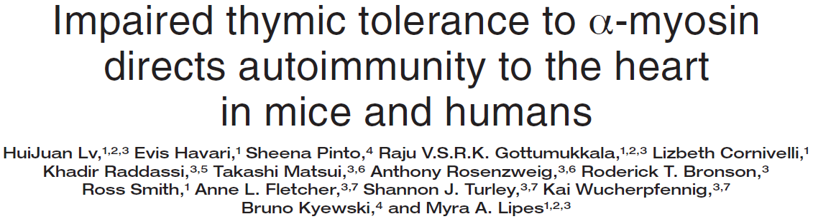
Proposed scheme of the relationship between hyperglycemia, cardiac autoimmunity, and increased CVD risk in T1D
Factor
Postulated consequence
At-risk individuals
A
Lack of thymic (‘central’) tolerance
to α-myosin (MYH6)
General population
Peripheral blood enriched in CD4⁺ T cells
specific to α-myosin
B
Chronic hyperglycemia
T1D and T2D with poor
glycemic control
Subclinical myocardial injury
Leakage and exposure of heart muscle proteins
C
Dysregulated (‘overreactive’) adaptive immune responses to α-myosin
T1D with poor glycemic control
Expansion and persistent activation of proinflammatory
α-myosin-reactive CD4⁺ T cells
Increased
“proinflammatory load”
in the vasculature
Elevated hsCRP levels
Positivity for multiple cardiac autoantibodies
particularly to MYH6
Accelerated atherosclerosis and increased risk of
CVD events
Sousa et al. Circulation, 2019

Slide 18
Impact of this NIDDK CR-based study included:
Featured in several editorials/commentaries
Low Wang CC, Michels A. Expert Analysis: The missing link for cardiovascular disease in type 1 diabetes mellitus? Hyperglycemia-induced cardiac autoimmunity. Am Coll Cardiol. 2019 Jul 15.
●
“The studies by Sousa et al are elegant and represent a credible additional mechanism for accelerated CHD risk in type 1 diabetes…and require urgent validation”
Stimulated other projects and further scientific discoveries
NIH/NIDDK R01 DK125677: “Cardiac Autoimmunity as a Mediator of Cardiovascular Disease in Type 1 Diabetes”
JDRF: “Validation of a New Approach for Cardiovascular Disease Risk Stratification and Therapeutic
Targeting in T1D”
→ Scottish Diabetes Research Network Type 1 Bioresource (H. Colhoun) and CACTI cohort (J. Snell-Bergeon)

