Slide 1
Leveraging NIDDK Central Repository Resources for Research: My Experience and Lessons Learned
Teresa K. Chen, MD, MHS
Assistant Professor of Medicine
University of California, San Francisco
San Francisco VA Healthcare System

Slide 2
Overview
Type of work: Disease progression
Pathway: X01 grant mechanism
Biospecimens: Stored serum samples from the African American Study of Kidney Disease and Hypertension (AASK)
Notes:
Instructions: Briefly describe the resources received and your research work
What resources (material, study collection) did you request? Through which pathway did you gain access to the resources, X01, R01, or Administrative Review?
What type of work (mechanistic, pathogenic process, disease progression, clinical response) did you conduct with the resources you received?

Slide 3
Research Questions
Are biomarkers of immune activation associated with development of ESKD among African American adults with CKD attributed to hypertension?
Do treatment effects on biomarkers of immune activation reflect treatment effects observed in clinical trials of CKD?
What are metabolomic predictors of biomarkers of immune activation?
Notes:
Instructions: Briefly describe the research work conducted using repository resources
High-level description of your research project(s), including the primary aims and knowledge gaps
How do the repository resources accelerate medical breakthroughs and innovation in your research?
Instructions: Briefly describe the scientific accomplishments of your research work
How did access to repository resources (data and specimens) facilitate your research?

Slide 4
Are biomarkers of immune activation associated with development of ESKD?
Setting and Participants
Results
500 AASK trial participants
Self-reported African-American
Hypertension-attributed CKD
GFR 20 to 65 ml/min/1.73 m²
Diabetes and UPCR>2.5 g/g excluded
Available serum samples at 0 months
161 events over a median follow-up of 8.5 years
Biomarker | ESKD
TNFR1 | ↑ 3.66-fold
TNFR2 | ↑ 2.29-fold
TNF-α | ↑ 1.35-fold
IFN-γ | NS
IL-6 | NS
IL-8 | NS
IL-10 | ↑ 1.28-fold
Exposures
Biomarker level at 0 months
TNFR1
TNFR2
TNF-α
IFN-γ
IL-6
IL-8
IL-10
Outcome
ESKD
Chronic dialysis
Kidney transplant
Per 2-fold higher level; adjusted for age, sex, SBP, BMI, smoking, GFR, log₂(UPCR)
Chen TK et al. Am J Kidney Dis 2021;78(1):75-84 and Chen TK et al. Nephrol Dial Transplant 2021;36(3):561-563
Notes:
Mean age 54 years; Mean GFR 45 ml/min/1.73 m²; 37% female; Median UPCR 0.09 g/g

Slide 5
Are changes in TNFR1 and TNFR2 associated with kidney disease progression?
AASK
VA NEPHRON-D
Setting and Participants:
418 AASK trial participants
Available serum samples at 0 months and 12 and/or 24 months
754 VA NEPHRON-D trial participants
Veterans with type 2 diabetes
eGFR 30 to <90 ml/min/1.73 m² and UACR ≥300 mg/g
Available plasma samples at 0 and 12 months
Exposures:
TNFR1 and TNFR2 slopes (from 0 to 24 months)
TNFR1 and TNFR2 change (from 0 to 12 months)
Outcome:
ESKD
129 events (median follow-up 7.0 years)
Kidney function decline (↓eGFR ≥30 ml/min/1.73 m², ↓eGFR ≥50%, ESKD)
118 events (median follow-up 1.5 years)
Results:
Biomarker | Slope | 0 months
TNFR1 | ↑ 2.98-fold | ↑ 2.20-fold
TNFR2 | ↑ 1.87-fold | ↑ 1.64-fold
Biomarker | Change | 0 months
TNFR1 | ↑ 3.20-fold | ↑ 3.52-fold
TNFR2 | ↑ 1.43-fold | ↑ 1.70-fold
Per 1 SD increase in ln(biomarker) slope or per 1 SD higher ln(biomarker) level. Adjusted for baseline ln(biomarker), age, sex, SBP, BMI, smoking, GFR, ln(UPCR)
Per 1 SD increase in ln(biomarker) change or per 1 SD higher ln(biomarker) level. Adjusted for baseline ln(biomarker), age, sex, race, SBP, BMI, HgbA1c, smoking, eGFR, ln(UACR)
Chen TK et al. J Am Soc Nephrol 2022;33(5):996-1010

Slide 6
Do treatment effects on TNFR1 and TNFR2 reflect treatment effects observed in clinical trials of CKD?
AASK
VA NEPHRON-D
Original Trial:
Ramipril vs. Amlodipine: 59% risk reduction for ESKD
Ramipril vs. Metoprolol: No difference
Intensive vs. Standard: No difference
Losartan + Lisinopril vs. Losartan:
No difference in risk for kidney function decline
Exposures:
BP Goal (intensive, standard)
BP Drug (ramipril, metoprolol, amlodipine)
Combination therapy (losartan + lisinopril)
Monotherapy (losartan)
Outcomes:
TNFR1 and TNFR2 slopes (from 0 to 24 months)
TNFR1 and TNFR2 change (from 0 to 12 months)
Results:
Randomized treatment groups |  | TNFR1 | TNFR2
BP goal | Standard vs. Intensive | NS | NS
BP drug | Metoprolol vs. Ramipril | NS | NS
 | Amlodipine vs. Ramipril | ↑ 1.91% | NS
Randomized treatment groups | TNFR1 | TNFR2
Losartan + Lisinopril vs. Losartan | NS | NS
Adjusted for baseline ln(biomarker), age, sex, race, SBP, BMI, HgbA1c, smoking, eGFR, ln(UACR)
Adjusted for baseline ln(biomarker), age, sex, SBP, BMI, smoking, GFR, ln(UPCR)
Chen TK et al. J Am Soc Nephrol 2022;33(5):996-1010

Slide 7
Summary of Research Findings
Higher baseline levels of TNFR1, TNFR2, TNF-⍺, and IL-10 were associated with increased risks of ESKD
Longitudinal increases in TNFR1 and TNFR2 were associated with increased risks of adverse kidney outcomes, independent of baseline biomarker level and kidney function
Among African American adults with hypertension and CKD
Among Veterans with diabetes and albuminuric CKD
Compared to ramipril, amlodipine was associated with greater increases in TNFR1

Slide 8
Scientific Career Journey
6/2017
Submitted K08
11/2017
K08 not funded
3/2018
Resubmitted
K08
8/2018
O’Brien P&F
Grant
3/2019
K08
awarded
9/2019
Samples
received
10/2017
Submitted X01
1/2019
Sample DUA
approved
2/2018
X01 approval
obtained
Notes:
Instructions: Briefly describe our scientific research journey
How did access to repository resources (data and specimens) facilitate your research?
What impact, if any, it had on your career journey?

Slide 9
Helpful Hints
The NIDDK Central Repository portal is your friend
Inquire about sample availability
Correspond with NIDDK Central Repository staff
Upload forms, progress reports, and manuscripts
The entire process takes time – plan accordingly!
Apply for X01 grant before applying for a K-award
But…need funding before samples can be received
Include costs of pulling/shipping samples in budget
If any questions, don’t be afraid to ask for guidance
Notes:
Instructions: List useful hints for investigators seeking access to repository resources.
Sometimes the later visits might have more sample availability.
Need to get approvals for manuscripts before submitting; use exact text

Slide 10
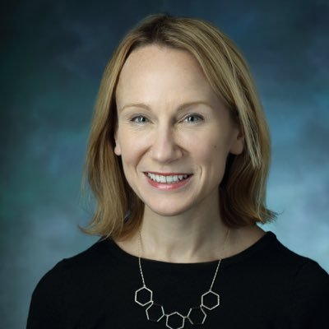
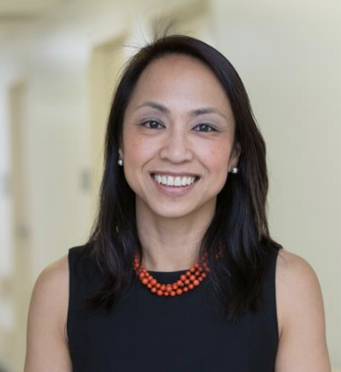
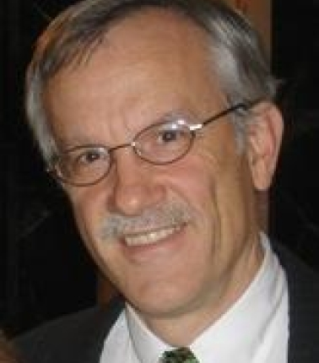
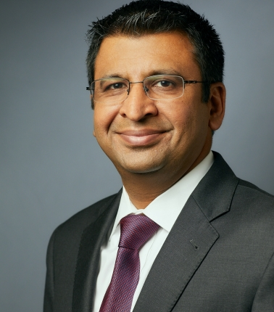
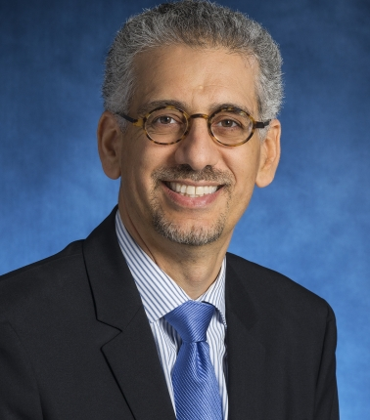
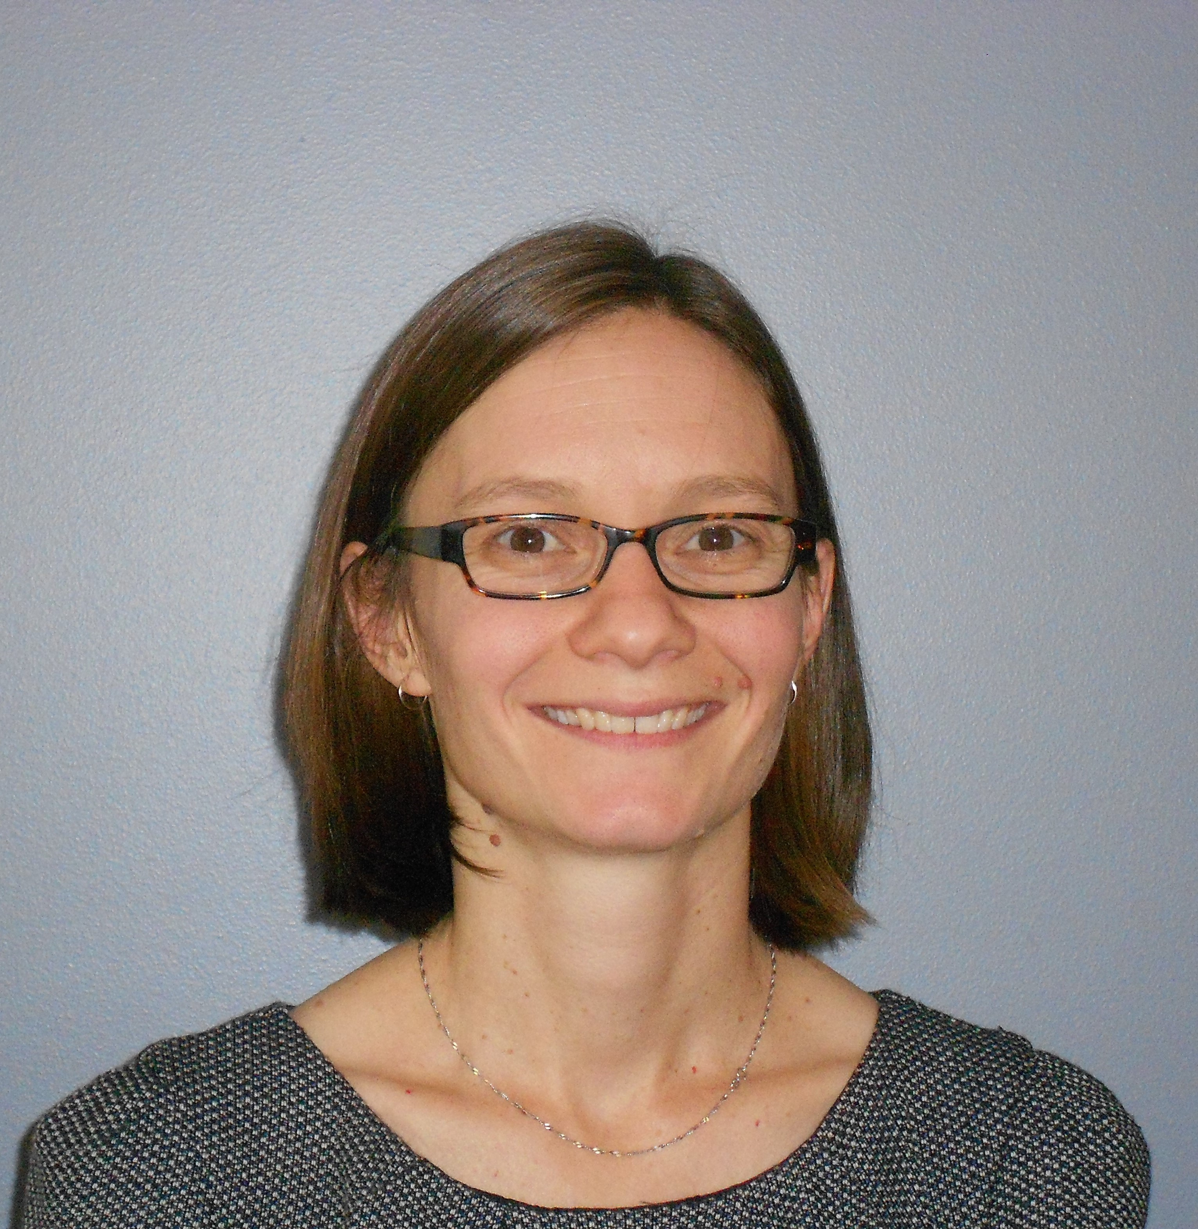
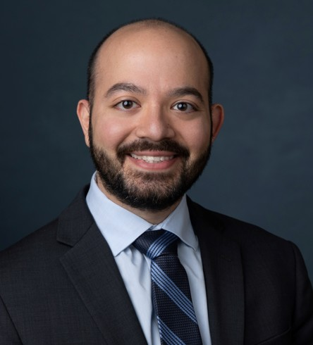
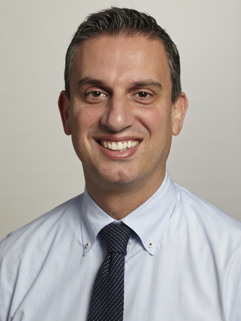
Acknowledgements
Funding and Support
NIDDK Central Repository
CKD Biomarkers Consortium
NIDDK K08DK117068, X01DK118497
Yale University, George M. O’Brien
Center Kidney Research Pilot &
Feasibility Grant (via NIDDK P30DK079310)

