Slide 1
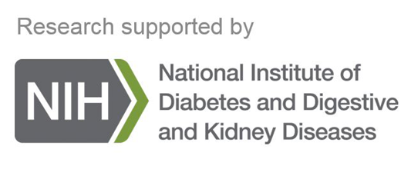
Critical Impact of NIDDK Data for Patients: Regulatory Outcomes and Accelerated Drug Development
Joseph A Hedrick, PhD
Critical Path Institute

Slide 2
The Critical Path Institute
Notes:
C-Path’s mission
The foundation of C-Path is based upon acting as a neutral, 3rd party convener that brings together academics/clinicians, industry, and regulatory agencies to address areas of the greatest unmet medical need.
How does C-Path achieve this mission?
We accomplish this by leveraging our core competencies, including biomarkers, data collaboration, quantitative modeling and analytics, clinical outcomes assessments, and regulatory science to bring together the researchers with the drug developers and regulators into specific consortia that aim to address a specific unmet need with the ultimate goal of developing and launching drug development tools, which may include therapeutics, clinical trial enrichment/simulation tools, qualified biomarkers, etc.

Slide 3
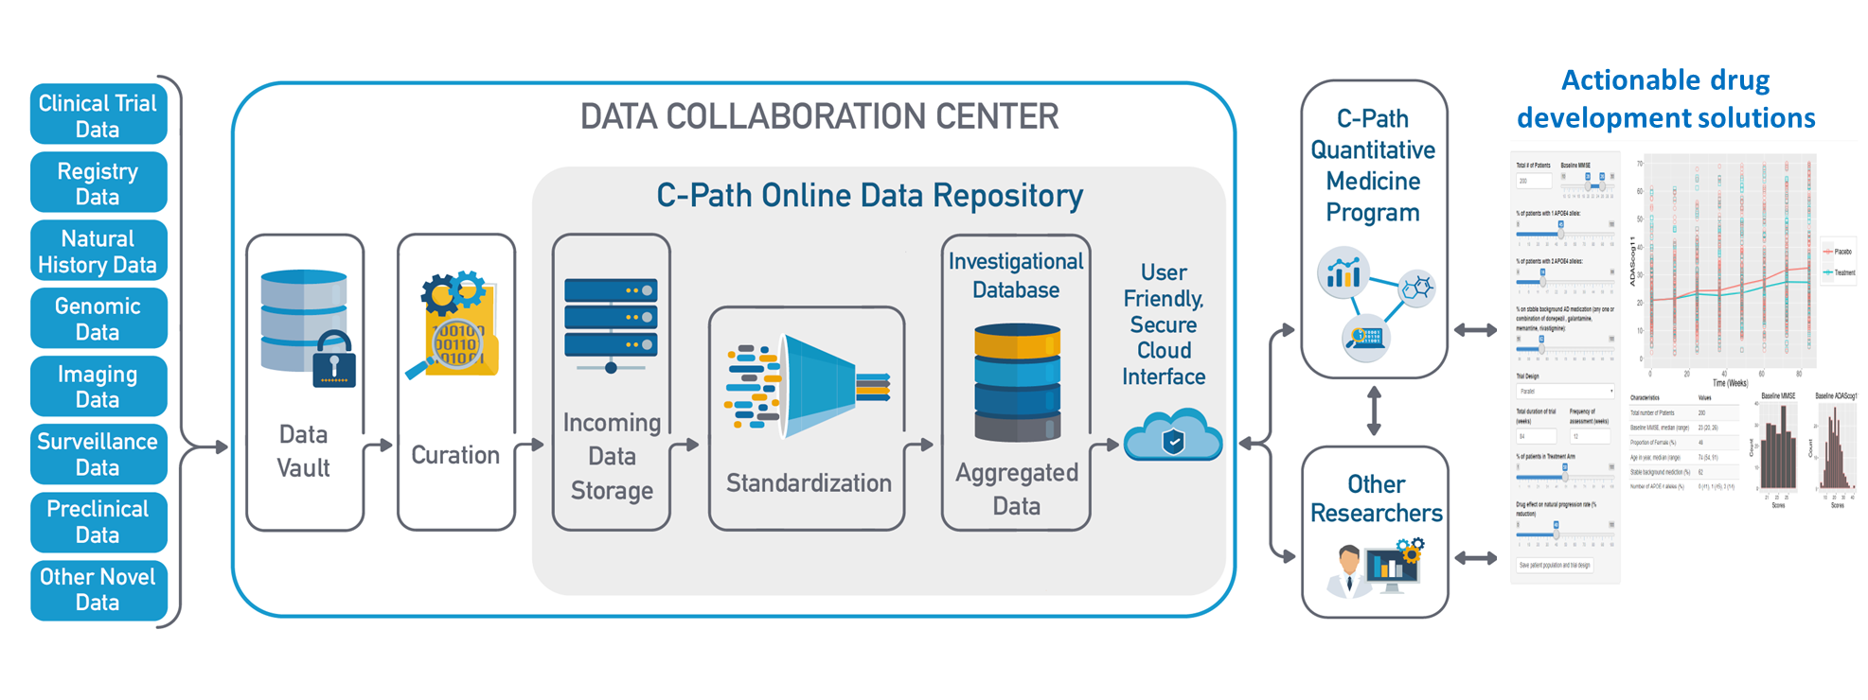
The Critical Path Institute

Slide 4
Type 1 Diabetes Consortium (T1DC) Data Acquisition Overview
Total n = 3222*
*Data from SEARCH (n = 6053) and DCCT (n = 705) not included

Slide 5
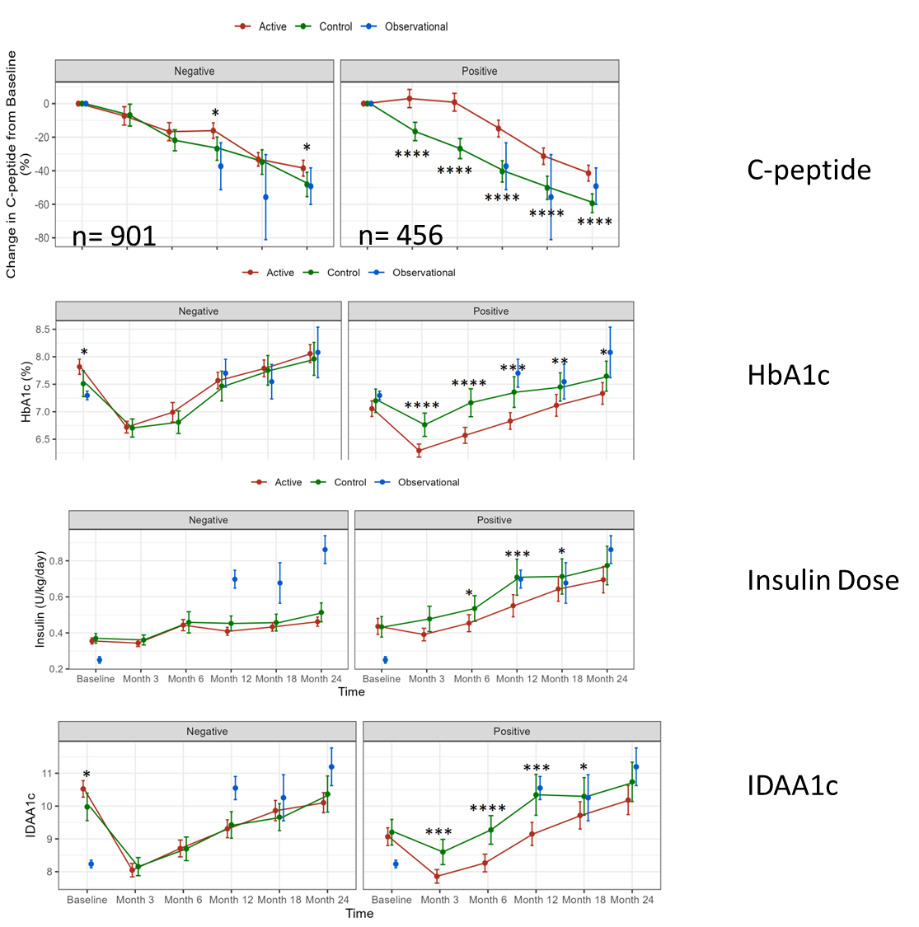
Key points on HbA1c (and composites)
HbA1c falls by 1% in first 3 months, then rises -”J-shape”
Differences in HbA1c in intervention group are significant from 3 months and persist to 2 years
Differences in HbA1c are apparent even when HbA1c is low/improving
No particular advantage with composites except Beta-2 score does not require MMTTs.

Slide 6
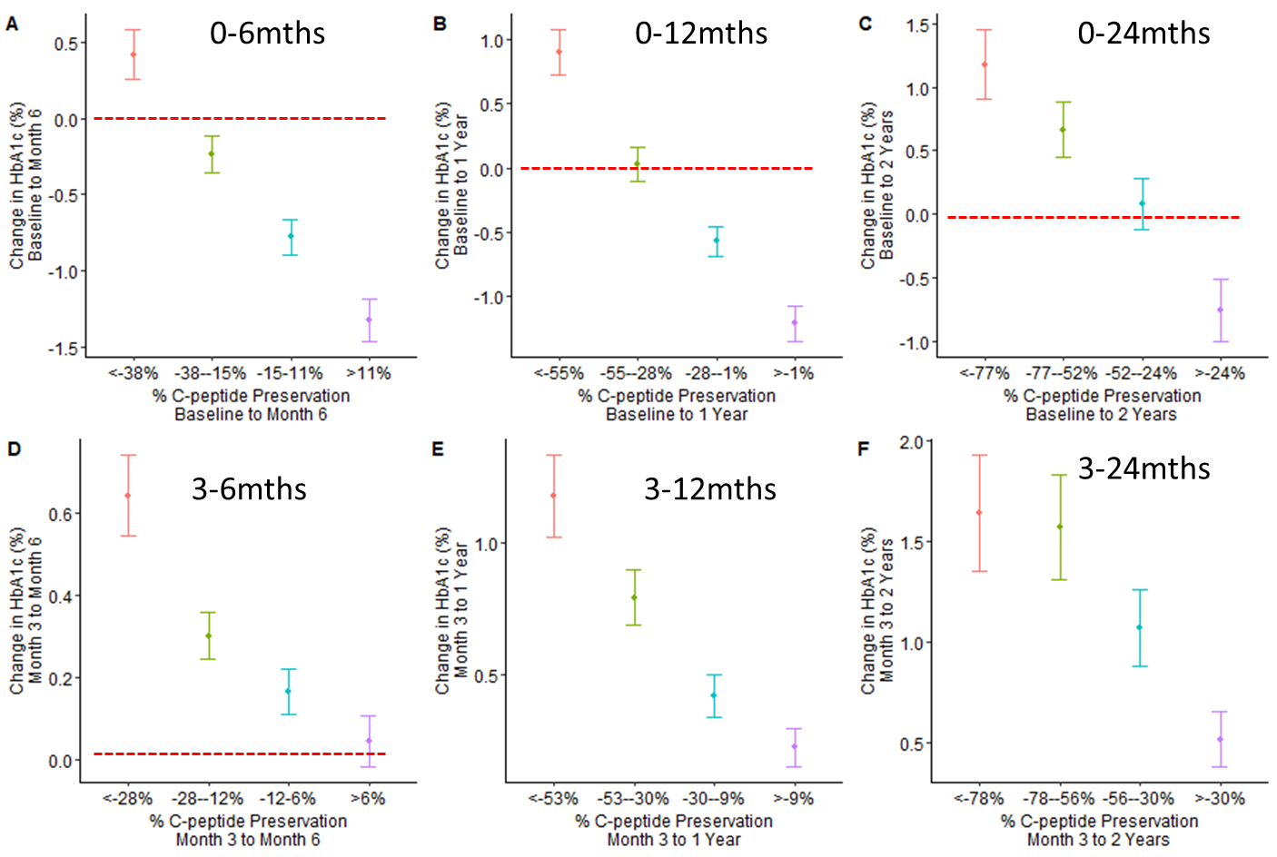
Key points on Proportionality
PROSPECTIVE: At 6 months a 24.8% difference in C-peptide preservation between active and controls within positive studies was associated with a 0.55% difference in HbA1c.
CROSS-SECTIONAL: At 1 year a 27%difference in preservation of C-peptide from baseline to 1 year is associated with a 0.64% (p=3.1e-9) improvement in HbA1c.

Slide 7
T1DC Accomplishments Enabled by NIDDK DATA
collaboration
Data
Launch of multi-stakeholder public-private partnership in T1D (2017)
Clinical Trial Design in New-Onset T1D Workshop discussing the use of C-peptide as a reasonably likely surrogate endpoint
Prevention: 10 datasets
n = 280,974 individuals;
4,324 subjects with ≥2 IAA
New Onset: 25 datasets
(2 obs. studies and 23 clinical trials)
n = 10,364 patients
MUCH OF THIS DATA IS FROM THE NIDDK REPOSITORY
regulatory
Positive EMA Qualification Opinion of islet autoantibodies in Prevention trial enrichment (March 2022)
Submission of initial Briefing Document to FDA for Clinical Trial Simulation tool (New Onset) and Letter of Intent for Clinical Trial Simulation tool in Prevention
modeling
Launched publicly available Prevention Clinical Trial Enrichment tool (June 2022)

Slide 8
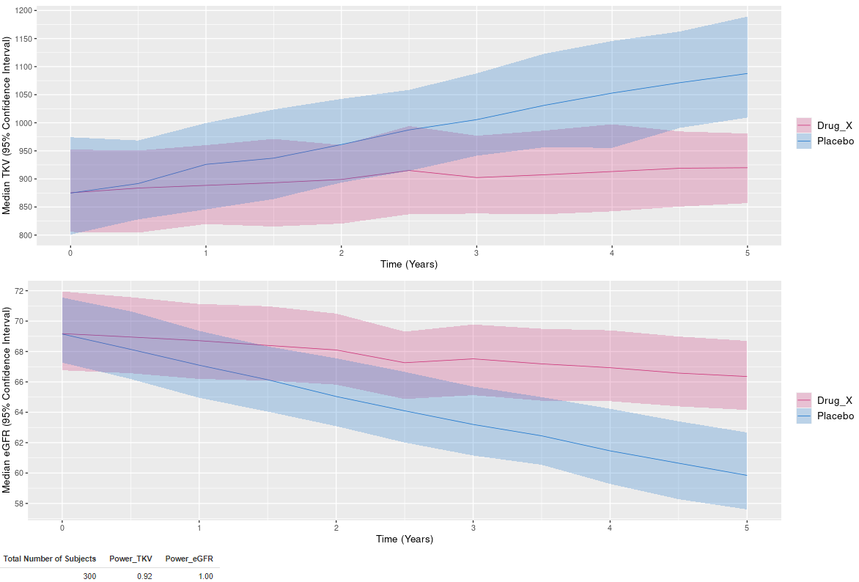
Polycystic Kidney Disease Outcomes Consortium (PKDOC)
Consortium for Radiologic Imaging Studies (CRISP1 and CRISP2):
Integral in the development of a CDISC therapeutic area user guide to collate data from ADPKD registries and observational studies
Used in the successful qualification of total kidney volume (TKV) by FDA and EMA as a prognostic biomarker for patient selection in ADPKD clinical trials, with subsequent FDA designation as a reasonably likely surrogate endpoint
CRISP1, CRISP2, and HALT-PKD:
Essential part of a new initiative to use model-informed drug development approaches to develop a regulatory-endorsed clinical trial simulator (CTS) tool and graphic user interface (GUI) to optimize clinical trial design in PKD

Slide 9
Polycystic Kidney Disease Outcomes Consortium (PKDOC)
Study​ | N subjects​ |  | N observations​
 | eGFR​ | TKV​ | eGFR​ | TKV​
CRISP 1* | 241​ | 241​ | 2622​ | 1499​
CRISP 2*​ | 202​ | 202​ | 2467​ | 1357​
HALT A​ | 534​ | 544​ | 4350​ | 2111​
HALT B​ | 475​ | 22​ | 4062​ | 140​
HALT unspecified​ | 18​ | 12​ | 174​ | 53​
EMORY​ | 318​ | 330​ | 1500​ | 838​
MAYO​ | 821​ | 978​ | 7514​ | 1545​
UCD​ | 777​ | 903​ | 4143​ | 2057​
Consortium for Radiologic Imaging Studies (CRISP1 and CRISP2):
Integral in the development of a CDISC therapeutic area user guide to collate data from ADPKD registries and observational studies
Used in the successful qualification of total kidney volume (TKV) by FDA and EMA as a prognostic biomarker for patient selection in ADPKD clinical trials, and later FDA designation as a reasonably likely surrogate endpoint
CRISP1, CRISP2, and HALT-PKD:
Essential part of a new initiative to use model-informed drug development approaches to develop a regulatory-endorsed clinical trial simulator (CTS) tool and graphic user interface (GUI) to optimize clinical trial design in PKD
*All subjects from CRISP2 participated in CRISP1. 39 subjects from CRISP1 did not continue to CRISP2, thus the difference in n subjects and data trends between CRISP1 and CRISP2. All subjects in the modeling dataset are modeled as unique longitudinal trajectories.

Slide 11
Clinical Trial Simulation (CTS) Tools
What is a CTS Tool?
A collection of mathematical models that quantitatively link the essential features of a trial (natural disease progression, placebo/dropout, drug effects) and provide a basis to answer trial design questions
How is a CTS Tool used?
Simulations of many clinical trials scenarios are performed based on sponsor input prior to the execution of the trial
These tools are usually web-based and user-friendly with a graphical user interface
What is a CTS Tool used for?
CTS tools are intended to provide insights for key trial design aspects:
Proposed entry criteria, enrichment strategies, and stratification approaches
Trial duration
Frequency of observations
Power and sample size calculations
Classical and adaptive design approaches
11

