Slide 1
What FAIR means to a Biobanker Panel Discussion
Marianne K Henderson, MS CPC PMP
Biological Resources team, Office of the Director
Division of Cancer Epidemiology and Genetics, NCI, NIH

Slide 2
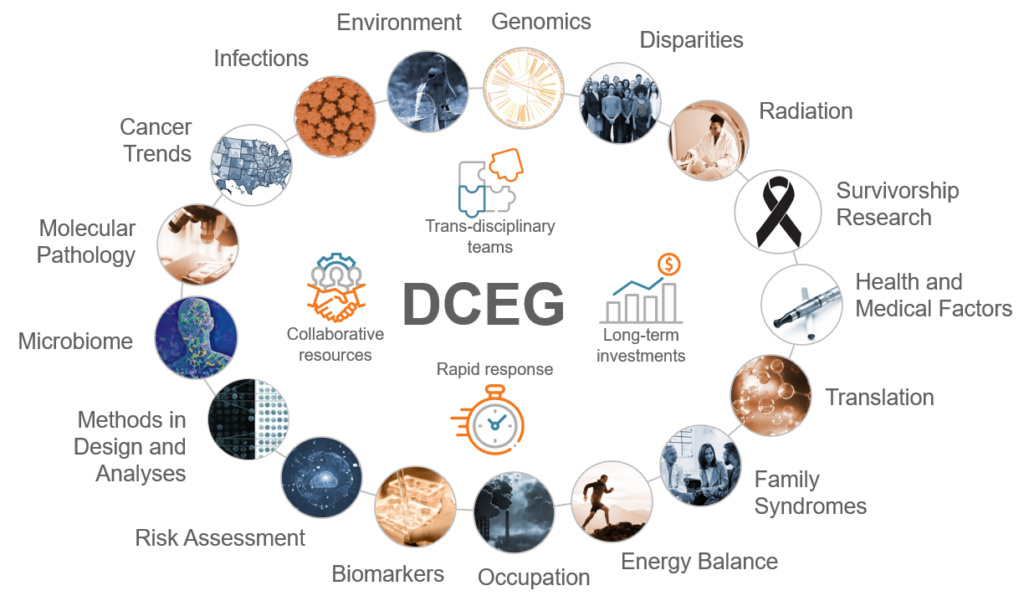
To discover the causes of cancer and inform the means of prevention by conducting transdisciplinary epidemiological and genetics research

Slide 3
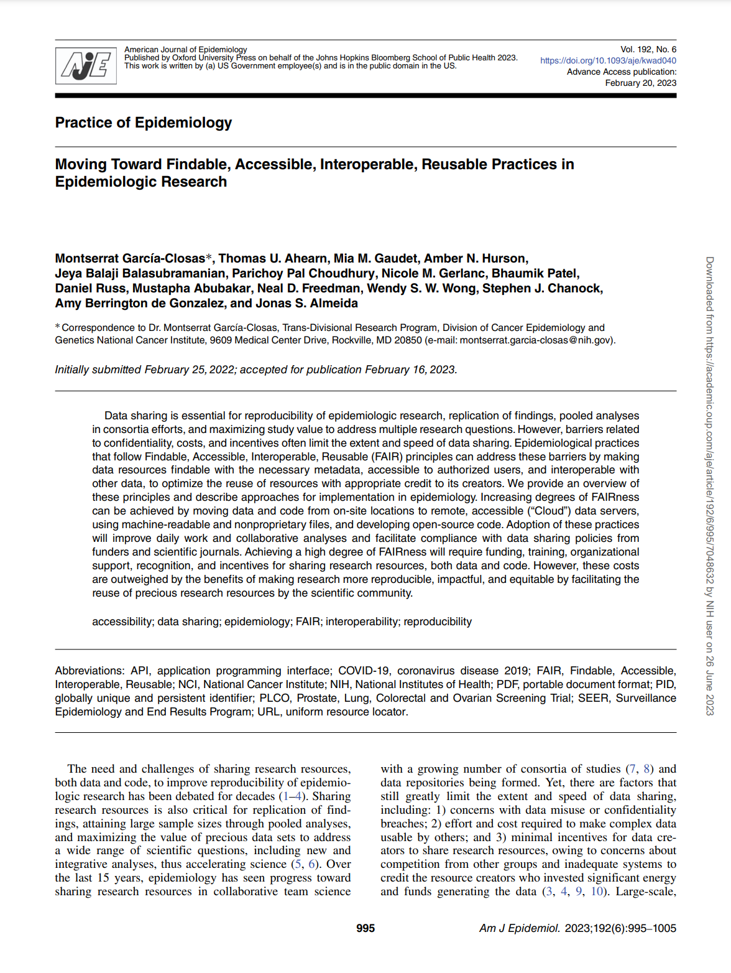
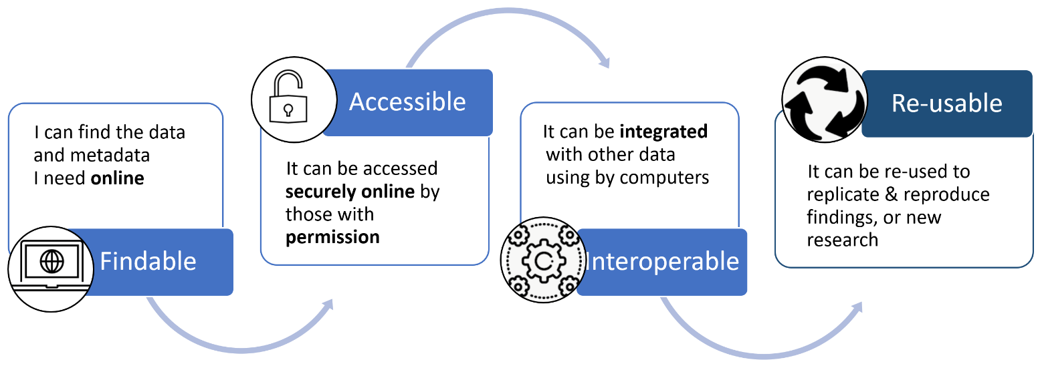
Guiding Principles in DCEG FAIR Practices in Epidemiology
Published in Am J Epidemiol, June 2023
https://pubmed.ncbi.nlm.nih.gov/36804665/

Slide 4
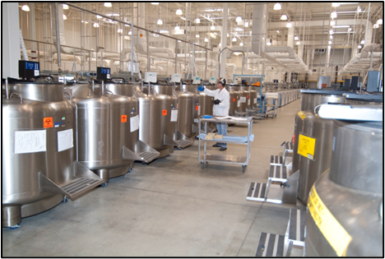
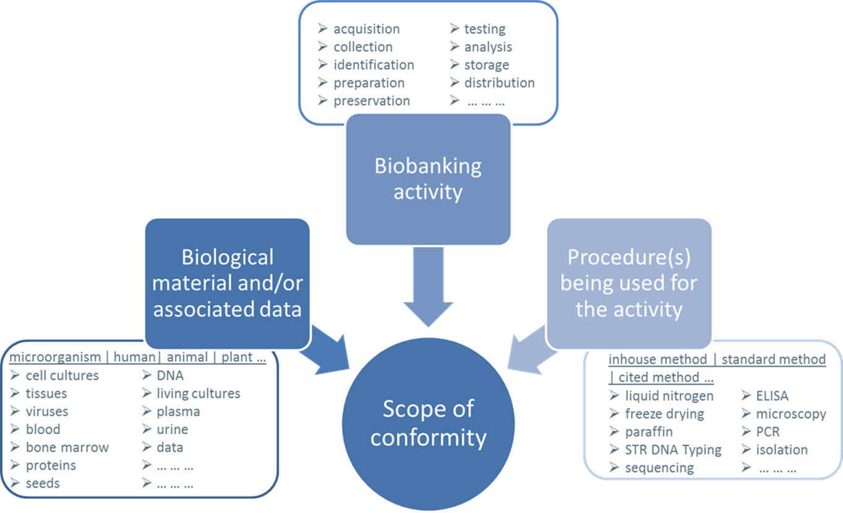
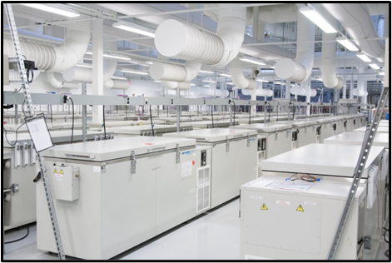
Requirements for Biobanking in support of DCEG Research
QUALITY
CONFORMITY
REPRODUCIBILITY
COMPARABILITY
>15M specimens
Notes:
Lack of standardization brings Inherent risks to precision medicine. Because
spurious analytical results can lead to artifacts being interpreted as valid findings
Thorough use of quality management processes, standards and best practices throughout the biospecimen continuum will bring quality, reproducibility, comparability and conformity to your biobank. Through these efforts, biobanks become the necessary TOOL for precision medicine.

