Slide 1
What “FAIR” Means to a Data Curator
Jennifer Darragh
Senior Research Data Management Consultant
Center for Data and Visualization Sciences
Duke University Libraries

Slide 2
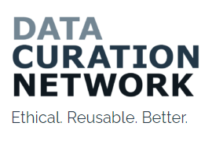
How Curation Enables FAIR - CURATED
How to Go beyond the “F” and “A”
Checking files to ensure they open
Reviewing submission package to ensure it is understandable and complete
Requesting any additional information for submission optimization and address any accidental omissions or errors.
Assessing metadata provided to ensure it adheres to minimum viable standards (or beyond when appropriate)
Transforming files from proprietary to open when needed
Evaluating final data submission package and repository record against FAIR principles
Documenting provenance and curation processes

Slide 3
Common Questions and Issues I Encounter
What do these terms mean in the NIH DMSP? Metadata, Standards, Repositories, Preservation? Can’t I just put my data up on my lab’s website?
How much data am I supposed to share? I generate petabytes of data per project.
Datasets need to be able to stand-alone as published objects and not rely on research articles for context.

