Slide 1
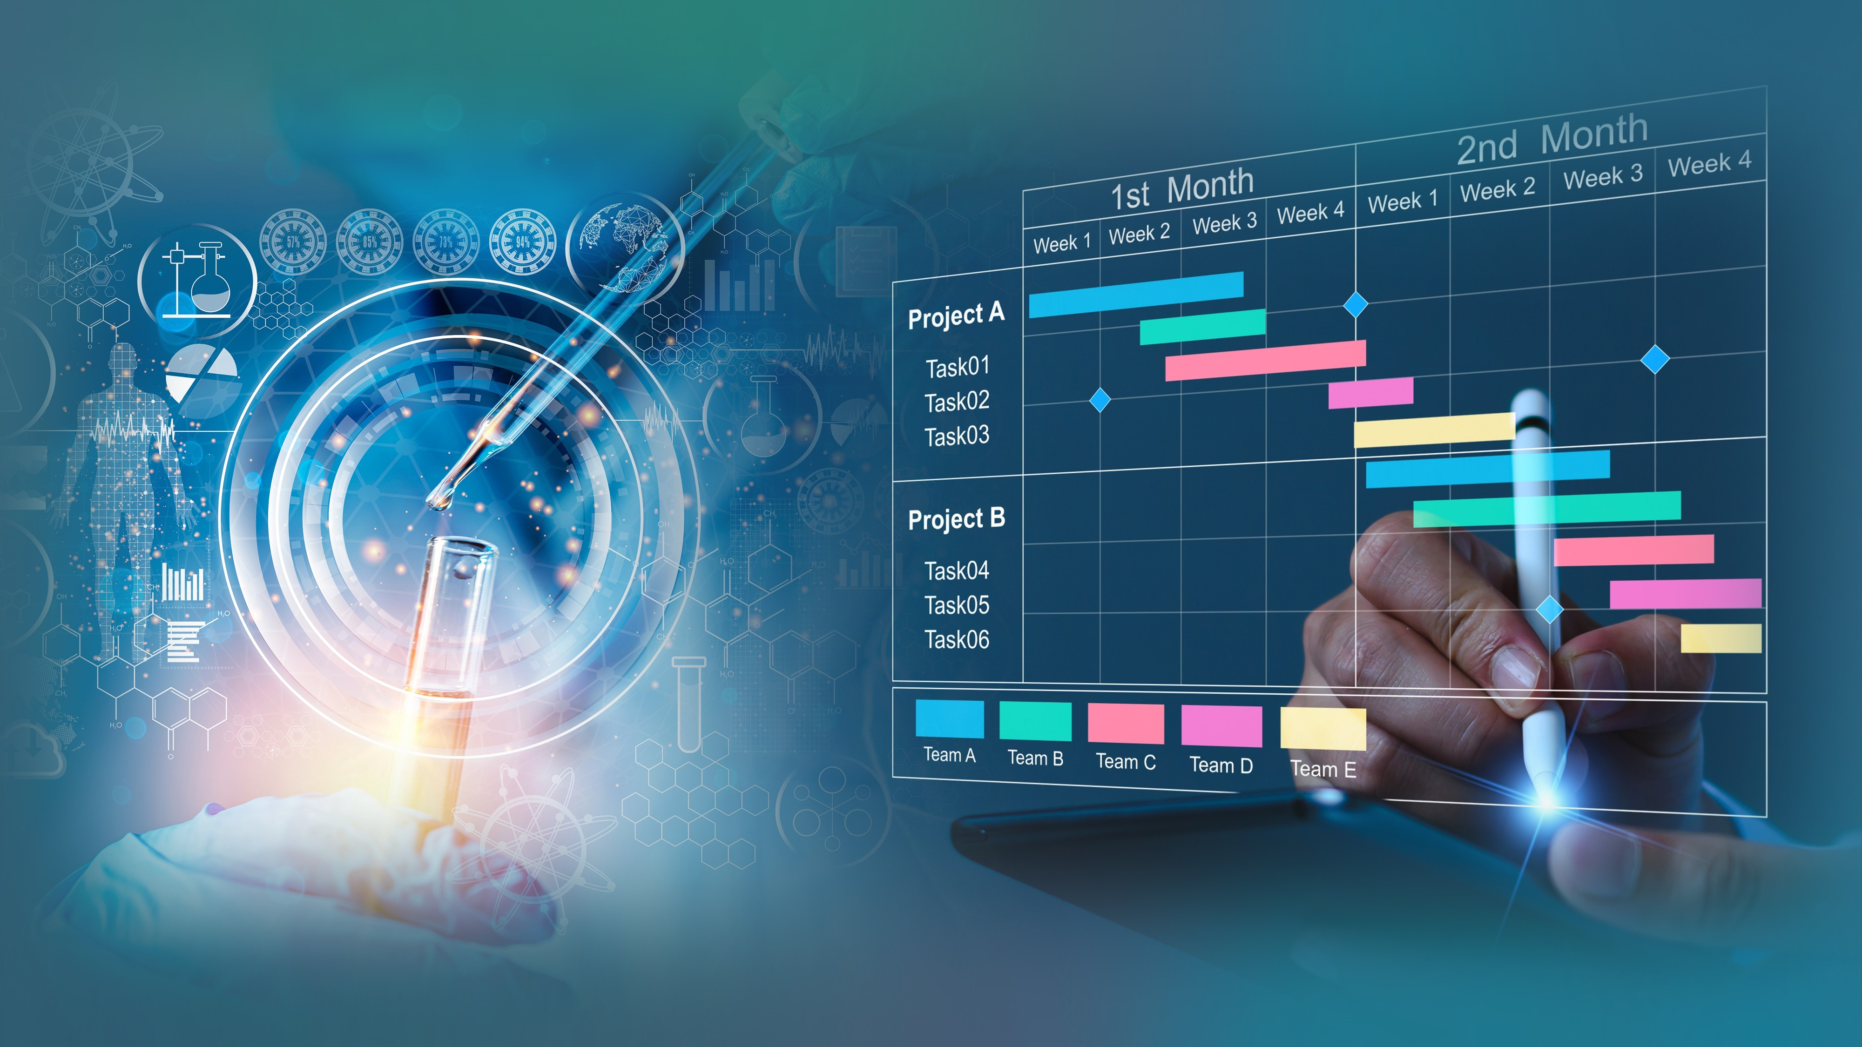


Closing Remarks
Notes:
building quality into data acquisition representing core (not all) variables.

Slide 2
Summary Day 2
Learned about practical examples for applying data standards throughout the resources’ life cycle as part of the continuum of FAIRization to meet the intent of the NIH sharing policy
Heard the scientific discoveries and career journeys from invited repository users who had been granted access to data and the impact these have made in advancing their research, their career paths, and the contributions to health and healthcare outcomes
Heard innovative approaches for secondary use from an informaticist’s perspective that take advantage of existing and new technologies in data standardization, aggregation, and analytics to achieve interoperability with evolving platforms
Heard a panel of experts discuss different platforms that support NIDDK-funded investigators and ways these strengthen and expand NIDDK’s data ecosystem, the potential to establish partnerships to continue to build out the ecosystem, develop tools and technologies in parallel, influence the new generation of informatics professionals and participate in outreach and training activities.
Demoed our new pilot analytics workspace and launched a data-centric challenge, the first in a series of challenges to enhance the repository’s datasets for future AI applications
Notes:
building quality into data acquisition representing core (not all) variables.

Slide 3
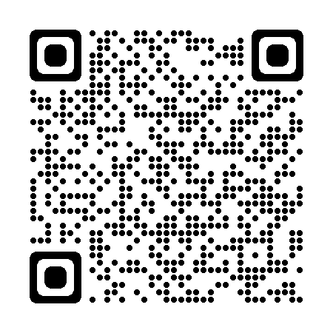
Recordings
Slides and Recordings will be available on the NIDDK Central Repository and NIDDK webpage
For more information on services and support or to provide feedback, visit our website at https://repository.niddk.nih.gov or email us at NIDDK-CRsupport@niddk.nih.gov
For Repository Program Administrative inquiries, email us at NIDDK-CRadmin@niddk.nih.gov
Notes:
building quality into data acquisition representing core (not all) variables.

Slide 4
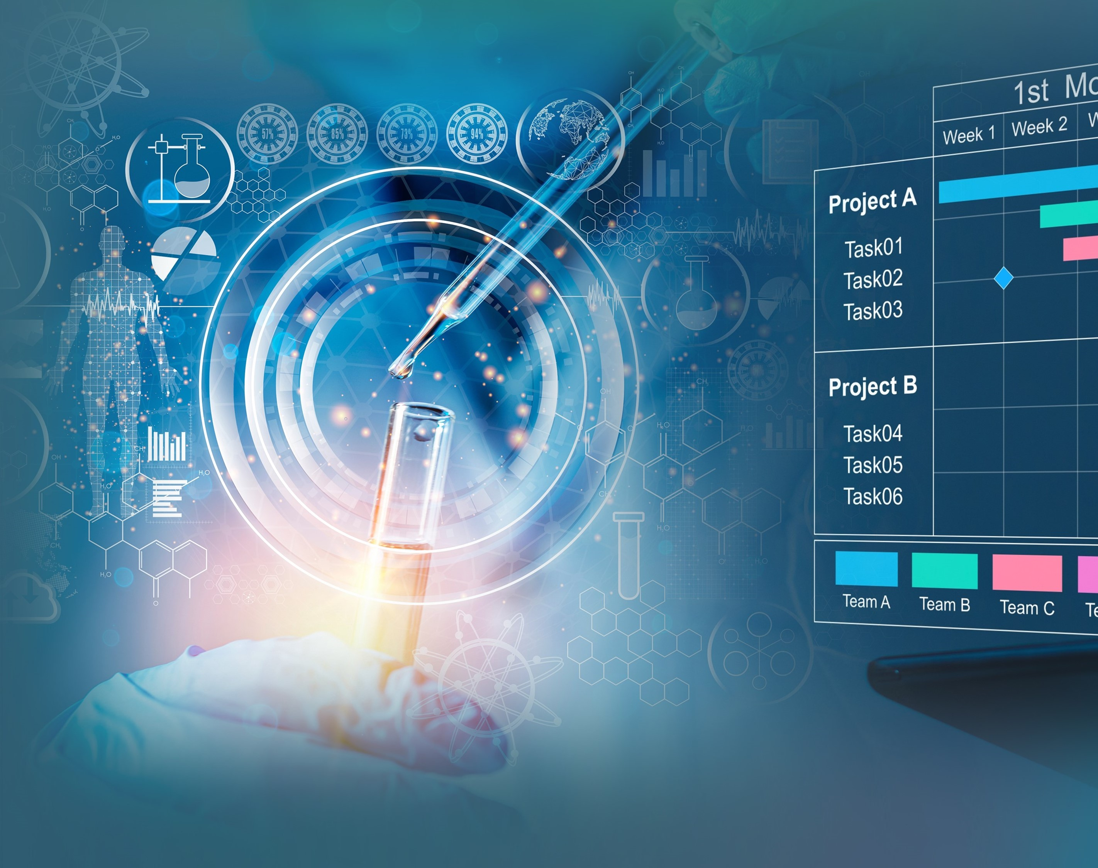
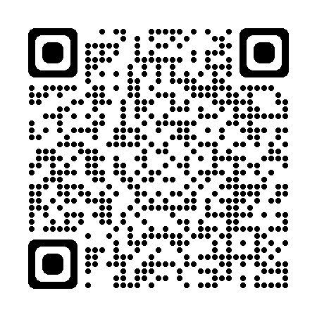
Data Challenge
NIDDK Central Repository Data-Centric Challenge:
Enhancing NIDDK datasets for future Artificial Intelligence (AI) Applications
Stay tuned for updates from NIDDK-CR!

Slide 5
Notes:
building quality into data acquisition representing core (not all) variables.

