Slide 1
Revolutionizing drug development in chronic kidney disease
Juhi Chaudhari, MPH
Tufts Medical Center, Boston, Massachusetts
September 20, 2023

Slide 2
Outline
Clinical problem and unmet need
Solutions
CKD-EPI CT
Meta-analysis
NIDDK data
Accomplishments
Lessons learned
Notes:
Figure: Truly collaborative science where we combine expertise from clinical and pharmacological knowledge, with conscientious statistical methods, and industry involvement, all fueled by clinical trial data sharing from across the world. Our research really stands on the generosity of the clinical trial participants for agreeing to share data and of all the ambassadors involved in preparing, uploading, and making data available for secondary analysis.
[highlight the science, that is, the research work accomplished with the use of the NIDDK-CR resources and how these have impacted your research and your scientific career. We would also like for you to describe to the audience your experiences and perspective as a repository user. For example, what you wish you knew before requesting data, what you would do differently, what are some things to know, etc. ]

Slide 3
The Problem
Chronic Kidney Disease
1.21 million
deaths in 2017*
Decline in kidney function without intervention
Kidney function
Early intervention helps but …
Few effective treatments
Time-ineffective endpoints for disease progression
*GBD Chronic Kidney Disease Collaboration 2020
Notes:
Kidney disease is a worldwide public health problem, disproportionately affecting older people and lower and middle income countries, with major outcomes including kidney failure and cardiovascular disease.
Early intervention can slow or prevent disease progression, before irreversible damage occurs, and provide added life years free from end-stage kidney disease.
Yet, before latest advances, there were few new drugs for slowing or preventing kidney disease progression.
One of the reasons for few treatments is a lack of valid endpoints accepted by regulatory agencies for clinical trials.
Endpoints are essentially markers that can be used to indicate efficacious treatments after a reasonable length trial.
Clinical endpoints used in pivotal CKD trials were based on kidney failure events.
They occur later in disease progression and hence require long follow-up periods in order to achieve sufficient statistical power.
They also require very large patient numbers, or need to be restricted to later-stage patients or those with disease with rapid GFR decline.

Slide 4
A solution: Validated Surrogate Endpoints
Can reduce the time and patient numbers required in clinical trials
Increase efficiency of drug development to slow CKD progression
Enhance feasibility of studies patients earlier in the disease process or who have slower progressing disease
Incentivise product developers to increase their engagement to develop new treatments for patients with CKD
Notes:
Validated surrogate endpoints can reduce the time and patient numbers required to assess whether treatments are effective to prevent CKD progression and KFRT and to consequently support market authorization of such treatments.
The acceptance of validated surrogate endpoints for use in the broad population of patients with CKD would increase efficiency of drug development to slow CKD progression across a spectrum disease types and would enhance feasibility of studies of interventions for patients earlier in the disease process or who have slower progressing disease.
This could incentivise product developers to increase their engagement to develop new treatments for patients with CKD, a patient population who continues to have a high medical need despite some recent advances.

Slide 5
Criteria for establishing the validity of a surrogate endpoint
Biological plausibility
There must be strong support from cellular, molecular, animal, and human studies that the endpoint can plausibly be expected to predict the clinical outcome of interest.
Individual level associations
There should be epidemiologic data demonstrating a strong and consistent relationship between the surrogate endpoint and outcome of interest.
Trial level analyses
It must be possible to predict the treatment effect on the clinical endpoint based on the treatment effect on the surrogate.
Image from visiblebody.com
Notes:
The two most widely studied biomarkers in CKD.
They are both measures of glomerular function.
Albuminuria is primarily a measure of the permeability of the glomerular capillary wall to macromolecules.
GFR is generally considered the most useful overall measure of kidney function in health and disease.
A severe reduction in GFR is defined as kidney failure.
Hence, by definition, GFR decline is on the path of progression to kidney failure for all kidney diseases, and it is more strongly related to development of kidney failure and its complication than increased albuminuria.

Slide 6
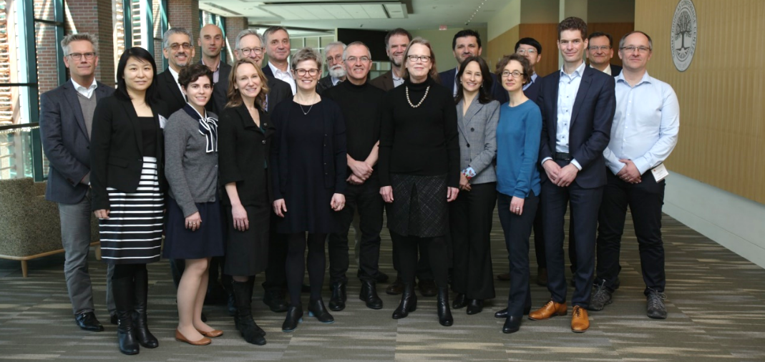
Scientific Collaboration
First formed in 2003 to evaluate one potential surrogate endpoint in CKD (proteinuria), as well as other key challenges in CKD epidemiology at the time
Milestone scientific workshops held in conjunction with the US Food and Drug Administration (FDA) and European Medicines Agency (EMA) in 2008, 2012, 2018
NKF-FDA-EMA Scientific Workshop 2018
Notes:
first formed in 2003 to evaluate one potential surrogate endpoint in CKD (proteinuria), as well as other key challenges in CKD epidemiology at the time.
Work has been conducted over the past two decades, facilitated by milestone scientific workshops held in conjunction with the US Food and Drug Administration (FDA) and European Medicines Agency (EMA) in 2008, 2012, and 2018. These investigations led to the conclusion that GFR slope fulfils the criteria for surrogacy for use as an endpoint in clinical trials for CKD progression under certain conditions. The work presented in this qualification request expand on the earlier findings and strongly support the use of GFR slope as a validated surrogate endpoint for CKD progression across a broad range of patient populations and therapeutic interventions.

Slide 7
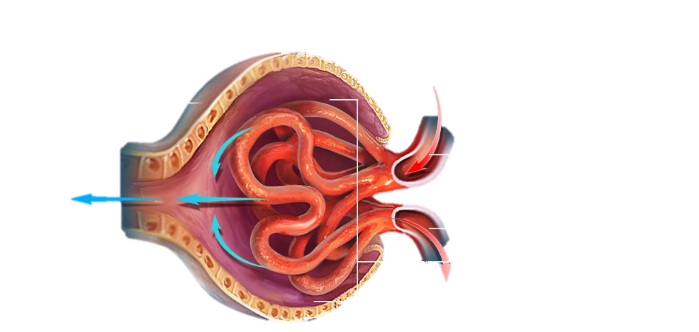
Glomerulus
GFR and albuminuria in a nutshell
Capsule
Blood flow
The two most widely studied biomarkers in CKD
GFR ~ how well glomerulus filters blood
Albuminuria or proteinuria ~ permeability of the glomerular capillary wall to macromolecules (or simply stated as ‘protein in urine’).
A severe reduction in GFR is defined as kidney failure.
Hence, by definition, GFR decline is on the path of progression to kidney failure for all kidney diseases, and it is more strongly related to development of kidney failure and its complication than increased albuminuria.
Image from visiblebody.com
Notes:
The two most widely studied biomarkers in CKD.
They are both measures of glomerular function.
Albuminuria is primarily a measure of the permeability of the glomerular capillary wall to macromolecules.
GFR is generally considered the most useful overall measure of kidney function in health and disease.
A severe reduction in GFR is defined as kidney failure.
Hence, by definition, GFR decline is on the path of progression to kidney failure for all kidney diseases, and it is more strongly related to development of kidney failure and its complication than increased albuminuria.

Slide 8
CKD-EPI CT individual participant meta-analysis
Two-step approach
WITHIN STUDY -- estimation of the treatment effects on the surrogate and clinical endpoints*
GFR slope as surrogate: Mean(GFRslope_{Tx}) – Mean(GFRslope_{control})
Albuminuria as surrogate: log geometric mean ratio for change in albuminuria
Clinical endpoint: Cox proportional hazards analysis
ACROSS STUDIES – trial-level meta-regression to relate the treatment effects on the surrogate and clinical endpoints
Bayesian mixed effects meta-regression overall and by disease, GFR and albuminuria
Models accounted for standard errors in the estimated treatment effects and for the correlation of errors in estimated treatment effects between the different endpoints
*Clinical Endpoint: composite of Kidney failure with replacement therapy, Sustained GFR <15mL/min/1.73m^{2,} Doubling of serum creatinine (57% decline in GFR)
Notes:
We conduct trial-level analyses to relate the treatment effects on the clinical endpoint to the treatment effects on the surrogate endpoint. The trial-level analysis requires two steps: intent-to-treat estimation of the treatment effects on the surrogate and clinical endpoints within each RCT followed by a meta-regression to relate the treatment effects on the surrogate and clinical endpoints across RCTs.

Slide 9
Included studies: power and heterogeneity
 | N studies total | Disease groups
 |  | CKD | Diabetes | Glomerular | CVD
Overall | 66 | 28 | 21 | 10 | 7
RASB v Control | 21 | 12 | 6 | 1 | 2
RASB v CCB | 4 | 2 | 2 | 0 | 0
RASB + CCB | 1 | 0 | 0 | 0 | 1
Immunosuppression | 9 | 0 | 0 | 9 | 0
Low v Usual BP | 7 | 5 | 1 | 0 | 1
SGLT-2 Inhibitor | 4 | 1 | 3 | 0 | 0
Antiplatelet | 3 | 0 | 1 | 0 | 2
DPP-4 Inhibitor | 3 | 0 | 3 | 0 | 0
Allopurinol | 2 | 2 | 0 | 0 | 0
GLP-1 Agonist | 2 | 0 | 2 | 0 | 0
Low v Usual Diet | 2 | 2 | 0 | 0 | 0
Mineralocort. rec. antagonist | 2 | 0 | 1 | 0 | 1
Nurse-coordinated Care | 2 | 2 | 0 | 0 | 0
Albuminuria Targeted Protocol | 1 | 1 | 0 | 0 | 0
Endothelin rec. antagonist | 1 | 0 | 1 | 0 | 0
Intensive Glucose | 1 | 0 | 1 | 0 | 0
Statin+Ezetimibe | 1 | 1 | 0 | 0 | 0
A high level of heterogeneity in interventions and disease subclasses across well powered RCTs is critical for the value of the analyses to achieve a broad scope of applicability.
Legend:
N, sample size, CKD, chronic kidney disease, CVD, cardiovascular disease, RASB, renin-angiotensin system blocker, CCB, calcium channel blocker, BP, blood pressure, SGLT-2, sodium-glucose cotransporter-2, DPP-4, dipeptidyl peptidase-4, GLP-1, glucagon-like peptide-1

Slide 10
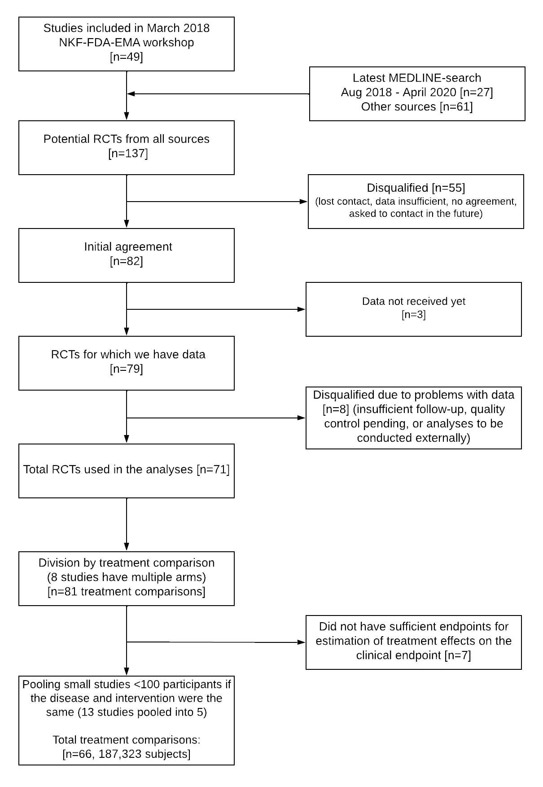
Systematic review and data acquisition
Data from NIDDK-CR:
HALT-PKD A and B (2016)
FSGS-FONT (2020)
Other sources of data:
NHLBI BioLincc, Clinical Study Data Request, Vivli, company’s portal, study investigator/sponsor
Flowchart of data acquisition (Sep. 2022)
Notes:
This is where the clinical trial data come into the picture.
We screen for trials and request access to their data, as you can appreciate from the flow chart. We currently have data from 66 trials included in our meta-analysis.
We received the HALT-PKD data and FSGS-FONT data from the NIDDK CR.
A high level of heterogeneity in interventions and disease subclasses across well powered RCTs included in a trial-level analysis is critical for the value of the analyses to achieve a broad scope of applicability.
Having access to these two studies from the NIDDK CR implied that we have a studies representing participants with polycystic kidney disease (i.e. HALT-PKD) and a glomerular disease FSGS (i.e. FONT)
We also received data from other sources namely …..

Slide 11
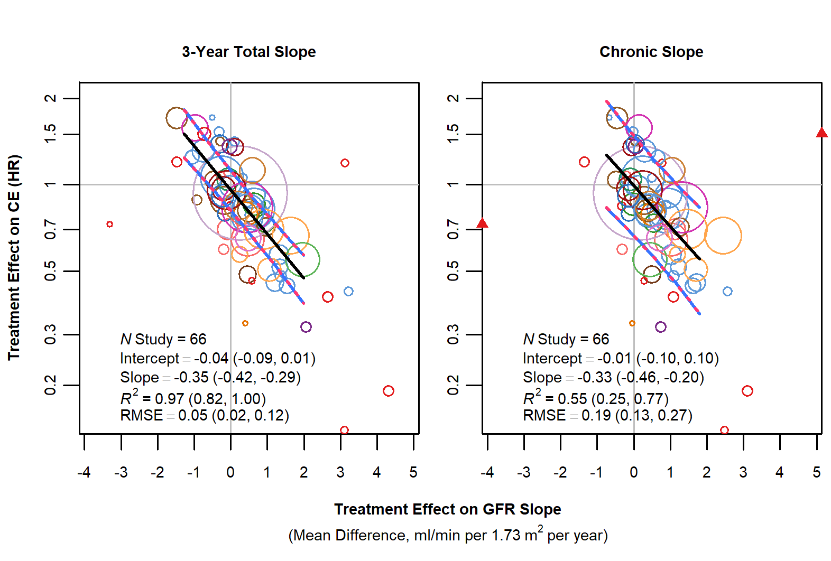
Scientific accomplishments
GFR slope
Inker et al, Greene et al, JASN 2019: GFR slope as valid surrogate
Methods for slope analysis accounting for acute effects, informative censoring by ESRD, heteroscedastic GFR variability, and proportional treatment effects Vonesh et al Stats in Medicine 2019
Trial level analyses (evaluation of surrogacy)
Bayesian trial level analyses relating association of treatment effects on CE to slope, CE to ACR, slope to ACR that account for correlation among the errors with Prediction for future trials with model evaluation and sensitivity analyses for comparable priors across ACR and Slope (more informative, less informative)
Updated analyses for expanded studies Inker Nature Med 2023; qualification procedures submitted to EMA
Notes:
Over the past two decades we have published our research in various respected journals. Our findings supported the use of albuminuria as surrogate endpoint, gradually lesser decline in GFR as surrogate endpoint we started at 57% decline, then to 30 and 40% decline), GFR slope as a surrogate endpoint, and even used the data as a basis for statistical simulation for testing performance of GFR slope as a surrogate endpoint

Slide 12
GFR
2012 NKF-FDA Workshop (Jointly with CKD-PC): Lesser decline in GFR (2012)
Coresh JAMA, Inker et al and Greene et al AKJD 30 and 40% decline valid surrogates
GFR slope
Inker et al, Greene et al, JASN 2019: GFR slope as valid surrogate
Methods for slope analysis accounting for acute effects, informative censoring by ESRD, heteroscedastic GFR variability, and proportional treatment effects Vonesh et al Stats in Medicine 2019
Assessment of non linearity in GFR slope CKD-EPI website
Biased estimation with shared parameter models in presence of competing dropout Vonesh Biometrics 2022
Trial level analyses (evaluation of surrogacy)
Bayesian trial level analyses relating association of treatment effects on CE to slope, CE to ACR, slope to ACR that account for correlation among the errors with Prediction for future trials with model evaluation and sensitivity analyses for comparable priors across ACR and Slope (more informative, less informative)
Impact of missing study correlation Manuscript under review
Updated analyses for expanded studies Inker Nature Med 2023; submitted qualification procedures submitted to EMA
Consistency of trial level analyses by subgroups and disease:
Situating individual studies within the broader trial level relationships across all CKD-EPI CT studies Inker Nature Med 2023
Accounting for variation in trial-level relationships across severity of kidney disease Collier et al JASN
Advanced methods to assess variation by subgroups Inker Nature Med 2023
Acute effects:
Description and timing and association with clinical endpoints Neuen et al JASN 2021;
Association of acute effects on clinical outcome Manuscript in progress
ACR
Data identification, acquisition and cleaning; analyses; method development
2008 FDA/NKF Workshop to discuss urine protein as endpoint
Inker et al AJKD: Cannot rule out association
Inker et al AJKD: Strong association in IgA
Extension of trial level models to jointly incorporate information on the treatment effect on CE as well as on slope and ACR
Application of trial level analysis to the design of Phase II trials: Heerspink et al JASN in press
Ultimate goal – development of adaptive design framework

Slide 13
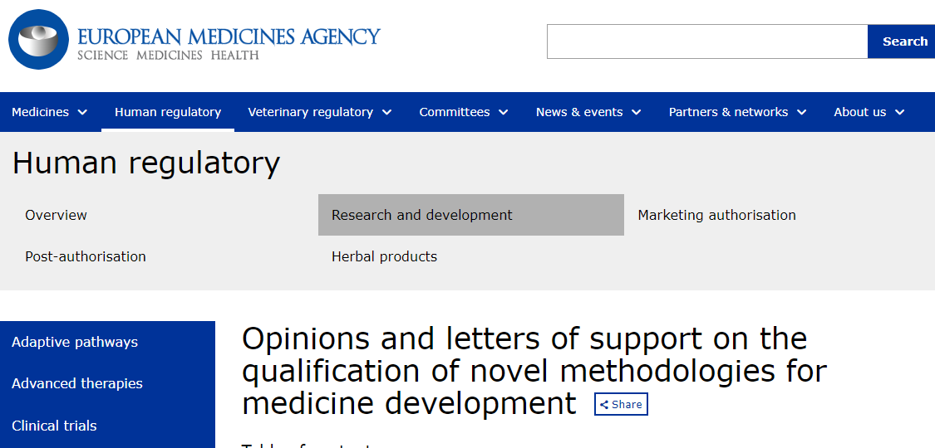
Translational science accomplishments
ALIGN (NCT04573478), PROTECT (NCT03762850),
APPLAUSE (NCT04578834), NEFIGARD (NCT03643965), MOSAIC (NCT04026165), METROPOLIS (NCT03764605), Artemis-IgAN (NCT03608033)
Accepted by FDA for rare chronic kidney diseases and being considered for use in trials in more common diseases (Thompson et al 2020)
Primary or secondary outcome in several ongoing phase III trials of IgA nephropathy approved in EU
Qualification opinion for GFR slope as a Surrogate Endpoint in RCT for CKD – European Medicines Agency
Notes:
Due to our active engagement with industry stakeholders and regulatory agencies, we have been able to translate the scientific advances to provide value from the patient and societal perspectives and drug development standpoint.
The FDA and EMA now accept GFR decline as validated surrogate endpoints^{13,15,46-48}. Following the March 2018 Workshop evaluating GFR slope as a surrogate endpoint, the FDA stated that they have “accepted GFR slope as an endpoint and basis for full approval of therapies for rare chronic kidney diseases”, with caveats for acute effects and that the “workshop analyses provide an important foundation for further discussions with the nephrology community about eGFR slope as an endpoint for registration trials for common chronic kidney diseases”⁴⁷, while EMA has stated that GFR slope “offers promising potential for a surrogate endpoint in the confirmatory phase of a specific clinical program”⁴⁸. Indeed since 2018, four trials on clinicaltrials.gov listed GFR slope as their primary efficacy endpoint, indicating the regulatory agencies’ willingness to consider GFR slope in the appropriate settings⁴⁹⁻⁵³.

Slide 14
Scientific Career Journey
Notes:
Instructions: Briefly describe your scientific research journey
How did access to repository data facilitate your research?
What impact, if any, it had on your career journey?

Slide 15
Challenges and lessons learned
JASN - Data sharing perspective - Accepted
Notes:
JASN - Data sharing perspective - Accepted

Slide 16
Define Research question, hypotheses, study design
Identify studies
Conduct systematic literature review
Determine study meets inclusion which may require discussion with collaborators
Agreements
Obtain agreement for access to individual patient data
anonymization strategy
Data transfer
From collaborators, via data sharing platform, or external coding)
Data access
Quality control
Verify all variables needed for analyses are available; Ask for missing variables; clarify details about variables
Transform data into CKD-EPI CT format
Convert units and create derived variables
Split data from multifactorial trials into separate treatment comparisons
Pool small studies
Within study analyses
Perform albuminuria analysis (~20 programs); Performing GFR analysis
(~25 programs); Exporting summary files if on remote server (~100 files w output)
Active state of research
Compiling results from different studies for meta-analysis
Pooled dataset
Ongoing method development
Testing of new codes
Meta-analyses
Conducting meta-analysis and generating final outputs; Comparison to prior results to recognize imapct of new studies
(~20 files)
Preliminary result review
Steering committee
Collaborators and sponsors
Technical reports on website
Publication/Presentation of results
Draft manuscripts, abstracts, progress reports
Seek approval for draft manuscripts
Nurture relationships
Host biyearly webinars and share newsletters
Sharing results
Administration
Seek/maintain funding: Submit progress reports to sponsors and data sharing platforms; Communications to sponsors and collaborators;-Maintain agreements
Notes:
Determination if study meets eligibility criteria prior to data acquisition
Challenge in locating study on DSP
Sponsors concern of disclosure of proprietary information to competitors or prior to regulatory approval and indicate that they may agree but at some point in the future
Steering committee does not agree to data sharing
Several iterations required over 3-12 months prior to final agreement
Computation speed and storage capacities of the host; Cost; Academic institution firewall may prevent access
Anonymization prevents computation of variables or analyses of subgroups or inability to verify published results
Inability to replicate published results due to protection laws preclude use of subset of studies
Inadequate information on variables
Inability to include earlier studies in updated analyses due to expired agreements
Inability to adhering to data sharing requirements by journals due to agreements
Inability to provide requested analyses due to expired agreements or accessing data again is too costly or time consuming

Slide 17
Step | Processes | Challenge | Solution
Data acquisition | Study identification | Determination if study meets eligibility criteria prior to data acquisition | Reporting of components of composite endpoints
 | Data source | Challenge in locating study on DSP | Increase transparency of DSP by integration and interoperability across DSP with increased participation from academics investigators and biotech companies
Data agreements | Verbal agreement | Sponsors concern of disclosure of proprietary information to competitors or prior to regulatory approval and indicate that they may agree but at some point in the future | Making data available after regulatory authorization of a drug
 |  | Steering committee does not agree to data sharing | A priori steering committee charter that includes release of data to DSP within a fixed time period following primary result publication
 | Terms of agreements | Several iterations required over 3-12 months prior to final agreement | Standardized agreements with pre-specified choices for the contentious items delineated, limiting the need for negotiation
Data analyses | Analyzing data through DSP | Computation speed and storage capacities of the host; Cost; Academic institution firewall may prevent access | Consolidated or integration and interoperability of DSP allowing for increased computing resources
 | Anonymization | Anonymization prevents computation of variables or analyses of subgroups or inability to verify published results | Advance anonymization standards to accommodate more dynamic rule structures
 |  | Inability to replicate published results due to protection laws preclude use of subset of studies | Provide computed treatment effects of shared data
 | Quality control | Inadequate information on variables | Clinical Data Interchange Standards Consortium, that provide common frameworks and terminology for study data Comprehensive data package including protocol, data dictionary, computed treatment effects if the data has been reduced or anonymized, as well as code to recreate main analysis
 | Meta-analysis across studies | Inability to include earlier studies in updated analyses due to expired agreements | Agreements to terminate at the end of research completion
Dissemination of results | Peer reviewed publications | Inability to adhering to data sharing requirements by journals due to agreements | Refining ICMJE requirements for analyses of third party data
 |  | Inability to provide requested analyses due to expired agreements or accessing data again is too costly or time consuming | Direct communications between authors and editors; Agreements to terminate at the end of research completion; No or reduced cost associated with reply to reviewers

Slide 18
Challenges and lessons learned
JASN - Data sharing perspective - Accepted
Documentation is key!
Look for variables used in the publication
Working closely with grants and contracts office to explain the nature of agreements
Notes:
Talk about problems with ACCORD

Slide 19
Thank you to our collaborators and data contributors
Clinical science,
pharmacology
From our vantage point, the landscape for drug development for chronic kidney diseases has changed dramatically over the last 10 years. We have arrived at this place because of efforts such as this and the willingness of the community to share data to answer important questions. We thank those who led and contributed to the workshop and in particular, those who shared their data, thus allowing us to move forward.
- Thompson et al AJKD 2020
Statistics
Organization
Core
Global Data
Sharing
Industry and regulatory involvement

Slide 20
FSGS/FONT and HALT-PKD Study A and B
The FSGS/FONT, HALT-PKD Study A and B were conducted by the investigators of the respective studies and supported by the National Institute of Diabetes and Digestive and Kidney Diseases (NIDDK). The data from these studies reported here were supplied by the NIDDK Central Repository. The manuscript does not necessarily reflect the opinions or views of the studies, the NIDDK Central Repository, or the NIDDK.

Slide 21
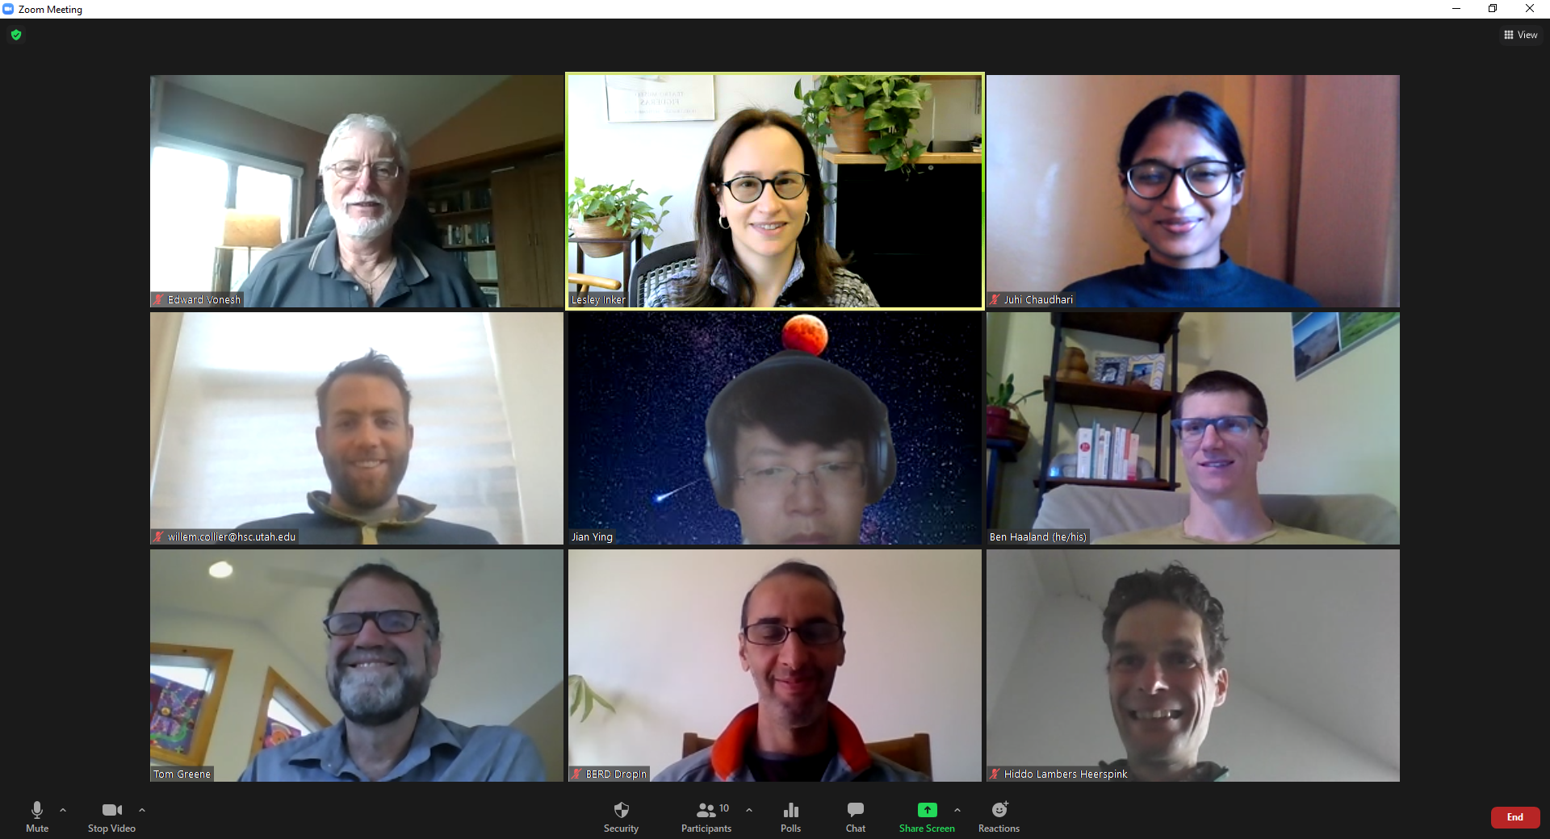
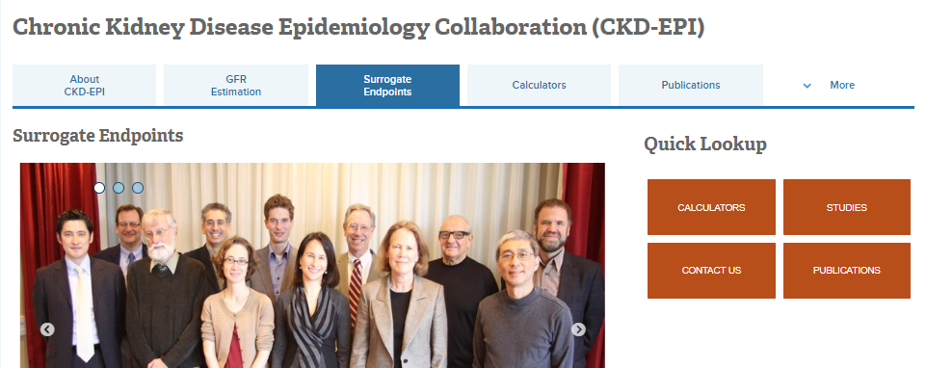
CKD-EPI CT
Lesley Inker lesley.inker@tuftsmedicine.org
NKF liaisons Anthony Gucciardo AnthonyG@kidney.org or Sarah Kim sarah.kim@kidney.org
tuftsmedicalcenter.org/ckdepi

