Slide 1
Modernizing the Data Repository Ecosystem to Accelerate the Pace of Biomedical Research
Patricia Flatley Brennan, RN, PhD
Director, National Library of Medicine

Slide 2
Agenda
NLM
Digital NIH and the NIH Strategic Plan for Data Science
New Initiatives
Common Data Elements
Data Life Cycle Consideration
DATA Catalog

Slide 3
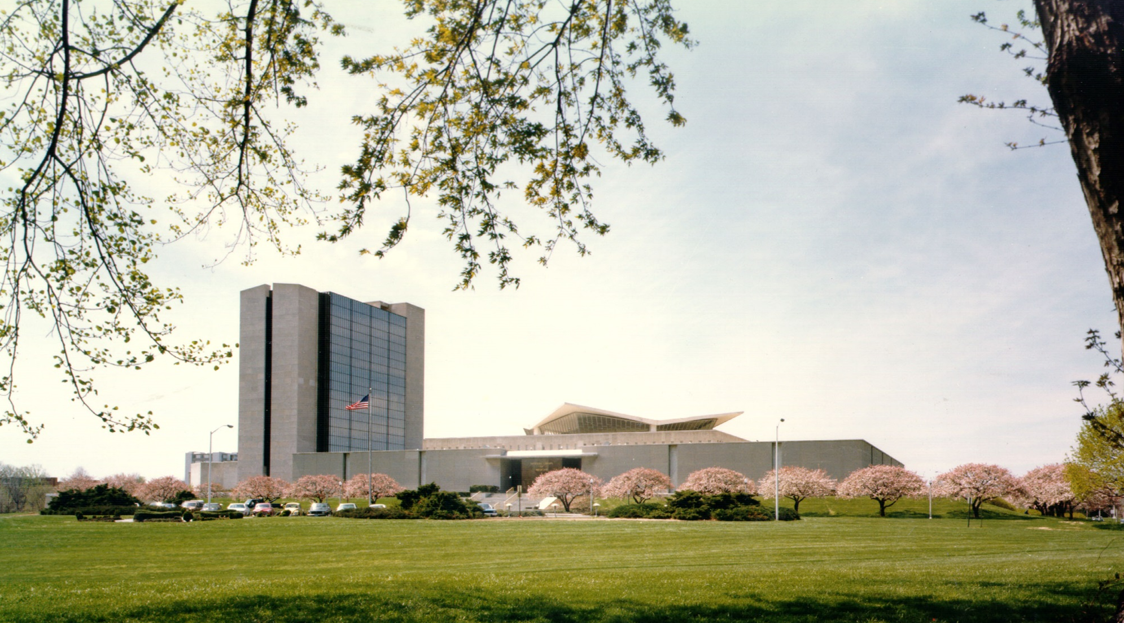
NLM Title slide
The National Library
of Medicine

Slide 4
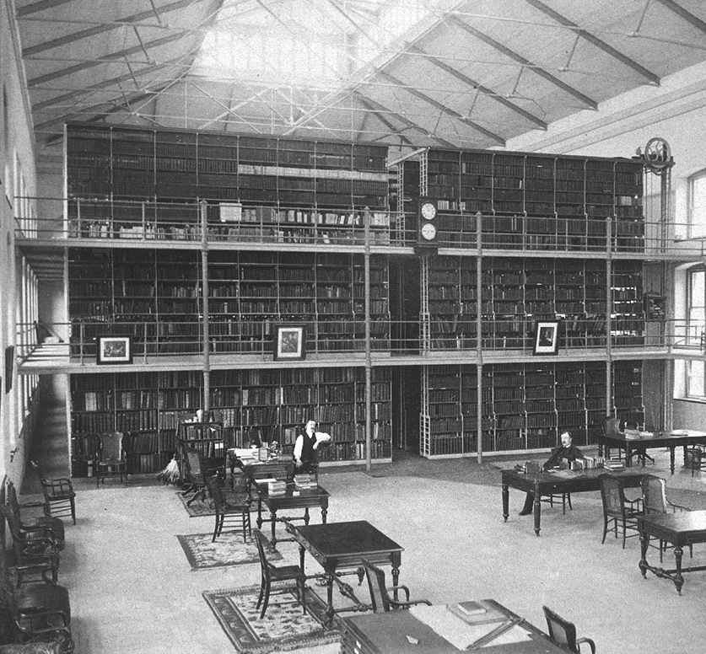
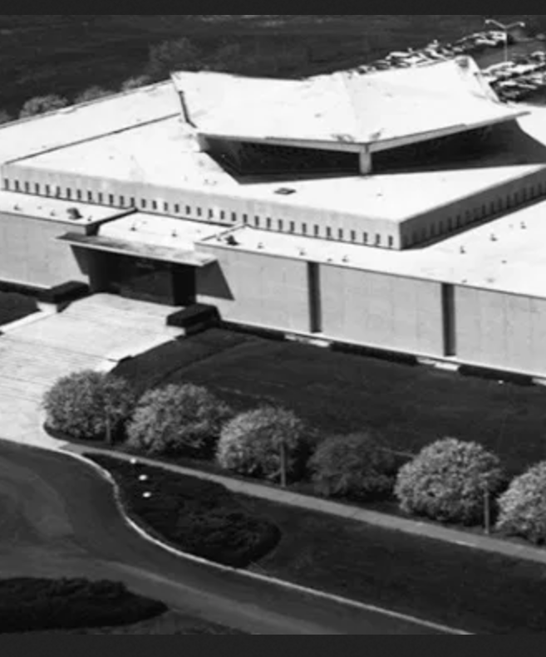
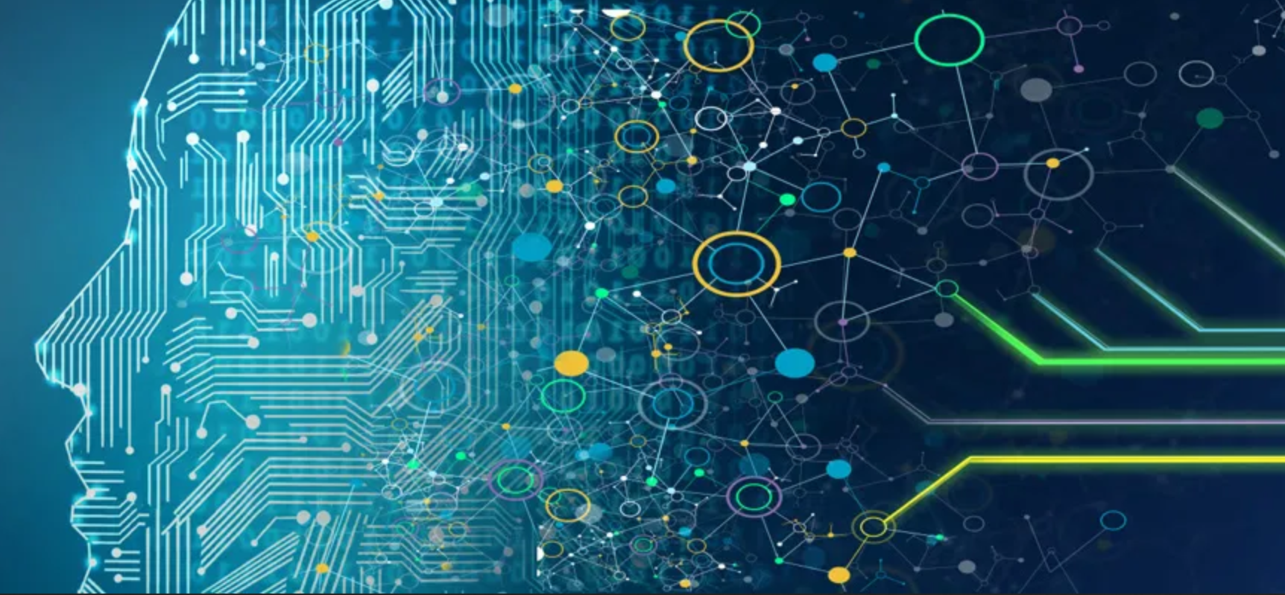
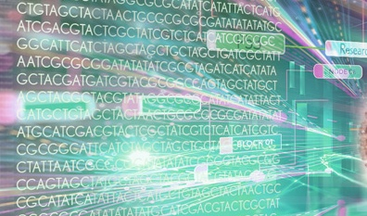
The National Library of Medicine Serving Science and Society Since 1836
1836-1968: A Collection of Books and Journals
1968-2000: Foundation of a Modern Library
2000-2036: The 21st Century Library
With roots in the office of the U.S. Army Surgeon General, Congressional authorization moved NLM to the Public Health Service. In 1965, NLM opened its doors on the NIH Campus in Bethesda, MD.
Expansion and impact in the Information Age.
NLM leads innovative research to accelerate NIH’s mission and reach scientists and society with trusted health information.
Create new search strategies
Present results in informative ways
Lister Hill National Center for Biomedical Communications
National Center for Biotechnology Information
Notes:
Before I walk you through more about NLM’s current operations, I wanted to share a bit of how we started, which led us to where we are today as the research enterprise for biomedical informatics.
In the 1800’s, NLM was actually a library under the U.S. Army Surgeon General. Over time, our purpose expanded -- including moving under NIH and in the late 1960’s, establishing stronger arms for also conducting research to support the broader biomedical community.
And landing into where we are now, of course we have evolved into diverse offerings – what was initially a collection of books and journals is now physical and digital history collections, but also a plethora of digital resources for researchers and the public to navigate a wealth of information about science and public health and we even conduct and fund new research as well.

Slide 5
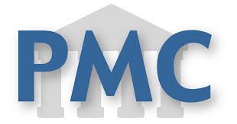
The NLM a knowledge hub that powers, and is powered by Artificial Intelligence
Research Literature
Health Standards
Biomedical Data & Tools
SNOMED
SRA
Library Resources
Consumer Health
NLM Catalog
Digital Repository
Bookshelf

Slide 6
Digital NIH: Innovation, Technology, and Computation for the Future of NIH
Patricia Flatley Brennan, RN, PhD
Director, National Library of Medicine
Dennis Papula
Acting CIO

Slide 7
Digital NIH is a framework to define high-priority capabilities and manage NIH technology investments across functional areas common to all ICs to achieve NIH outcomes.
The Digital NIH framework applies across…
EXTRAMURAL RESEARCH MANAGEMENT
INTRAMURAL
CLINICAL & BASIC
RESEARCH
ADMINISTRATION AND MANAGEMENT
CROSS-CUTTING CAPABILITIES
NIH must also look at enabling capabilities and solutions that cut across functional areas.

Slide 8
Implementing Digital NIH is a multi-year journey that will iteratively explore solutions to prioritized capabilities over the next several years.
Year 1
Establishing infrastructure, developing Capabilities Portfolio, and Roadmap, Beginning Capability Proof of Concept
Year 2
Collecting Lessons Learned consulting Capabilities Portfolio and Roadmap, Continuing subsequent Capability Proof of Concepts
Year 3
Roadmap Refinement, Spinning off Full-Scale Projects, Integration into Operations
Year 4+
Integration into Operations, Revise and Vision next phase

Slide 9
2023 Strategic Plan for Data Science at a glance
Digital NIH will provide the light-weight infrastructure needed to
modernize the NIH biomedical data-resource ecosystem through the 2023 Strategic Plan for Data Science
DATA STORAGE & SECURITY
DATA DISCOVERY AND NOVEL APPLICATIONS
DATA SCIENCE METHODS AND TOOLS
v
v

Slide 10
NIH 2023-2028 Strategic Plan for Data Science
GOAL 1
Capabilities to Sustain the NIH Data Management and Sharing Policy
GOAL 2
Programs to Enhance Human Derived Data for Research
GOAL 3
New Opportunities in Methods and Artificial Intelligence
GOAL 4
Support for a Federated Biomedical Research Data Infrastructure
GOAL 5
Strengthen a Broader Community of Data Science

Slide 11
Five Year Outcomes
Innovative approaches to data curation, harmonization, and validation
Increase support for communities to develop and implement new Common Data Elements and standards in priority disease areas
Increase support for research on clinical and healthcare data science, including methods for privacy protection, participant informed consent, and data governance
Increase support for tools to collect and analyze data from wearable devices and other new RWD technologies
Develop new research, training programs, and collaborations in AI and Bioethics
New capabilities for researchers to search, discover, access, and analyze data
Engage researchers and communities in data science training across biomedical, social, environmental, and behavioral disciplines

Slide 12
Strategic Plan for Data Science and Digital NIH
Data Science
Digital NIH
a). Technology resources support the implementation of critical policies
a). Support the Biomedical Community to Manage, Share, and Sustain Data
Develop, test, validate, and implement ways to federate NIH data and infrastructure
Common Architecture with Well-Defined Standards to Enable Integration
b). Strengthen NIH’s Data Repository and Knowledgebase Ecosystem
b). Optimize Technology Investments
Enhancing Data Science Collaboration within the NIH Intramural Research Program
Support Intramural Research
c). Innovative, Cutting-Edge Storage, Analytics, and Computational Infrastructure
c). Develop cutting edge software technologies
Increased Technically Competent Workforce

Slide 13
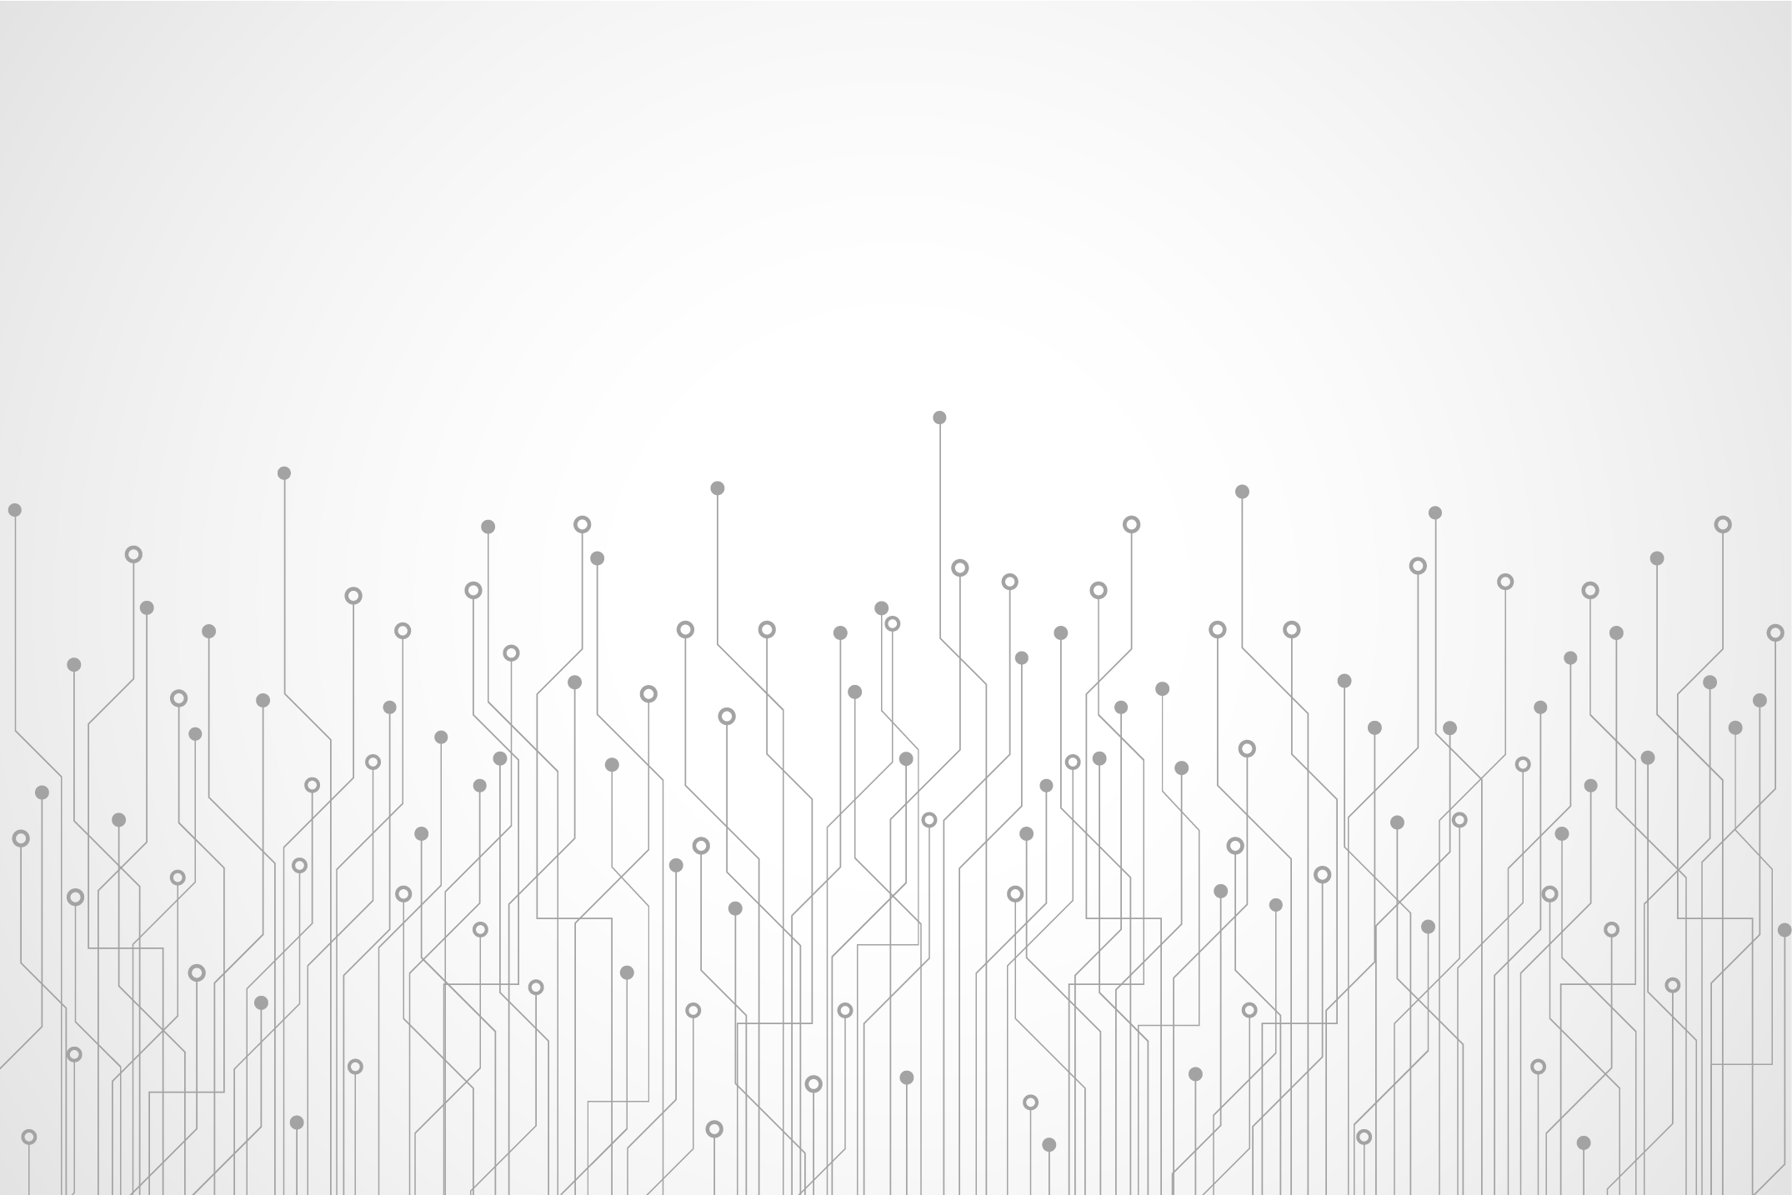
Common Data Elements Building QUALITY into Data Acquisition

Slide 14
Defining Common Data Elements (CDE)
Common Data Elements are a combination of…
Common Data Elements are common to…
Common Data Elements can be structured as …
A defined variable or question
A single data element
or
A collection of data elements to compute a survey score
Multiple data sets or designated for use across different studies
Paired with a specified set of similarly coded permissible responses to questions
CDEs typically represent core variables, not all variables

Slide 15
Sample Common Data Elements (CDE)
SEX
Definition: sex at birth
Indicator: Male, female, intersex
AGE
Definition: the length of time that a person has lived
Indicator: Age_years or dob_mdy
RACE
Definition: self-identified membership in a heritage category
Indicator: white, black or African American, American Indian/Alaska Native, Asian, Native Hawaiian or other Pacific Islander
DISABILITY
Definition: CDC National Center for Birth Defects and Disability
Indicator: Self-report – 7-item indicator (e.g. dressing, walking, concentration…)

Slide 16
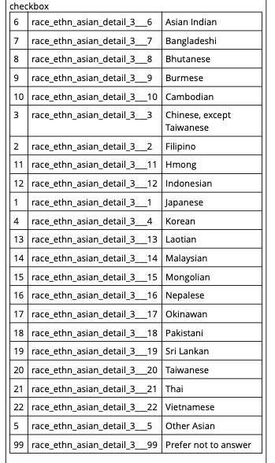
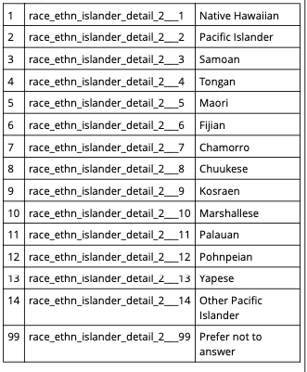
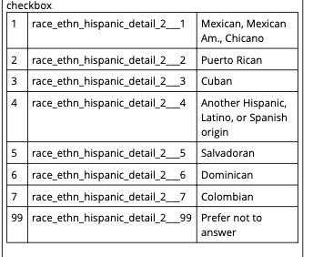
CDEs can get complicated …
For example, when analyzing Race and Ethnicity data elements can have a rage of definitions and indicators.

Slide 17
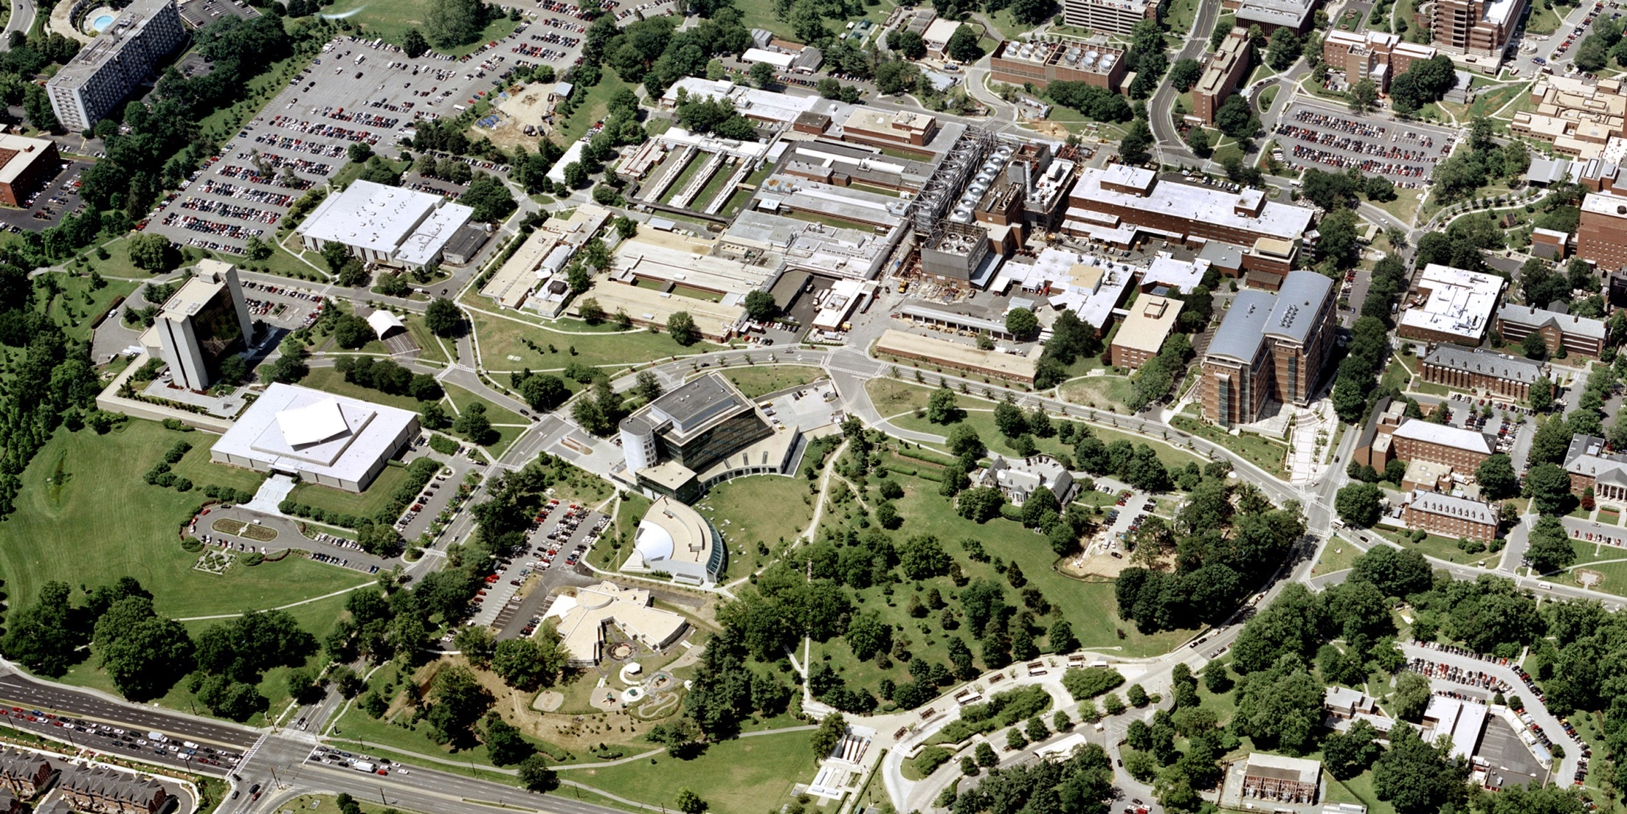
Data Life-Cycle Considerations
Glean the most out of every research project
All research projects aim first to answer the original question(s) and second to make data properly protected and available for subsequent use.

Slide 18
Data Life-Cycle Considerations
For …
Index Researchers
Planning for data sharing beings in the design phase
Where possible, use common data elements
Employ Standard terms and formats (e.g. SNOMED, FHIR)
Obtain consent for sharing and re-use
Select Appropriate Repositories & use metadata
Deposit data
Future Researchers
Discover and evaluate relevant data
Comply with existing stipulations (e.g. Enclave restrictions)

Slide 19
NIH Data Life Cycle Initiatives
NIH Recommendations for Open Access Data Repositories
Small (< 2 gigabytes) PubMed Central
Medium (2-20 gigabytes) Generalist repositories
Large (>20 gigabytes) STRIDES
NIH Controlled Access Data Management
All data must be managed and most data shared
2023 Data Management and Sharing Plan
Preserve data, once collected, for future use
Respect for participant considerations (consent, de-identification)
Authentication, Authorization, and Access control
Innovations in NIH Data Repositories
Enclaves, N3C, CBIIT, AoU, SRA

Slide 20
FAIR Data Making Data Finable
National Library of Medicine
Notes:
Hi my name is Peter Seibert, I’ve worked at NLM for a little over 8 years and am currently a unit head in MMS but first and a Librarian. I’ll be discussing the work we’ve been doing to develop a semantically driven data catalog to aid in the discoverability and re-use of biomedical research data.

Slide 21
Overview: NLM Data Catalog
“The PubMed of datasets!"
Launch data Spring 2024
WHAT
A curated catalog of biomedical datasets from selected publicly available repositories.
WHY
Provide discovery systems for users, as stated in NIH Strategic Plan for Data Science and NLM 2017-2027 Strategic Plan.
Allow researchers to discover biomedical datasets from many repositories.
Standardize metadata for biomedical datasets into a linked data model that will facilitate the creation and discovery of related information.
Push linkable metadata about biomedical datasets to the Semantic Web to facilitate data discovery in a broader environment and create relationships that might otherwise not be apparent.
Drive adoption and acceptance of the NLM standard.
HOW
Launch a beta version of NLM Data Catalog using DATMM (DATaset Metadata Modeling):
DATMM is a semantic metadata model developed by NLM to provide a common model that can be used by biomedical datasets, repositories, and discovery services.
DATMM leverages existing RDF ontologies and schemas to facilitate metadata harvesting and promote wide adoption.
Notes:
Overview of NLM Data Catalog
What is update cycle? Is this a push or pull? Talking about generalist repositories and lack of topical break down
DeNOTO has ingested MeSH as a way of refining searching
Need to craft policy on retention, withdrawal, etc.

Slide 22
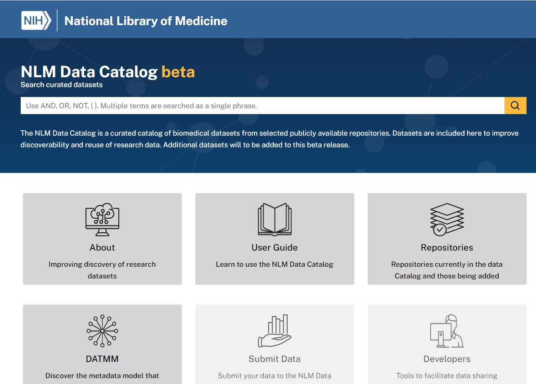
DATMM Home | NLM Semantic Data Catalog (datmm-search.s3.amazonaws.com)

Slide 23
Onward towards the Future
Architecture: End-to-end, life-cycle approach to data acquisition, preservation, sharing
Technology: Search and Analytics platforms
Policy: Consent management and data access controls

Slide 24
Questions?
For questions on Digital NIH, Reach out to the Digital NIH mailbox (digitalnih@od.nih.gov); Ivor D’Souza, Acting CIT Director (Ivor@nih.gov) or Dennis Papula, Acting Chief Information Officer (dennis.papula@nih.gov)
For questions on 2023 Data Science Strategy, reach out to Susan Gregurick, Associate Director for Data Science (susan.gregurick@nih.gov).

